Slide 1
Digital Testing with Multivalued Logic Signals
Final Exam, April 15, 2015
Baohu Li
Committee Chair: Dr. Vishwani Agrawal
Committee Members: Dr. Adit Singh
Dr. Bogdan Wilamowski
Dr. Victor Nelson
External Reader: Dr. Xiao Qin
Department of Electrical and Computer Engineering
Auburn University, AL 36849 USA

Slide 2
Acknowledgment
Prof. Vishwani Agrawal for his invaluable guidance throughout my research and study,
Prof. Adit Singh, Prof. Bogdan Wilamowski and Prof. Victor Nelson for being my committee members and for their courses,
Prof. Xiao Qin for being my external reader, and
My family and friends for their support.

Slide 3
Outline
Introduction
Problem Statement
Multi-valued logic (MVL) test application and its error protection
Hardware design for MVL channel
Experimental setup and results
Conclusion

Slide 4
Introduction
How to test a device

Slide 5
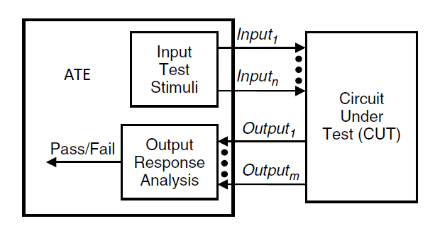
ATE (Automatic Test Equipment)

Slide 6
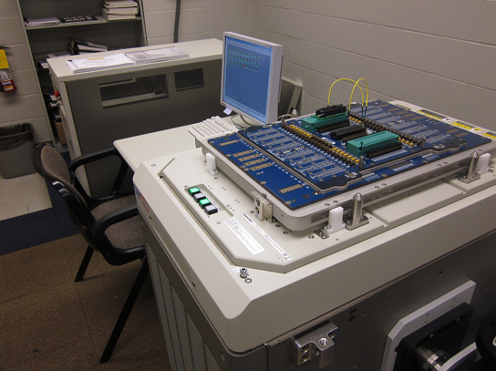
Our ATE
Advantest T2000GS ATE System
Housed in the ECE department

Slide 7
Advantest T2000GS System
Components
Main frame
Test head
User interface
Manipulator (optional)
Properties
Expensive in capital and running costs
Speed cap 125MHz
Limited channels (128) and memory depth (64MW/CH)
Major modules
250MHz DM (Digital Module) and 500mA DPS (Device Power Supply)

Slide 8
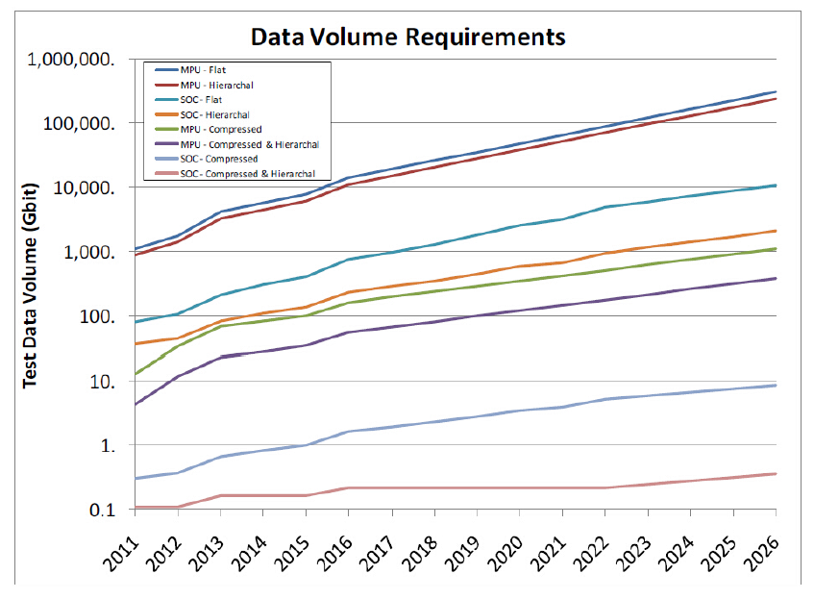
Test Mission and Technologies in Trend
Enormous and growing test size
[ITRS 2011]

Slide 9
Test Compression
What does test compression do
Reduce test volume as to reduce test time and cost
Test compression technology types:
Code based schemes (Huffman code [Jas 2003] and Golomb code [Chandra 2003], etc.)
Linear-decompression based schemes (EDT (Embedded Deterministic Test) from Mentor Graphics [Rajski 2004], etc.)
Broad-scan based schemes (OPMISR+ from Cadence [Keller 2005] and adaptive scan from Synopsys [Sitchinava 2004], etc.)
Performance
Reduce test size by up to 100x

Slide 10
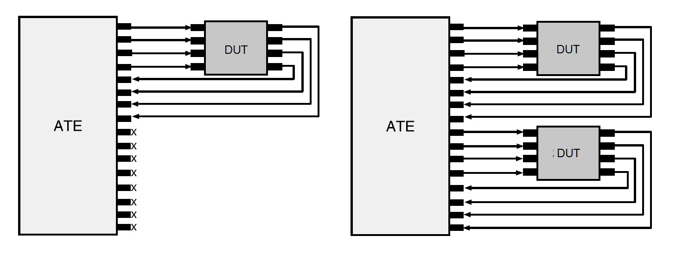
Multi-site Test
What does multi-site test do
Test multiple devices with fixed ATE resource

Slide 11
Multi-site Test
Reason for multi-site test
Increase test parallelism and throughput
Better utilize ATE resource, avoid spare channels
Save test cost
Multi-site test considerations
TAM optimization
Based on ATE resource constraints (number of channels and memory depth, etc. [Iyengar 2002], [Goel 2005] and [Bahuk. 2009], etc.)
Bandwidth matching ([Volkerink 2001])
Reduce test pins in device

Slide 12
Reduce Test Pins
Enhance multi-site test
Decrease test resource requirement per DUT
Increase multi-site test parallelism
Implementations
Enhanced reduced pin-count test ([Vranken 2001])

Slide 13
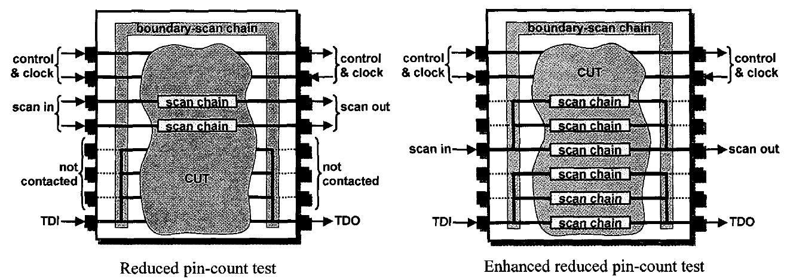
Enhanced Reduced Pin-count Test
Similar to RPCT we call today

Slide 14
Reduce Test Pins
Enhance multi-site test
Decrease test resource requirement per DUT
Increase multi-site test parallelism
Implementations
Enhanced reduced pin-count test ([Vranken 2001])
Three-pin test ([Moreau 2009])

Slide 15
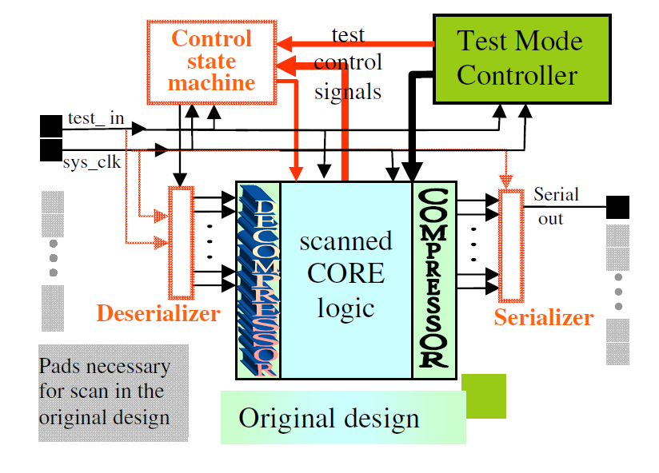
Three-pin Test

Slide 16
Reduce Test Pins
Enhance multi-site test
Decrease test resource requirement per DUT
Increase multi-site test parallelism
Implementations
Enhanced reduced pin-count test ([Vranken 2001])
Three-pin test ([Moreau 2009])
SmartScan ([Chakra. 2013])

Slide 17
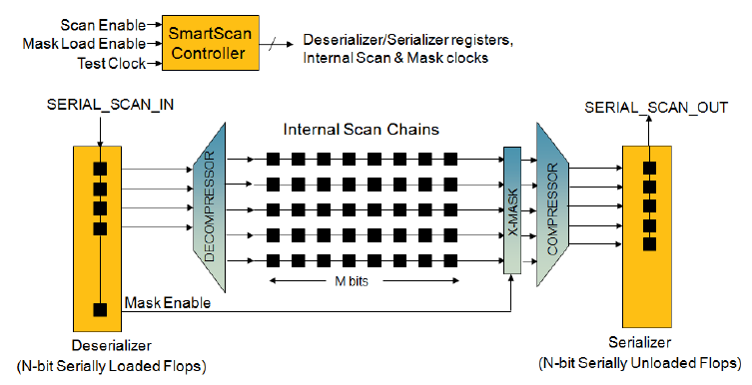
SmartScan

Slide 18
Reduce Test Pins
Enhance multi-site test
Decrease test resource requirement per DUT
Increase multi-site test parallelism
Implementations
Enhanced reduced pin-count test ([Vranken 2001])
Three-pin test ([Moreau 2009])
SmartScan ([Chakra. 2013])
Similarity: all major test pin reduction schemes are based on serialization and deserialization of test data
Approach to combine RPCT with test compression

Slide 19
Test Compression and RPCT
Trend to combine two techniques
Three-pin test ([Moreau 2009])
SmartScan ([Chakra. 2013])
Pin-limited mode in adaptive scan ([Synopsys 2009])
How RPCT benefit test compression
Details discussed in SmartScan ([Chakra. 2013])
Major reason:
RPCT increases the number of decompressor inputs with narrow TAM, which breaks the inputs correlation barrier of compression algorithm, improving fault coverage.

Slide 20
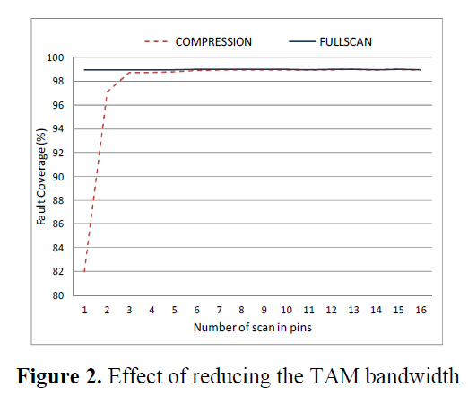
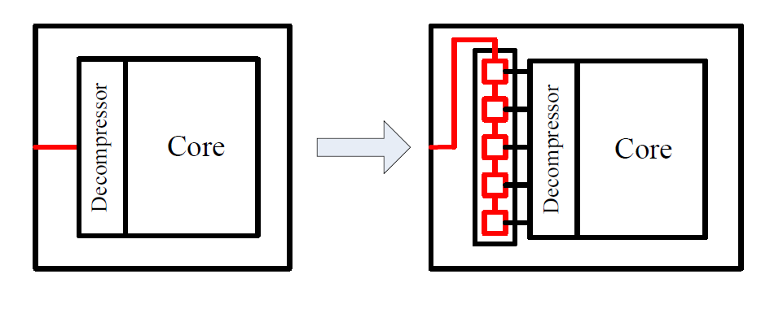
Input correlation barrier of compression algorithm

Slide 21
RPCT Benefit to Test Compression

Slide 22
Problem in RPCT
Sacrifice test speed for TAM reduction
Assume certain channel speed, the scan speed in RPCT scheme is 1/5 of traditional case to match the bandwidth.

Slide 23
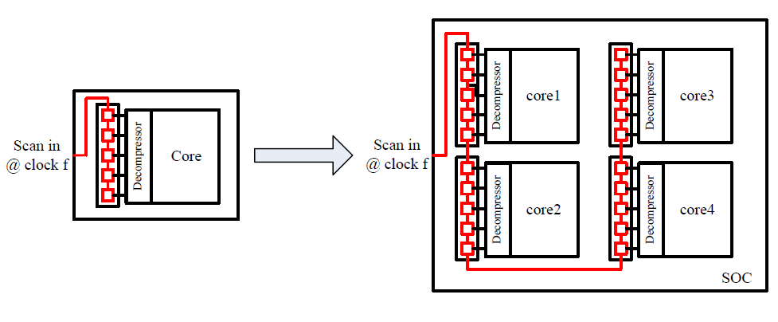
Problem in RPCT
Problem gets worse with multi-core SoCs
Scan speed: 1/5 of clock f → 1/20 of clock f
Limited by the data rate of single channel

Slide 24
Problem Statement
How to deal with the growing test volume
Compress test data
Faster tester
Enhance the capacity (improve the data rate) of test channel (this work)
How to resolve the mentioned problem in RPCT
Increase the data rate of test channel (same as enhancing test channel capacity)
Solutions to the two problems join together

Slide 25
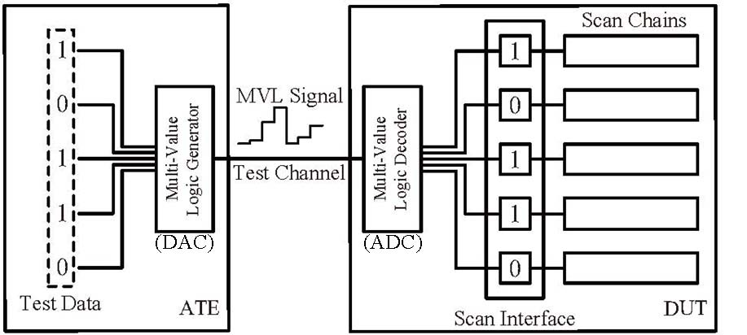
Multi-Valued Logic (MVL) Test Channel
2⁵ = 32 levels
Data Rate = clock f x log₂N
Enhancement

Slide 26
MVL Channel for RPCT Scheme
How MVL test application resolves test speed sacrifice in RPCT scheme
Scan speed: 1/20 of clock f → 1/5 of clock f
Speed increases by data rate enhancement of MVL channel (log₂16)

Slide 27
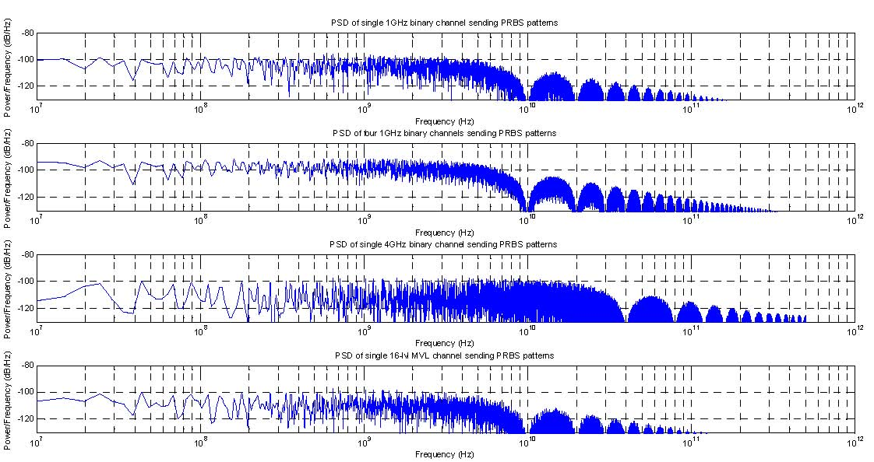
Advantage of MVL Data Transmission in Power Consumption
One binary channel
0
1
1
0
0
1
0
1
0
0
1
1
0
1
1
1
0
1
1
1
0
0
0
1
0
0
1
0
Four binary channels
1 binary pin serially send some data at clock f
0
1
1
0
0
1
0
1
0
0
1
1
0
1
4x SerDes channel
1
1
0
1
1
1
0
0
0
1
0
0
1
0
4 binary pins parallel send same data at clock f
1 binary pin send same data
with 4x clock frequency (4f)
A 16 lvls MVL pin send same data
at clock f
16-level MVL channel

Slide 28
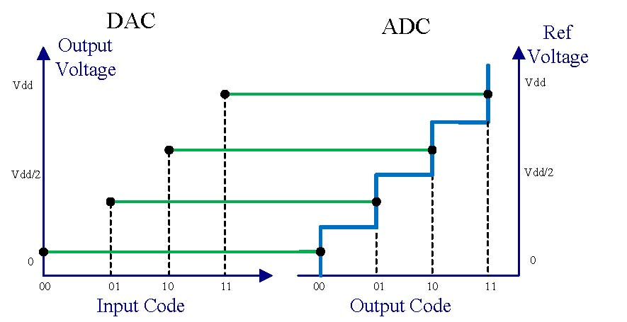
Ideal MVL Signal Transmission
In the ideal situation, every code is correctly encoded and decoded with maximum noise margin.
Compared to binary signal, the noise margin is shrunk for MVL.
Notes:
So, because of the noise margin reduction and the extra components for MVL signal generation/decoding, we have to concern about the possible errors in MVL transmission

Slide 29
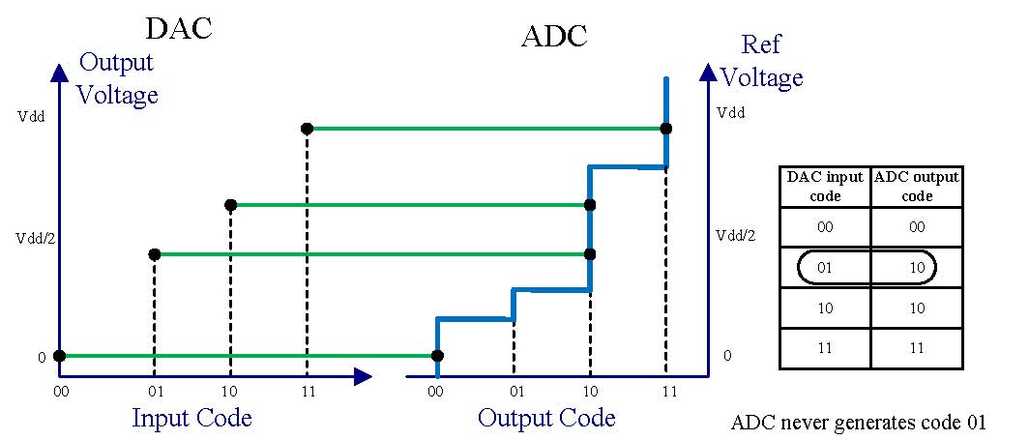
Error Sources of MVL Channel
Data converter errors
Nonlinearity in DAC: DAC cannot convert a digital pattern into an analog voltage level exactly.
Nonlinearity in ADC: The ranges of ADC codes are not ideal.
Mismatch between DAC and ADC.
Noise in channel
Data converters have dynamic noise.
Digital switching noise, power supply and ground noise, EMI.

Slide 30
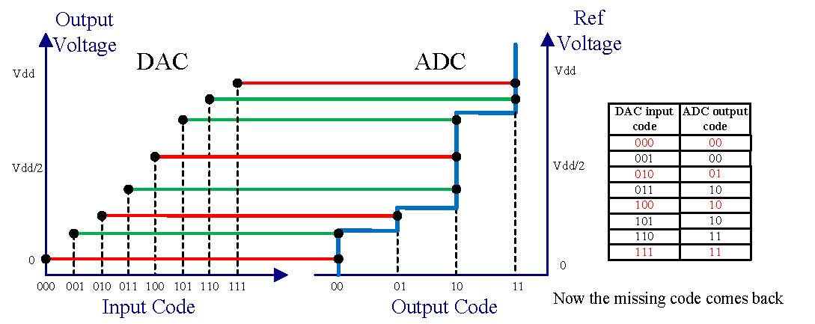
Calibration of ADC nonlinearity
DAC in ATE is assumed calibrated.
ADC in DUT is hard to modify after fabrication.
ADC nonlinearity must be calibrated.
Method:
calibrate ADC nonlinearity by adjusting DAC output (use finer resolution DAC)
Sweep all DAC input codes and capture the decoded codes from ADC
Pick the code, which is median among which are decoded as the same code, to be the DAC output for this ADC code
For devices cannot be calibrated, they are marked as MVL-incompatible to be tested with binary channel

Slide 31
Error Detection and Retest
An error control technique:
Noise is the major factor causing erroneous test data application after nonlinearity calibration.
Solution: detect any error during test application; if error occurs, conduct retest.
We compact all decoded patterns into the Applied Test Signature (ATS) to be examined at the end of test.
Devices failing the maximum repetition of retests are marked as MVL-incompatible, to be tested with binary channel.

Slide 32
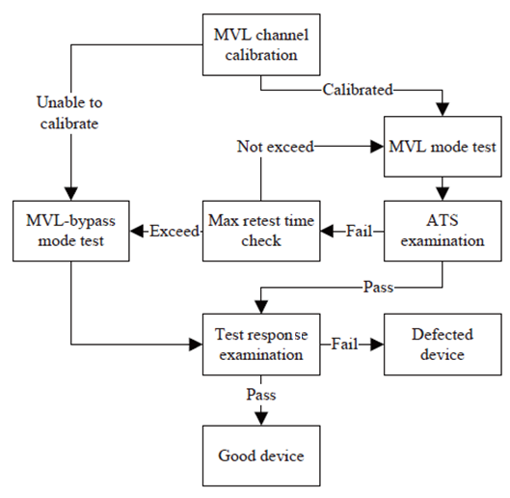
Test Flow Design

Slide 33
Hardware Design for MVL Channel
MVL channel Implementation
Requirements
Able to generate MVL signal
Able to conduct calibration
Major components
MVL generator (DAC)
Calibration circuitry

Slide 34
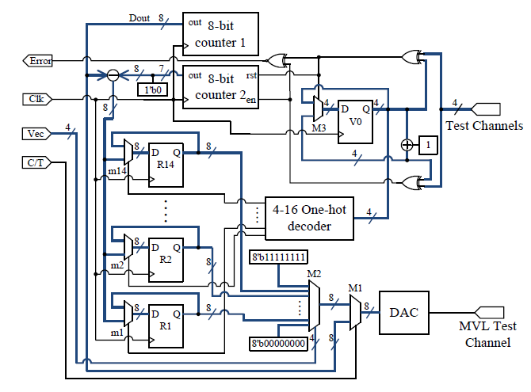
Hardware Design of 4-bit MVL Channel with 8-bit DAC
RTL diagram

Slide 35
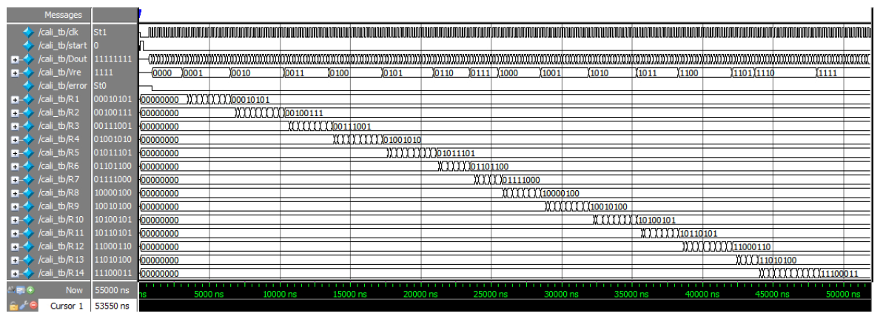
Hardware Design of 4-bit MVL Channel with 8-bit DAC
Simulation result of calibration procedure
Dout is the ramp-up DAC inputs for calibration;
Vre is the captured ADC output, corresponding to Dout;
R1-R14 store the calibrated result.

Slide 36
Hardware Design for MVL-compatible Device
MVL-compatible DUT Implementation
Requirement
Able to decode MVL signal
Able to generate ATS
Able to be tested with binary signal
Major components
MVL decoder (ADC)
MISR for ATS compaction
Multiplexers to switch between different modes

Slide 37
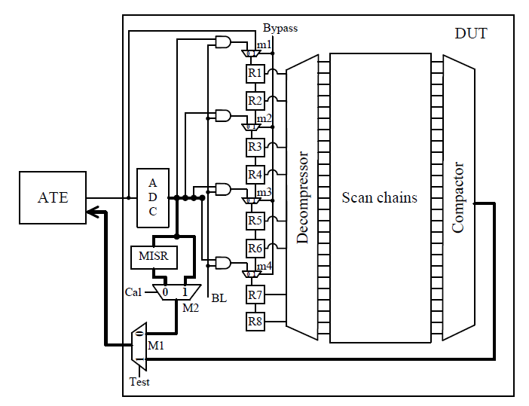
Hardware Design of MVL-Compatible DUT
RTL diagram
Mode | Test | BL | Cal | Bypass
ADC Nonlinearity Calibration | 0 | 0 | 1 | 0
MVL Test | 1 | 1 | X | 0
ATS Capture | 0 | 0 | 0 | X
Binary Test | 1 | 0 | X | 1

Slide 38
Experimental Setup and Results
Setup of ELVIS system based experiment
Use DAC AD557 and ADC AD7822 to imitate the MVL generator and decoder
Use NI ELVIS II+ system as the platform to send and receive test data
DE2 FPGA board is used to imitate the core logic under test
Experimental items conducted
Reliability Measurement: measure the SER (Symbol Error Rate) of the converter pair in terms of noise margin with/without FPGA load
Verify the nonlinearity calibration scheme
Apply scan test with MVL signal

Slide 39
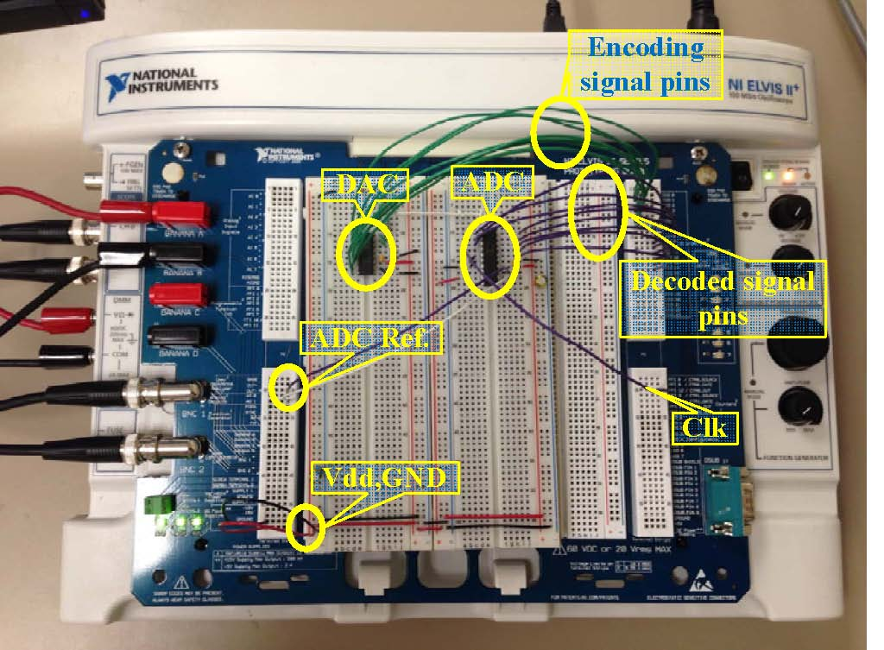
Experimental Setup
Hardware setup
Hardware system without FPGA load

Slide 40
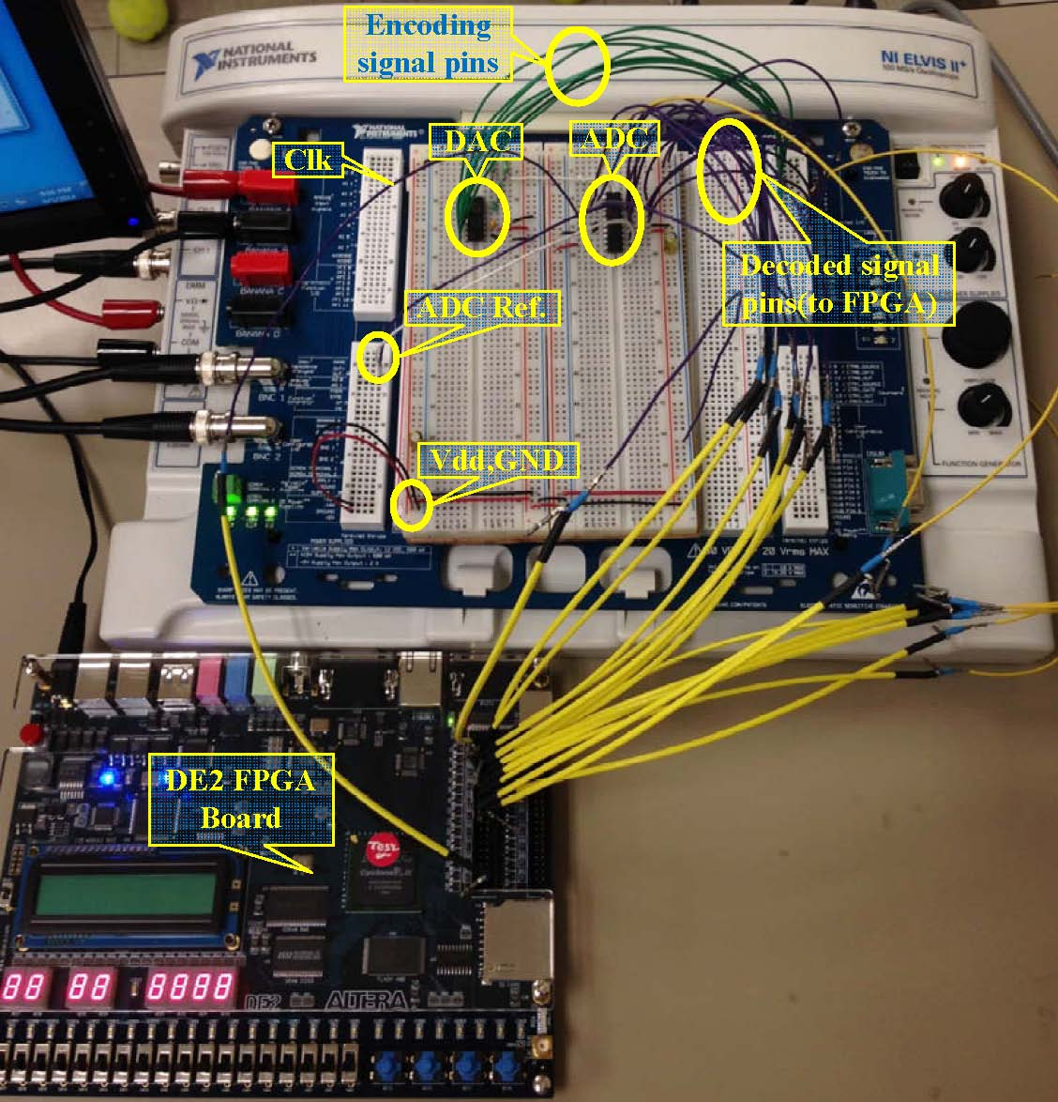
Experimental Setup
Hardware setup
Hardware system with FPGA load

Slide 41
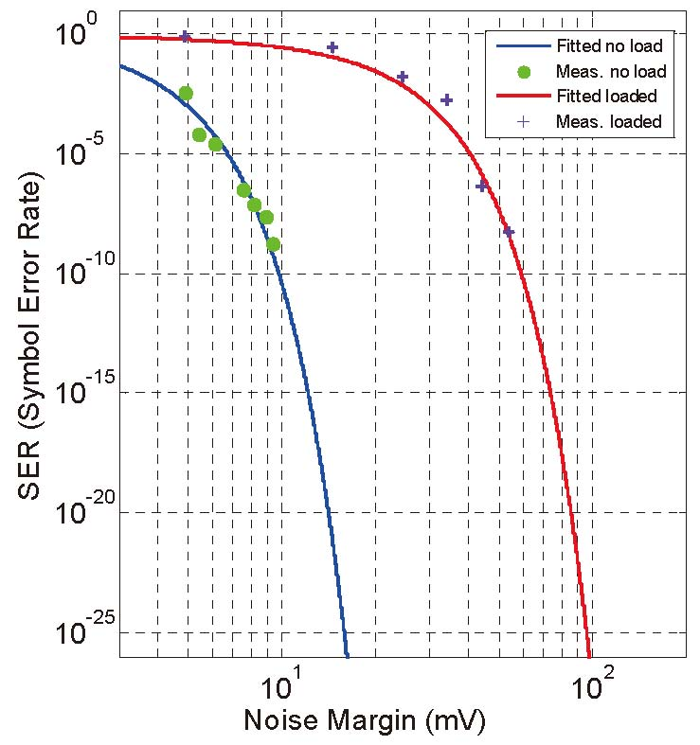
Experimental Result
Reliability (SER) measurement
We used voltage divider on the output of DAC to change the full scale voltage in which case the noise margin was controlled.

Slide 42
Scan Test Result
National Instruments ELVIS system and AD577 DAC serve as an ATE.
AD7822 ADC and DE2 FPGA board implementing benchmark s298 serve as DUT.
Five inputs, G0, G1, G2, scan_in1 and scan_en, are sent in MVL format, clock and reset remain binary.
Test channels are reduced from 7 to 3.
MVL test feasibility is established by obtaining test result identical to the case with 7 binary input pins.

Slide 43
Experimental Setup and Results
Setup of ATE based experiment
Use T2000GS tester to build MVL test channel
Use ADC and DE2 FPGA board to build MVL-compatible DUT with RPCT interface and test compression decompressor.
Experimental items conducted
Apply scan test with compressed test data through RPCT interface using MVL signal
Justify the test speed improvement with MVL channel

Slide 44
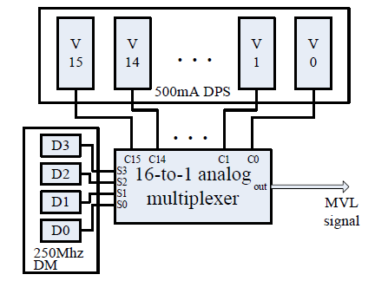
Experimental Setup
Build MVL channel with Advantest T2000GS

Slide 45
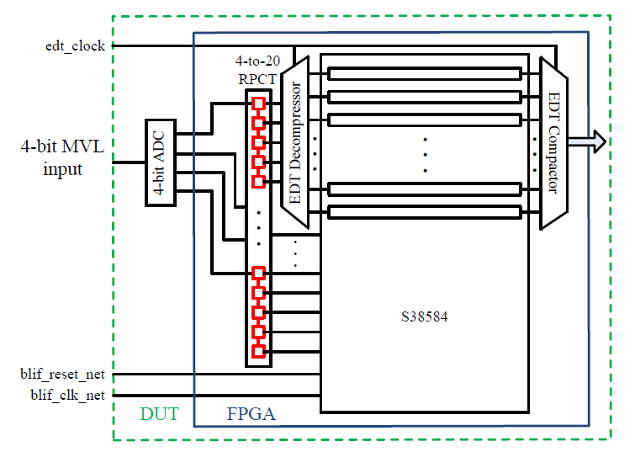
Experimental Setup
Build MVL-compatible device with RPCT and decompressor

Slide 46
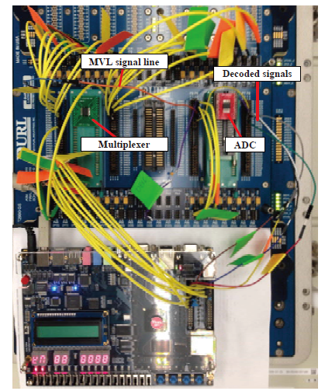
Experimental Setup
Hardware setup

Slide 47
Test Result and Speed Improvement
20 inputs, including EDT channel inputs and other primary inputs, are sent in 4-bit MVL format; clocks and reset remain binary.
Test channels are reduced from 23 to 4.
MVL test feasibility is established by obtaining test result identical to the case uses binary channel and a 1-to-20 RPCT interface.
Test time with MVL channel is 30.88ms, compared to 123.51ms with binary channel. (clock f = 2MHz)

Slide 48
Conclusion
This is the first work to apply test data in MVL format.
Application of MVL test channel on RPCT with test compression is proposed.
Reliability issues and proposed solutions are discussed in the dissertation.
A prototype experiment proves the feasibility and verifies proposed error control solutions.
ATE-based experiment shows notable test speed improvement with RPCT.
Overhead remains an issue but will be helped as data converter techniques evolve.

Slide 49
References
[ITRS2011] “Test and Test Equipment,” International Technology Roadmap for Semiconductors, 2011 Edition, www.itrs.net/Links/2011ITRS/2011Chapters/2011Test.pdf.
[Jas 2003] A. Jas et al., “An Efficient Test Vector Compression Scheme Using Selective Huffman Coding,” IEEE Trans. Computer-Aided Des., vol. 22, no. 6, pp. 797–806, 2003.
[Chandra 2003] A. Chandra et al., “Test Data Compression and Test Resource Partitioning for System-on-a-Chip Using Frequency-Directed Run-Length (FDR) Codes,” IEEE Trans. Computers, vol. 52, no. 8, pp. 1076–1088, 2003.
[Rajski 2004] J. Rajski et al., “Embedded Deterministic Test,” IEEE Trans. Comput.-Aided Des., vol. 23, no. 5, pp. 776–792, 2004.
[Keller 2005] B. Keller, “Encounter Test OPMISR⁺ On-Chip Compression, Proc. International Test Conference, Panel 5.2, 2005.
[Sitchinava 2004] N. Sitchinava et al., “Changing the Scan Enable During Shift,” Proc. IEEE VLSI Test Symp., April 2004, pp. 73–78.
[Iyengar 2002] V. Iyengar et al., “Test Resource Optimization for Multi-Site Testing of SOCs Under ATE Memory Depth Constraints,” Proc. International Test Conf., 2002, pp. 1159-1168.

Slide 50
References, Continued
[Goel 2005] S. Goel and E. J. Marinissen, “Optimisation of On-Chip Design-for-Test Infrastructure for Maximal Multi-Site Test Throughput,” Proc. Computers and Digital Techs., 2005, pp. 442-456.
[Bahuk. 2009] S. Bahukudumbi and K. Chakrabarty, “Test-Length and TAM Optimization for Wafer-Level Reduced Pin-Count Testing of Core-Based SoCs,” IEEE Trans. Computer-Aided Design of Integrated Circuits and Systems, vol. 28, no. 1, pp. 111-120, 2009.
[Volkerink 2001] E. Volkerink, A. Khoche, J. Rivoir, and K. Hilliges, “Enhanced Reduced Pin-Count Test for Full-Scan Design,” Proc. IEEE VLSI Test Symp., 2002, pp. 411-416.
[Moreau 2009] J. Moreau et al., “Running scan test on three pins: yes we can!,” Proc. International Test Conf., 2009, pp. 1-10.
[Sanghani 2011] A. Sanghani et al., “Design and Implementation of A Time-Division Multiplexing Scan Architecture Using Serializer and Deserializer in GPU Chips,” Proc. 29th IEEE VLSI Test Symp., 2011, pp. 219-224.
[Chakra. 2013] K. Chakravadhanula, et al., “SmartScan - Hierarchical Test Compression for Pin-limited Low Power Designs,” Proc. International Test Conf., 2013. Paper 4.2.
[Synopsys 2009] DFTMAXTM Compression Backgrounder, Synopsys, 2009, http://www.synopsys.com/Tools/Implementation/RTLSynthesis/CapsuleModule/dftmax_bgr.pdf.

Slide 51
Thank you

