Slide 1
Keynote:
A History of the VLSI Design Conference
Vishwani D. Agrawal
James J. Danaher Professor
Electrical and Computer Engineering
Auburn University, USA
Hyderabad, India, January 9, 2012

Slide 2
First
December 26-28, 1985, Chennai, IIT Campus
Organizers: H. N. Mahabala, Vishwani Agrawal
Sponsors: Computer Society of India, IEEE India Council
Some delegates
    H. N. Mahabala, IITM
    Hank Hulsoor, DEC
    A. Prabhakar, ITI
    Dhiraj Pradhan, UMASS
    Jacob Abraham, UIUC
    Vinod Agarwal, McGill U
    Dr. Zarabi, SCL
    Prathima Agrawal, Bell Labs
    L. S. Srinath, Director, IITM
    Jank Patel, UIUC
    Sudhakar Reddy, U Iowa
    A. B. Bhattacharya, IITD

Slide 3
Second
December 15-18, 1988, Bangalore
Organizers: L. M. Patnaik, Adit Singh
Sponsors: CSI, DOE
Some delegates
    H. N. Mahabala, IITM
    P. Pal Chaudhuri, IITKh
    A. Prabhakar, ITI
    Chandra Sekhar, CEERI
    Avin Despain, UC Berkeley
    Anshul Kumar, IITD
    A. V. ferris-Prabhu, IBM
    Prathima Agrawal, Bell Labs
    S. D. Sherlekar, IITB
    C. P. Ravikumar, IITD
    Sharad Seth, U Nebraska
    M. M. Hasan, IITK
    A. B. Bhattacharya, IITD
    S. S. S. P. Rao, IITB

Slide 4
Third
January 6-9, 1990, Bangalore
Organizers: L. M. Patnaik, Adit Singh
Sponsors: IISc, DOE
Some delegates
    H. N. Mahabala, IITM
    P. Pal Chaudhuri, IITKgp
    A. Prabhakar, ITI
    Prith Banerjee, UIUC
    M. Balakrishnan, IITD
    Anshul Kumar, IITD
    Yashwant Malaiya, Colorado St. U
    Prathima Agrawal, Bell Labs
    James Jacob, IISc
    A. J. Paulraj, BEL
    Bernard Courtois, France
    M. M. Hasan, IITK
    A. B. Bhattacharya, IITD
    S. S. S. P. Rao, IITB

Slide 5
Fourth
January 4-8, 1991, New Delhi
Organizers: Vishwani Agrawal, A. Prabhakar
Sponsors: CSI, DOE; In cooperation with: IEEE-CS (DATC, VLSI), CAS
Some delegates
    H. N. Mahabala, IITM
    L. M. Patnaik, IISc
    Adit Singh, UMASS
    P. Pal Chaudhuri, IITKh
    A. Prabhakar, ITI
    Prith Banerjee, UIUC
    M. Balakrishnan, IITD
    Anshul Kumar, IITD
    Yashwant Malaiya, Colorado St. U
    Prathima Agrawal, Bell Labs
    James Jacob, IISc
    Rubin Parekhji, IITB
    Bernard Courtois,
    M. M. Hasan, IITK
    A. B. Bhattacharya, IITD
    S. S. S. P. Rao, IITB

Slide 6
International Conference on VLSI Design
No. | Year* | Place and Dates | Papers/ Tutorials | Proceedings Pages** | Approx. Attendance
1st | 1985 | Chennai, Dec 26-28 | 29/1 | 193 | 75
2nd | 1988 | Bangalore, Dec 15-18 | 26/4 | 496 | 150
3rd | 1990 | Bangalore, Jan 6-9 | 30/4 | 390 | 150
4th | 1991 | New Delhi, Jan 4-8 | 45/9 | 315 | 250
5th | 1992 | Bangalore, Jan 4-7 | 57/4 | 378 | 300
6th | 1993 | Mumbai, Jan 3-6 | 70/6 | 371 | 300
7th | 1994 | Kolkata, Jan 5-8 | 87/6 | 448 | 400
8th | 1995 | New Delhi, Jan 4-7 | 77/6 | 456 | 450
9th | 1996 | Bangalore, Jan 3-6 | 75/6 | 480 | 550
* All meetings sponsored by the VLSI Society of India (VSI) and in cooperation with ACM SIGDA, IEEE local chapters and several IEEE societies.
** 1991 onwards all proceedings published by the IEEE Computer Society Press.

Slide 7
International Conference on VLSI Design
No. | Year | Place and Dates | Papers/ Tutorials | Proceedings Pages* | Approx. Attendance
10th | 1997 | Hyderabad, Jan 4-7 | 84/6 | 608 | 550
11th | 1998 | Chennai, Jan 4-7 | 98/6 | 624 | 600
12th | 1999 | Goa, Jan 7-10 | 103/6 | 682 | 600
13th | 2000 | Kolkata, Jan 3-7 | 93/6 | 590 | 700
14th | 2001 | Bangalore, Jan 3-7 | 77/9 | 592 | 750
15th | 2002† | Bangalore, Jan 7-11 | 109/8 | 834 | 1,000
16th | 2003‡ | New Delhi, Jan 4-8 | 84/6 | 622 | 800
17th | 2004‡ | Mumbai, Jan 5-9 | 120/8 | 1,132 | 800
18th | 2005‡ | Kolkata, Jan 3-7 | 113/9 | 922 | 850
19th | 2006‡ | Hyderabad , Jan 3-7 | 136/11 | 880 | 1,000
20th | 2007‡ | Bangalore, Jan 6-10 | 147/15 | 990 | 800
† 2002 Conference held jointly with ASPDAC.
‡ Held jointly with Embedded Systems Conference.

Slide 8
International Conference on VLSI Design
No. | Year | Place and Dates | Papers/ Tutorials | Proceedings Pages* | Approx. Attendance
21st | 2008‡ | Hyderabad, Jan 4-8 | 108/10 | 780 | 1700
22nd | 2009‡ | New Delhi, Jan 5-9 | 79/9 | 632
23rd | 2010‡ | Bangalore, Jan 3-7 | 70/8 | 461
24th | 2011‡ | Chennai, Jan 3-7 | 66/8 | 391 | 630
25th | 2012‡ | Hyderabad, Jan 7-11 | 69/14 | 358 | ~1800
26th | 2013‡ | Pune, Jan 5-9
‡ Held jointly with Embedded Systems Conference.

Slide 9
Accepted Papers

Slide 10
Conference Cities
Bangalore (8)
Chennai (3)
Delhi (4)
Goa (1)
Hyderabad (4)
Kolkata (3)
Mumbai (2)

Slide 11
Some Highlights
25 meetings since 1985 in Chennai.
Creation of VLSI Society of India (VSI), http://vlsi-india.org/vsi/
Joint meetings:
    With ASP-DAC, Bangalore 2002.
    With Embedded Systems Conference since 2003.
Spin-off meetings
    VLSI Design & Test (VDAT) Symposium started as a workshop at Chennai in January 1998.
    IEEE International Workshop on Reliability Aware System Design and Test (RASDAT) started at Bangalore in January 2010.
All VLSI Design Conference papers since 1990 are available through IEEE Xplore.
Industry forum (started in 2000) and exhibits.
Student programs.

Slide 12
Highlights (Cont.)
Sister Conferences: Mutual relationship with the Design Automation Conference.
Sponsors:
    VSI
    IEEE Circuits and Systems Society (CAS)
    IEEE Solid State Circuits Society (SSCS)
    IEEE Electron Device Society (ED)
    IEEE Computer Society (CS)
    Government of India
    Many educational institutions
    Companies

Slide 13
Awards
Arun Kumar Chaudhuri Best Paper Award.
Nripendra Nath Biswas Best Student Paper Award.
Design Contest Award.
Honorable Mention Paper Awards.
All awards given annually since 1991.

Slide 14
Fellowship Program
An original concept initiated in Kolkata (1994).
Enables a student or faculty to learn about VLSI and possibly pursue a career in this area.
Includes travel support, local expenses and conference and tutorial registration.
Funded through support from VSI and industry sponsors.
100+ fellowships awarded in 2012.

Slide 15
Student Conference
Initiated in Hyderabad (2008).
Program designed for local students.
Introductory lectures organized in VLSI design.
Students can attend conference keynote and invited talks by experts.
Student Project Contest (2012): Projects to be displayed in Student Pavilion.
Organizer: Subbarangaiah Kopparapu
1200 students registered in 2012.

Slide 16
VLSI Society of India (VSI)
Founded in 1990
Sponsor of many conferences, symposia and workshops
Mission:
    To make India a significant force in the VLSI field
    To promote applications and research related to all aspects of VLSI in India
http://vlsi-india.org/vsi/
Organizers:
    President: Jaswinder Ahuja, Cadence Design Systems
    Secretary: Jayanta Lahiri, ARM India
    Treasurer: Sathya Sargunesan, ARM India

Slide 17
VLSI Design & Test Symposum (VDAT)
Event Title | Venue | Date | Participants
1st VDAT | Chennai | January 7, 1998 | 30
2nd VDAT | New Delhi | August 6-7, 1998 | 70
3rd VDAT | New Delhi | August 20-21, 1999 | 120
4th VDAT | New Delhi | August 25-26, 2000 | 150
5th VDAT | Bangalore | August 16-18, 2001 | 220
6th VDAT | Bangalore | August 29-31, 2002 | 300
7th VDAT | Bangalore | August 28-30, 2003 | 300
8th VDAT | Mysore | August 26-28, 2004 | 250
9th VDAT | Bangalore | August 10-13, 2005 | 300
10th VDAT | Goa | August 9-12, 2006 | 220

Slide 18
VLSI Design & Test Symp. (VDAT)
Event Title | Venue | Date | Participants
11th VDAT | Kolkata | August 8-11, 2007 | 250
12th VDAT | Bangalore | July 23-26, 2008 | 200
13th VDAT | Bangalore | July 8-10, 2009 | 200
14th VDAT | Chandigarh | July 7-9, 2010 | 200
15th VDAT | Pune | July 7-9, 2011 | 150
16th VDAT | Shibpur | July 1-4, 2012

Slide 19
Conference Scenes
16th International Conference on VLSI Design
&
2nd International Conference on Embedded Systems
New Delhi, January 4-8, 2003

Slide 20
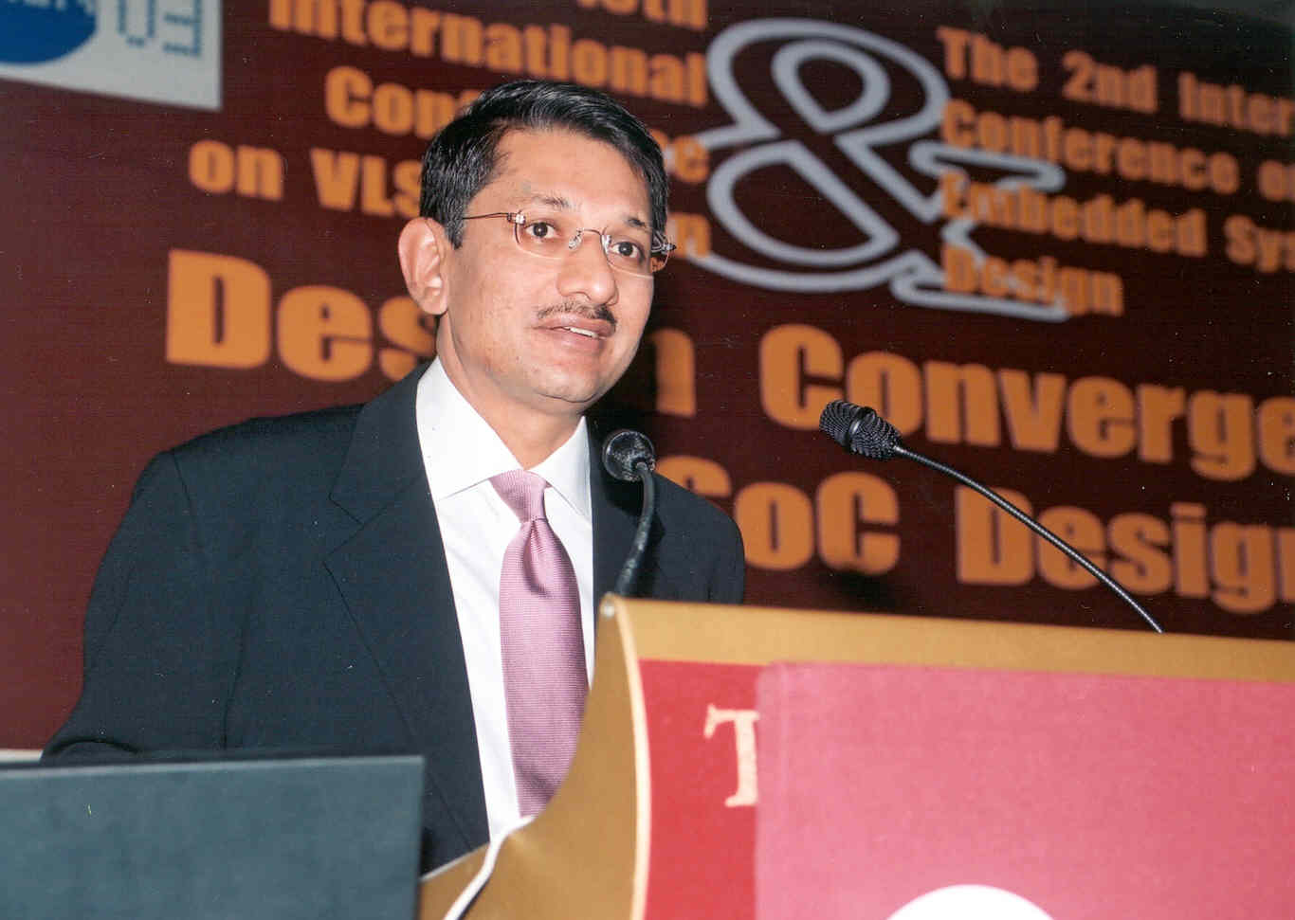
2003: Rajiv Modi, Sasken
Inauguration

Slide 21
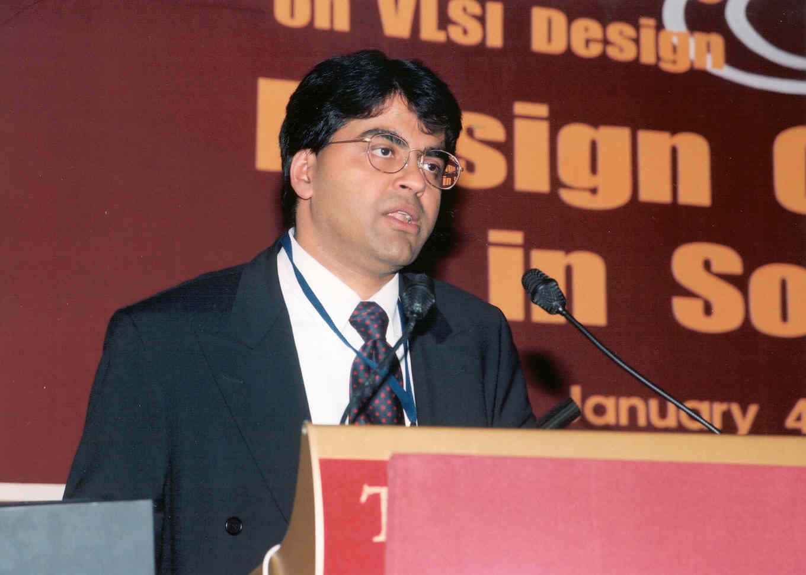
2003: Rajeev Madhavan, Magma
India Building the Tall, Thin VLSI Engineer

Slide 22
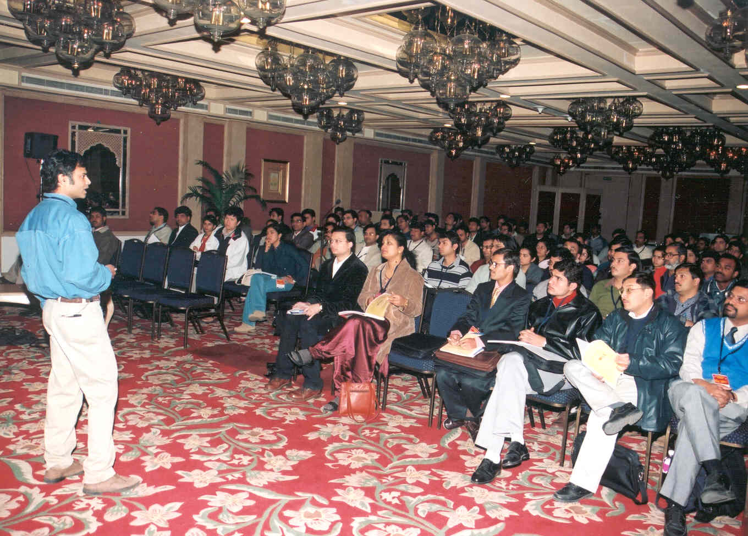
2003: Tutorial by Kaushik Roy
Design of Deep Sub-Micron VLSI Circuits

Slide 23
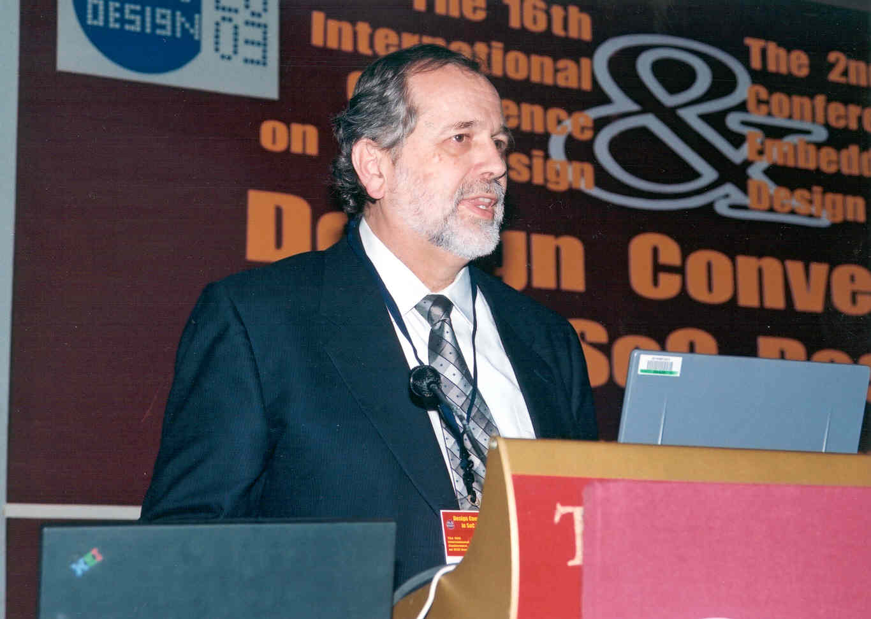
2003: Gene Franz, Texas Instruments
Personal and Portable: The Evolving Definition

Slide 24
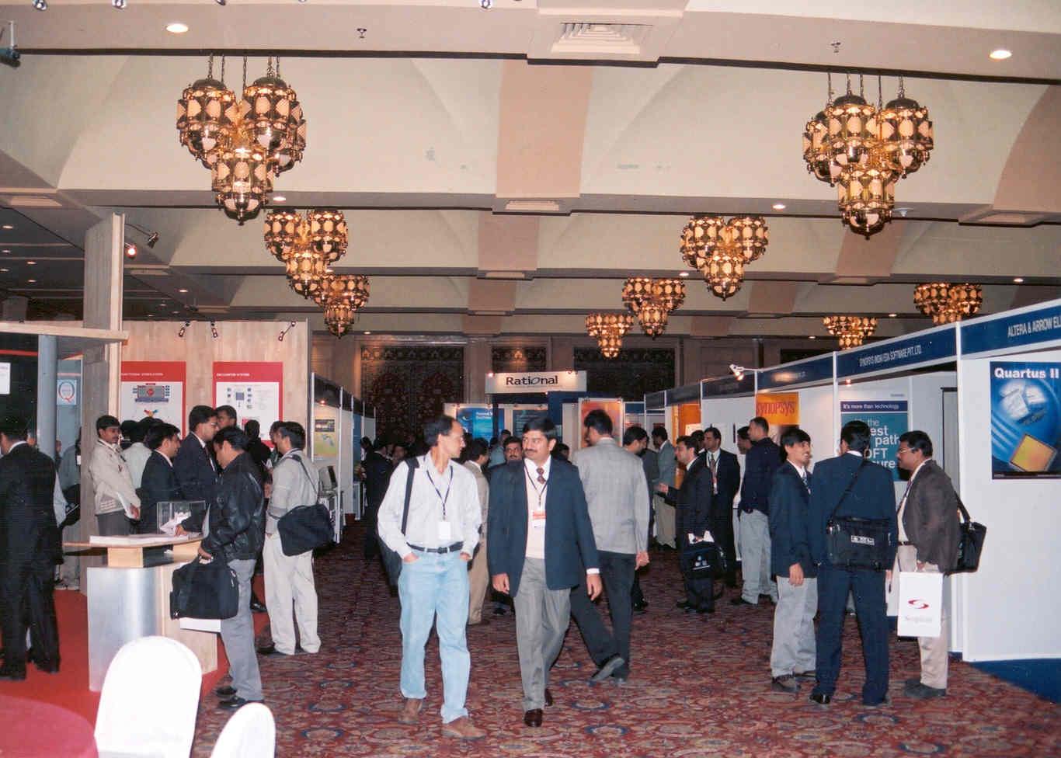
2003: Exhibition

Slide 25
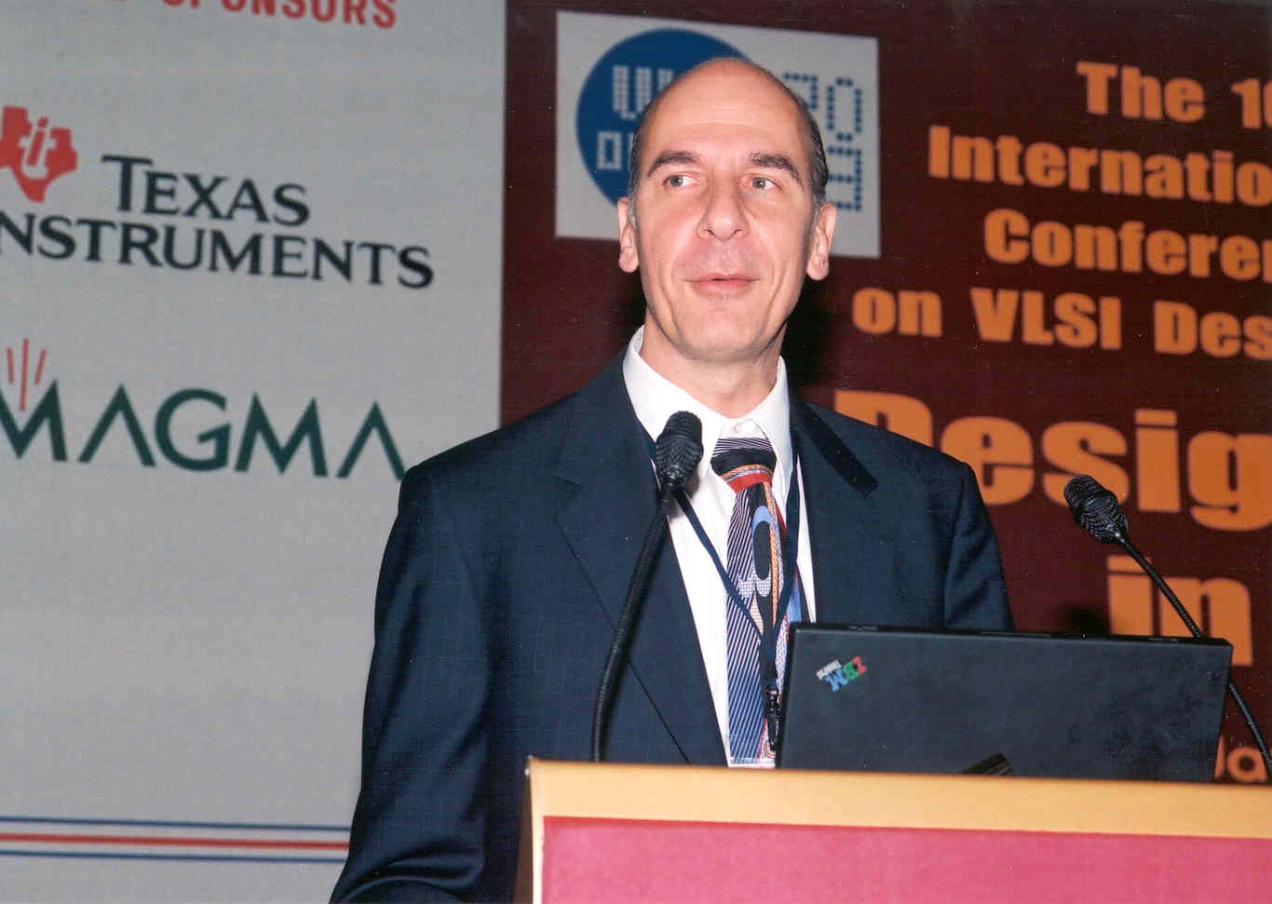
2003: Ted Vucurevich, Cadence
Living at the Edge

Slide 26
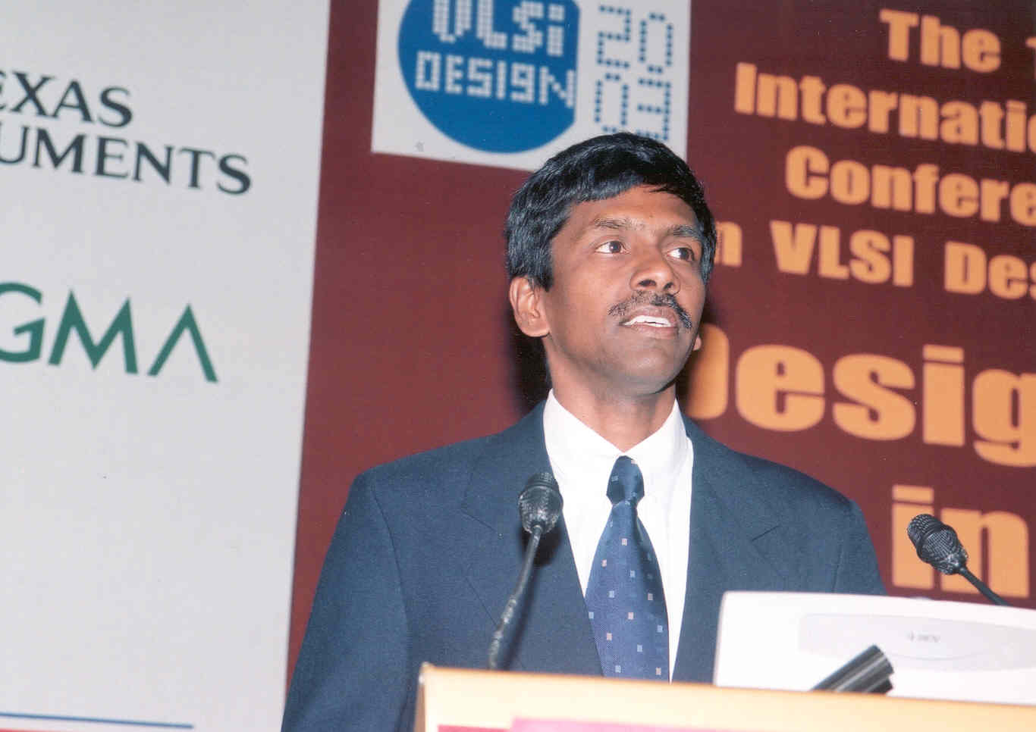
2003: A. Vasudevan, Wipro
Advances in VLSI Design and Product Development Challenges

Slide 27
A Widely-Recognized Proceedings Cover
by IEEE Computer Society Press

Slide 28
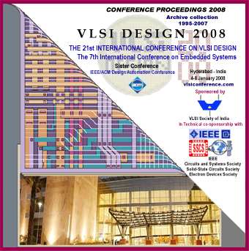

Slide 29
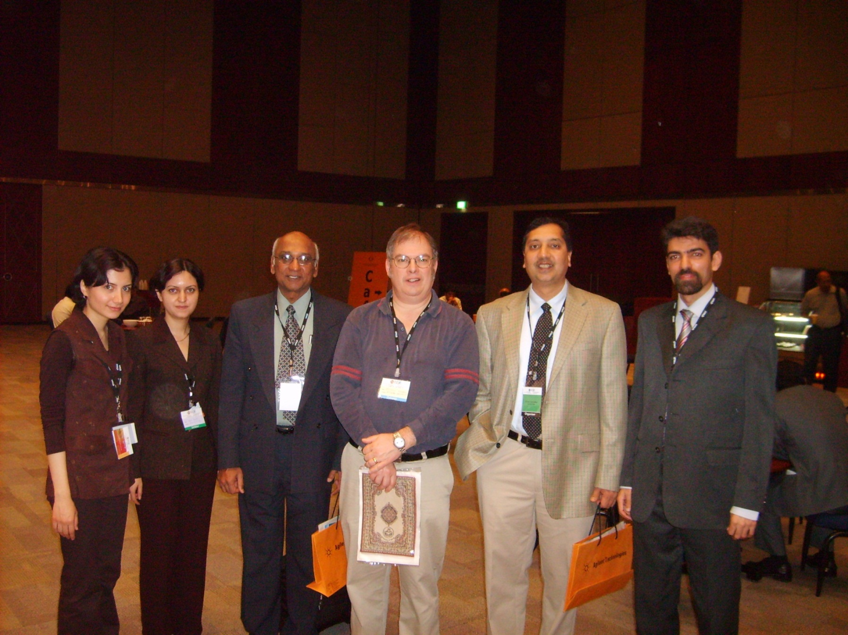
Agrawal, Bushnell and Chakradhar with Three Iranian Students
at 2008 Conference in Hyderabad

Slide 30
Scenes From
22nd International Conference on VLSI Design
&
8th International Conference on Embedded Systems
New Delhi, January 5-9, 2009

Slide 31
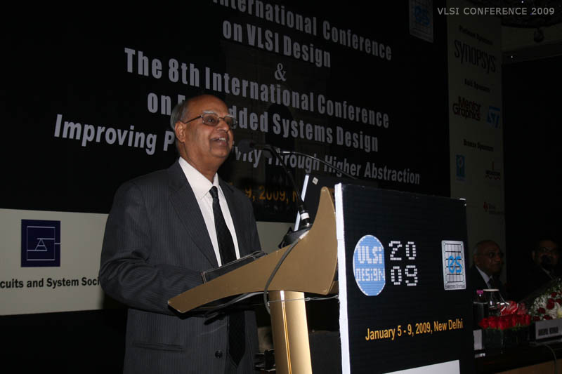
P. V. Indiresan – Keynote Speaker

Slide 32
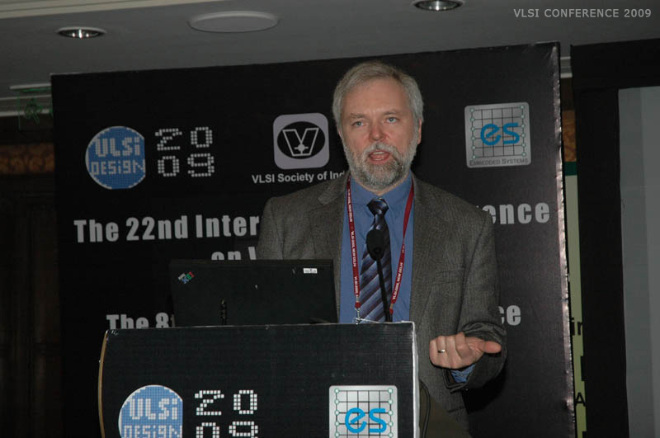
Rob Aitken, ARM Computers

Slide 33
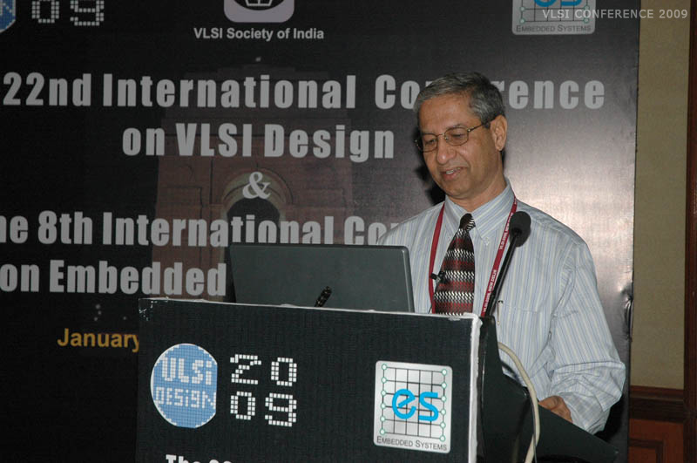
Kewal Saluja – University of Wisconsin-Madison

Slide 34
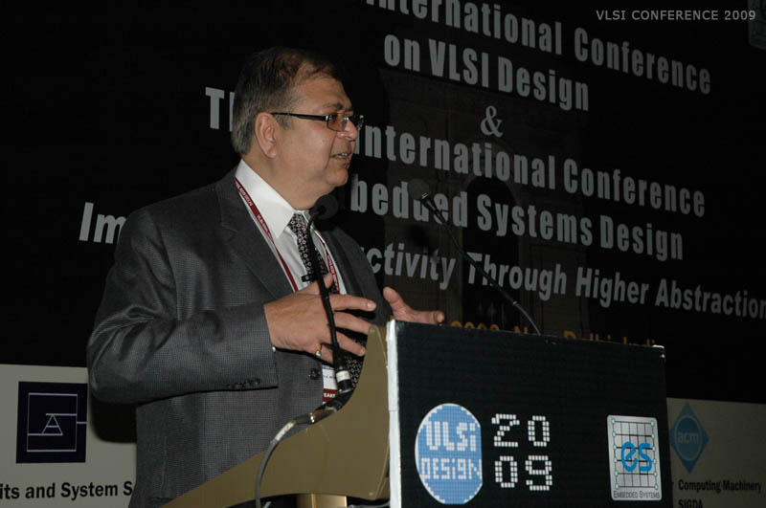
Ajoy Bose – Founder and CEO, Atrenta, San Jose, CA

Slide 35
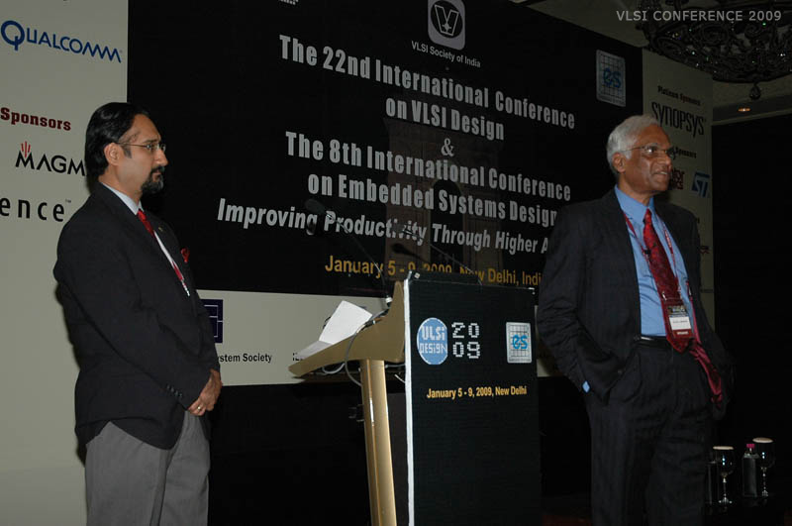
Jaswinder Ahuja, Cadence and Jacob Abraham, UT-Austin

Slide 36
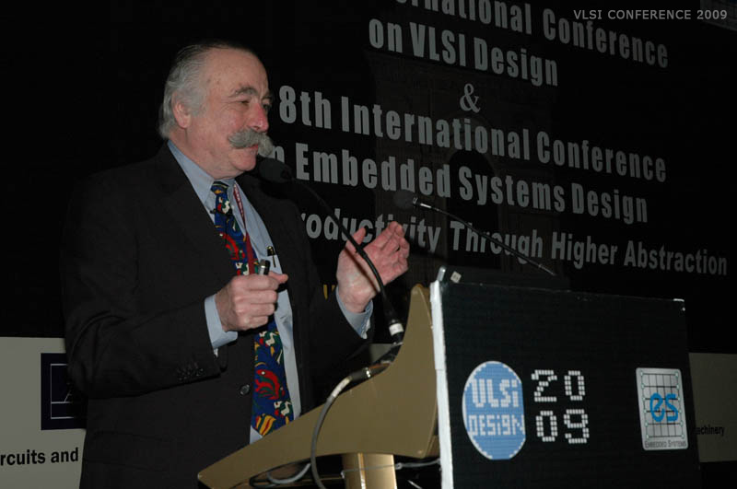
Tom Williams – IBM – Synopsys – Retired in Canada

Slide 37
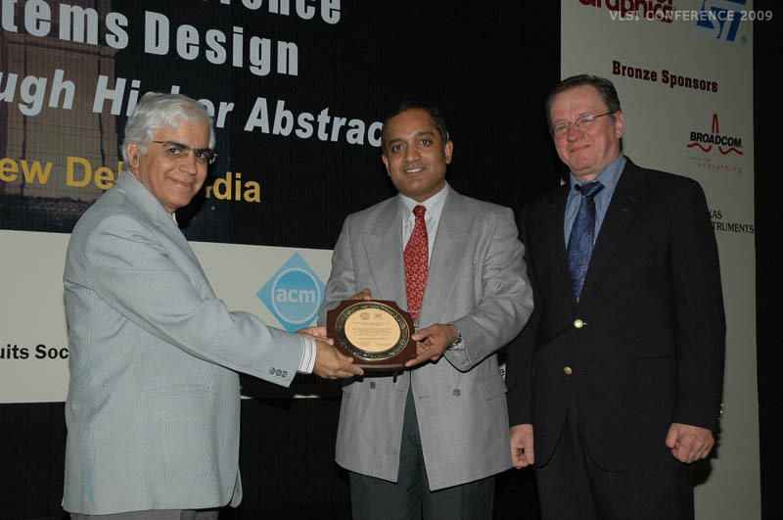
Surendra Prasad – Director, IITD, Nilanjan Mukherjee
and Janusz Rajski – Mentor Graphics

Slide 38
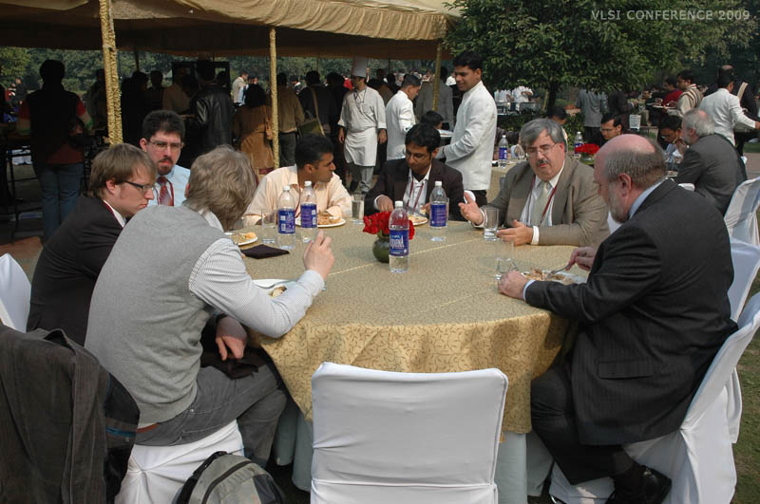
New Delhi: Who says there is fog in January?

Slide 39
Where Are We Going?
26th VLSI Design Conference, Pune, January 5-9, 2013.
16th IEEE VLSI Design & Test Symposium, Shibpur, July 1-4, 2012.

Slide 40
VLSI Design Conference Steering Committee (2012)
Vishwani D. Agrawal, Chair, Auburn University, USA
Jaswinder Ahuja, Cadence, India
M. Balakrishnan (Embedded Systems), IIT Delhi, India
Srimat T. Chakradhar, NEC, USA
Dasaradha Gude, SoCtronics Technologies Pvt. Ltd., India
V. Kamakoti, IIT Madras, India
Anshul Kumar, IIT Delhi, India
Jayanta Lahiri, ARM, India
N. Ranganathan (IEEE), Univ. of South Florida, USA
Anurag Seth, anurag.seth@gmail.com, India

Slide 41
A Vote of Thanks
Anand Baria
Bhargab Bhattacharya
Debashis Bhattacharya
Arun Chandorkar
J. A. Choudary
P. P. Das
Apurva Kalia
Asoke Laha
H. N. Mahabala
Bobby Mitra
Naresh Malipeddi
P. Palchaudhuri
L. M. Patnaik
A. Prabhakar
S. Ramadoorai
Srivaths Ravi
C. P. Ravikumar
Sunil Sherlekar
Naveed Sherwani
Adit Singh
N. Venkateswaran

Slide 42
Conclusion
VLSI Design Conference continues to serve the interest of individuals and organizations.
Every year it is organized around a timely theme, keeping in line with advances in VLSI.
It contributes to VLSI education and research.
It contributes to VLSI industry.
It creates professional networking.

Slide 43
Scenes From
25th International Conference on VLSI Design
&
11th International Conference on Embedded Systems
Hyderabad, January 7-11, 2012

Slide 44
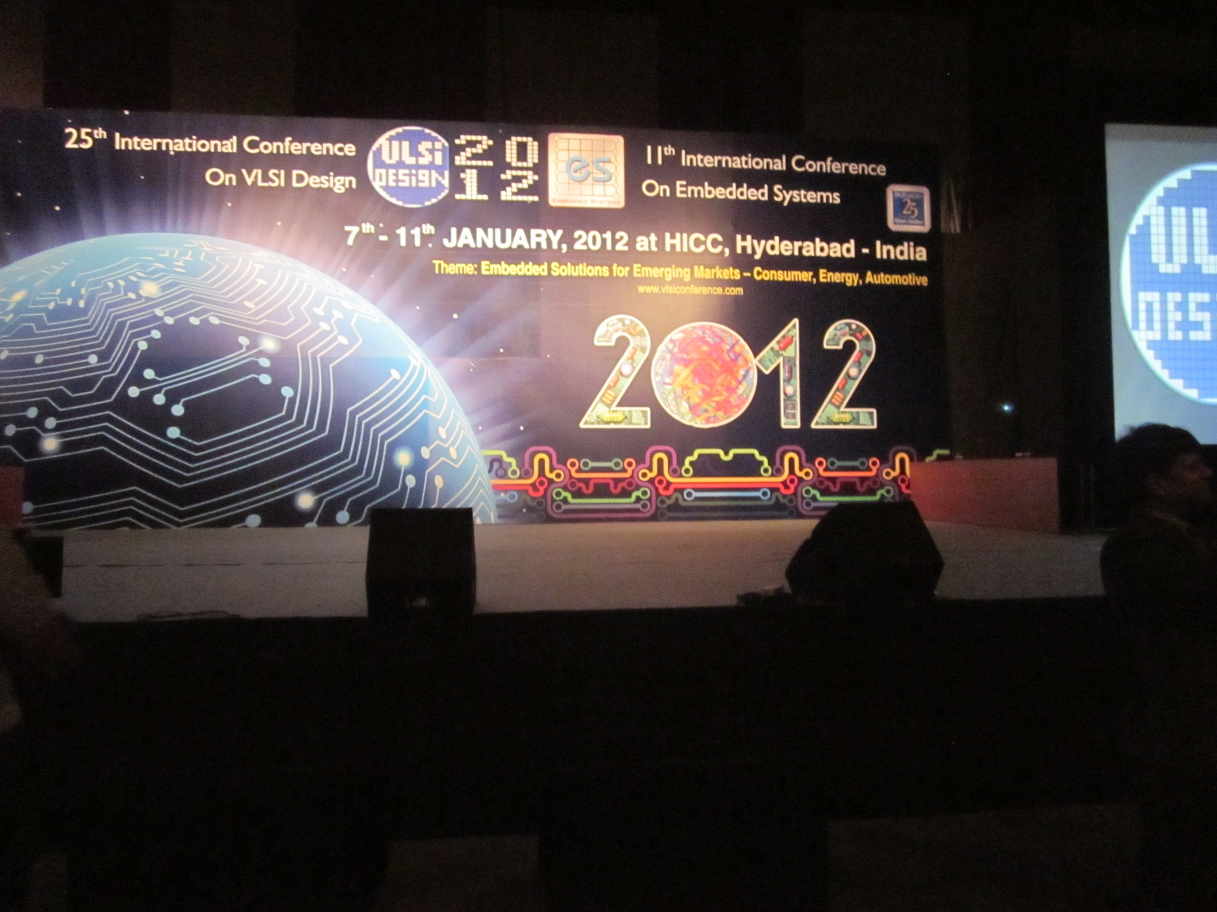

Slide 45
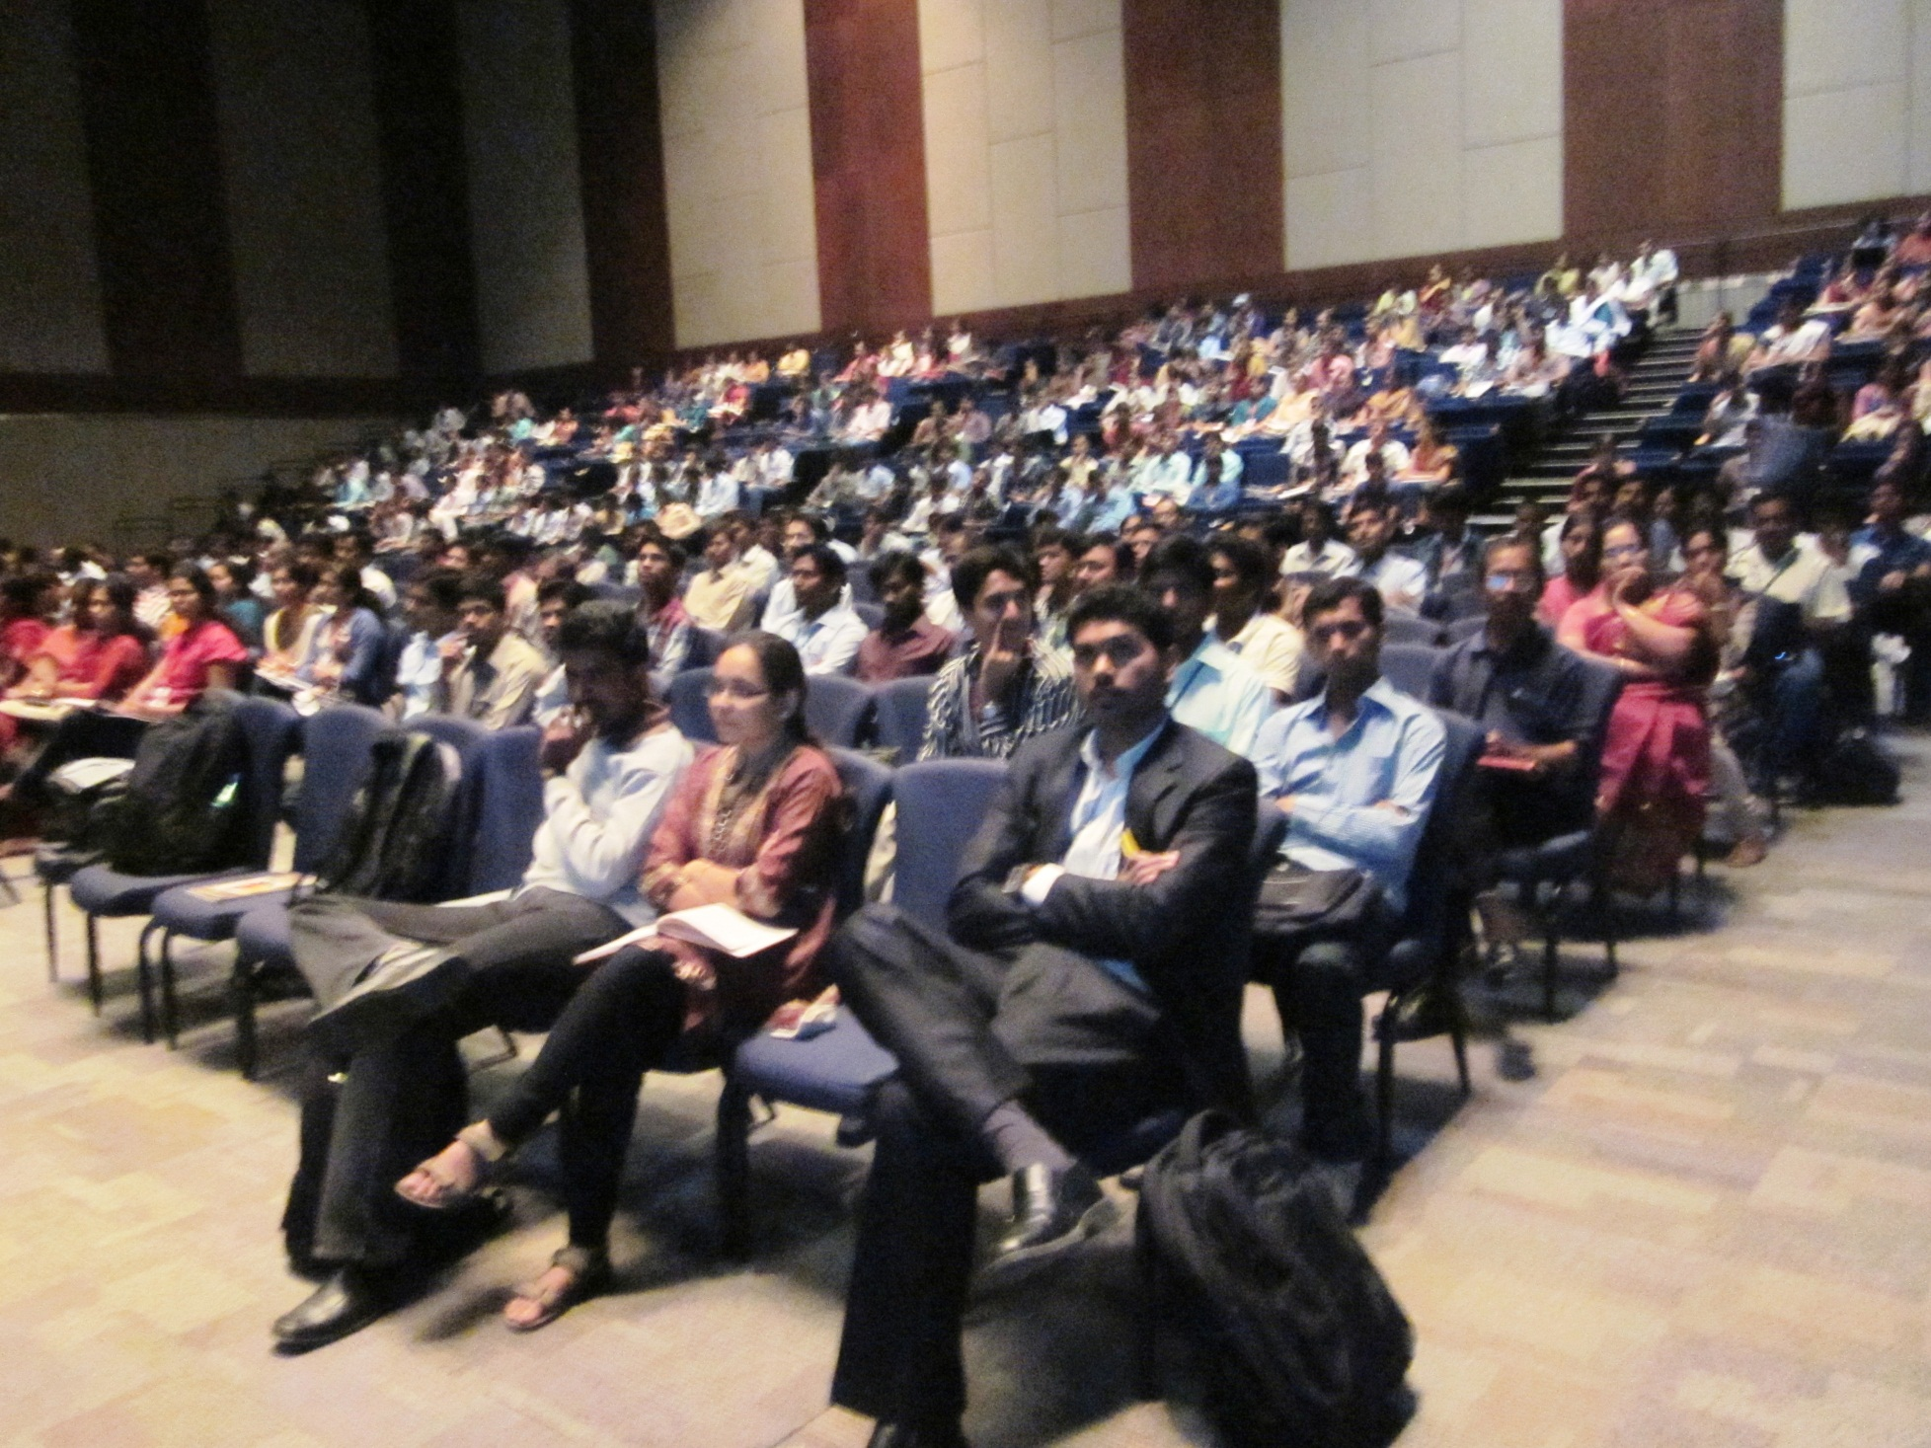

Slide 46
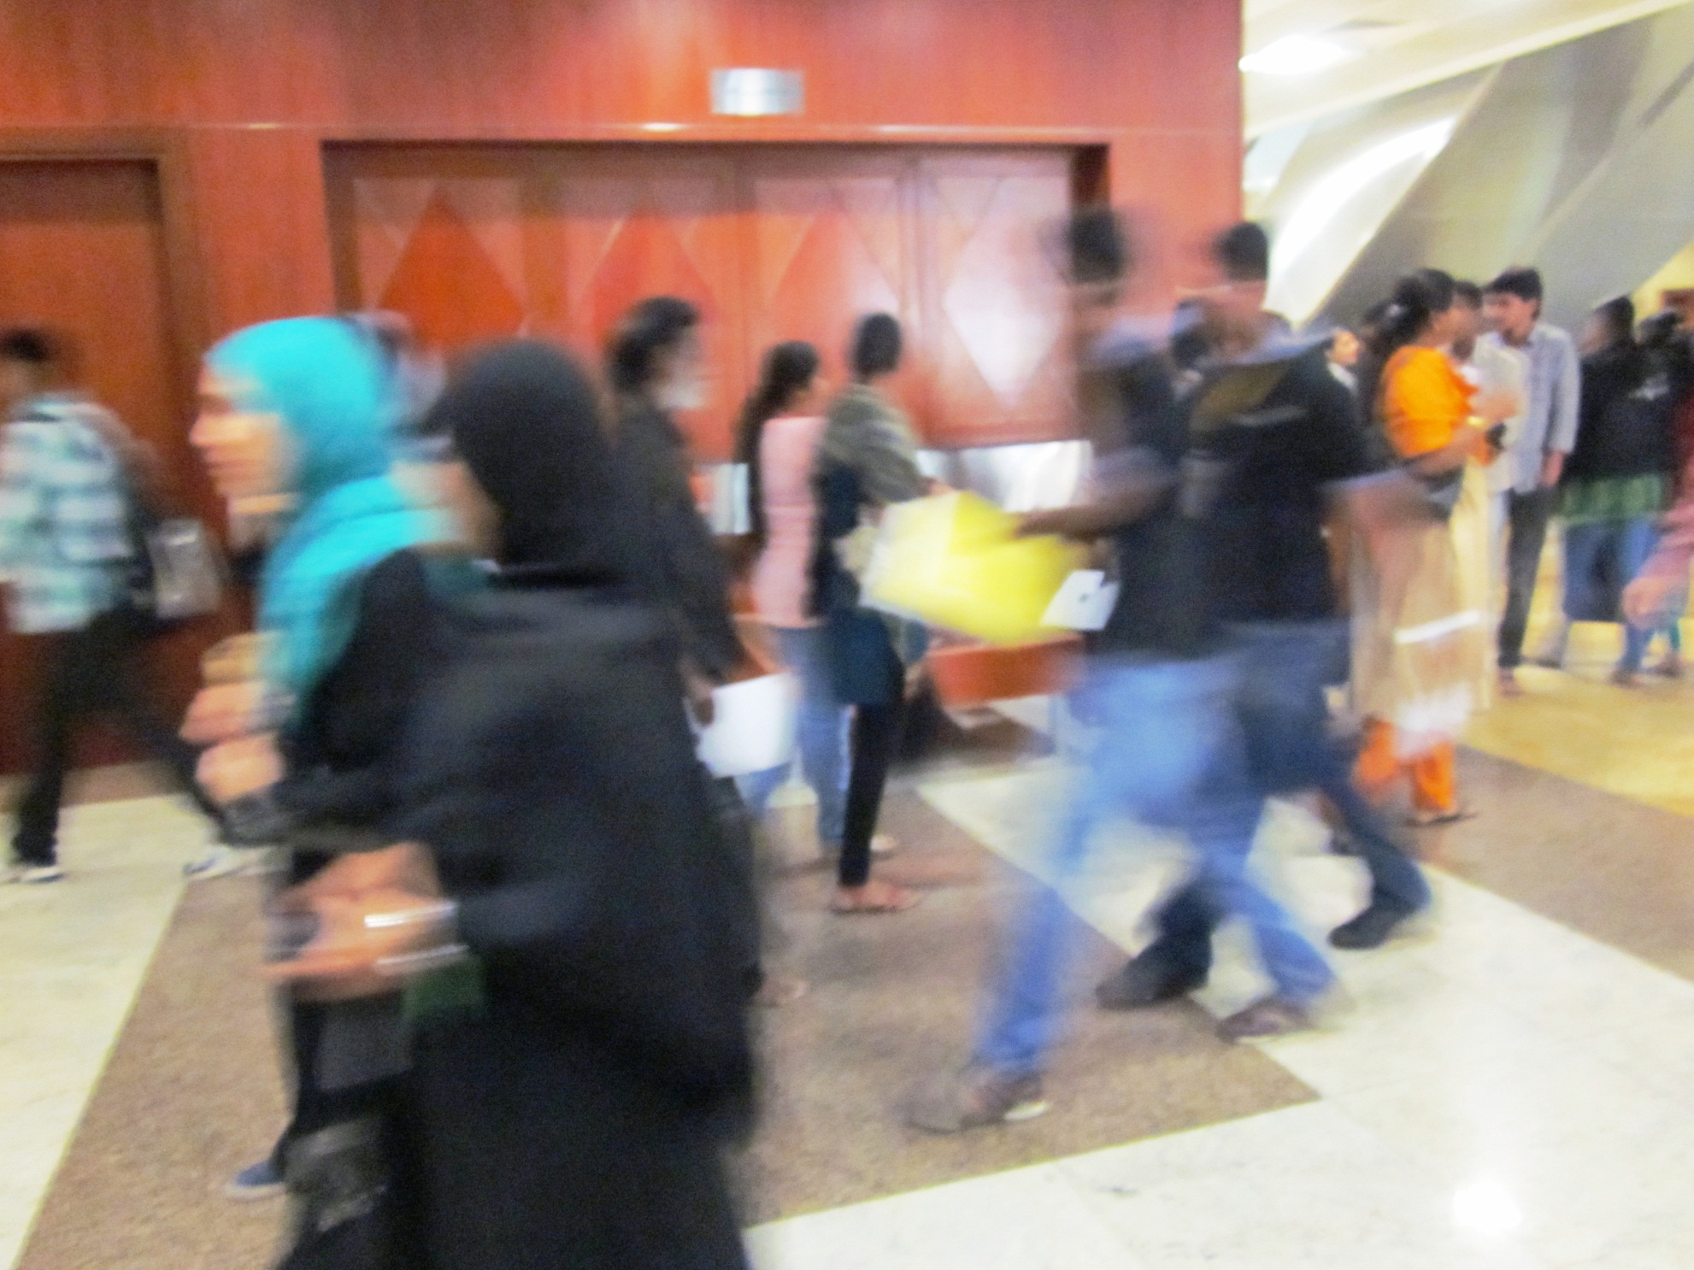

Slide 47
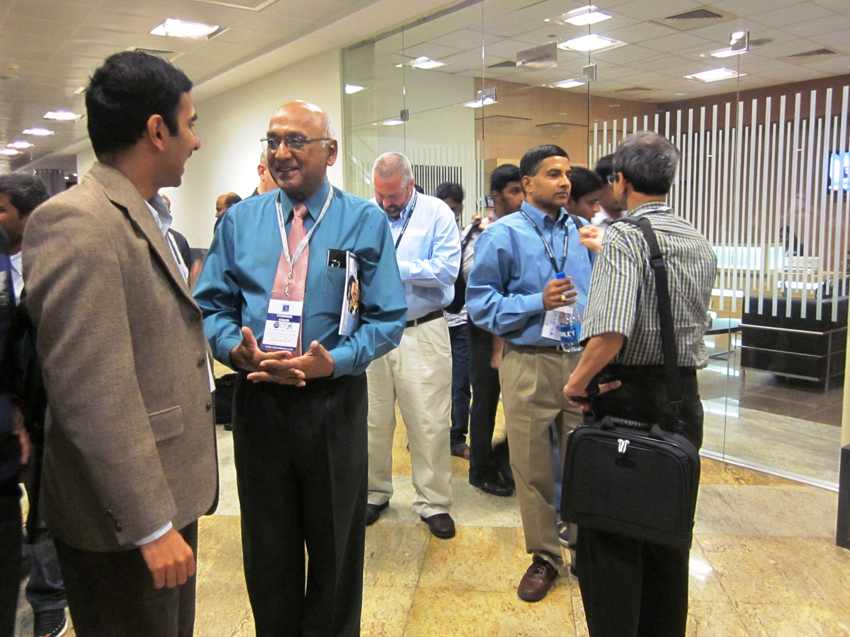

Slide 48
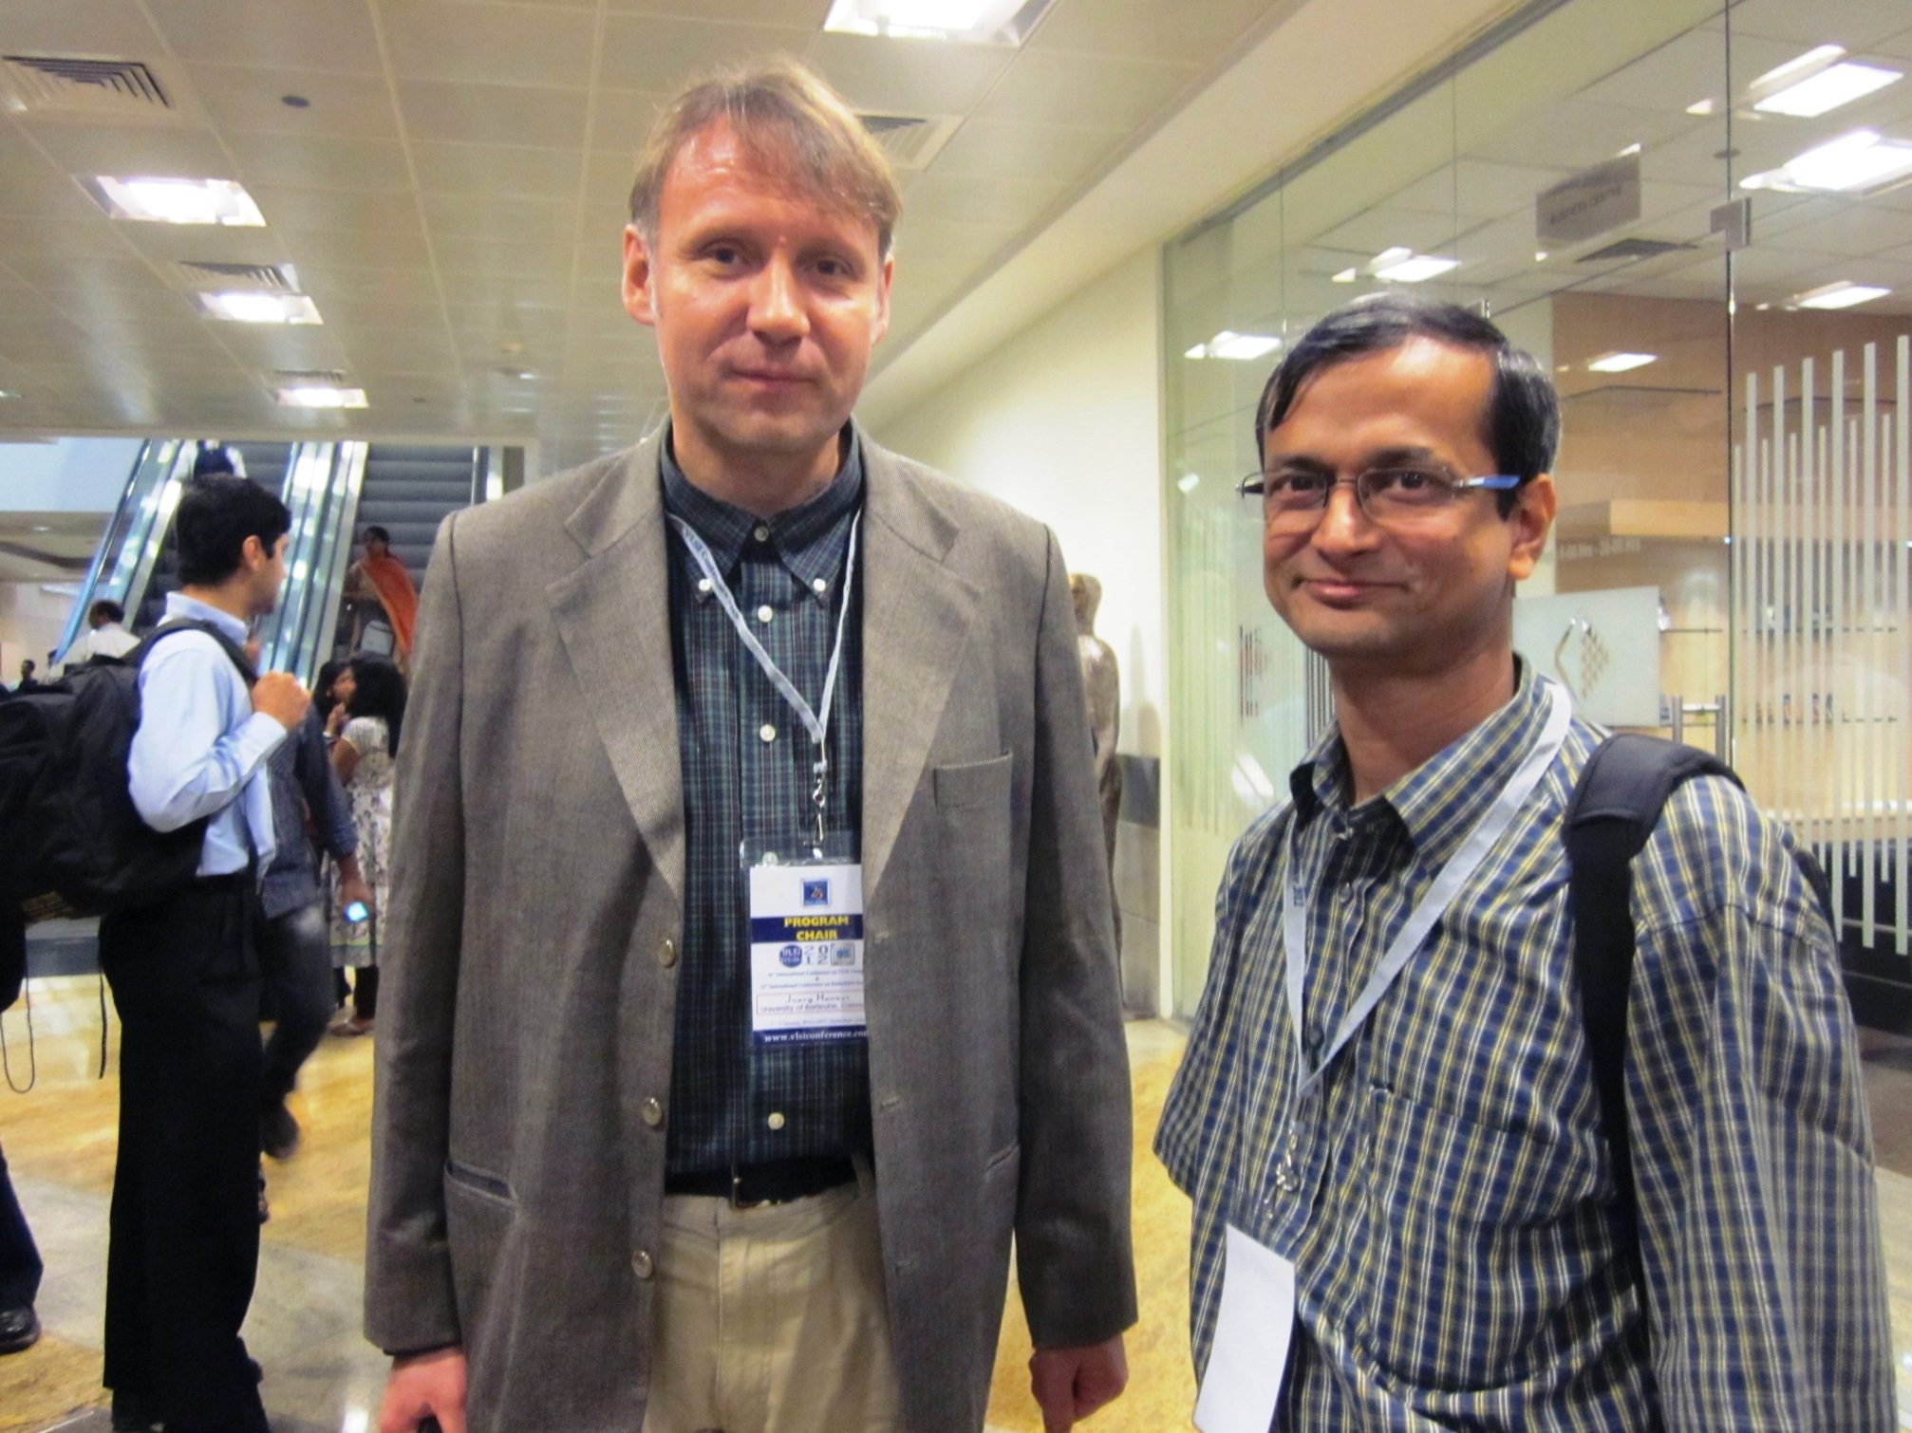

Slide 49
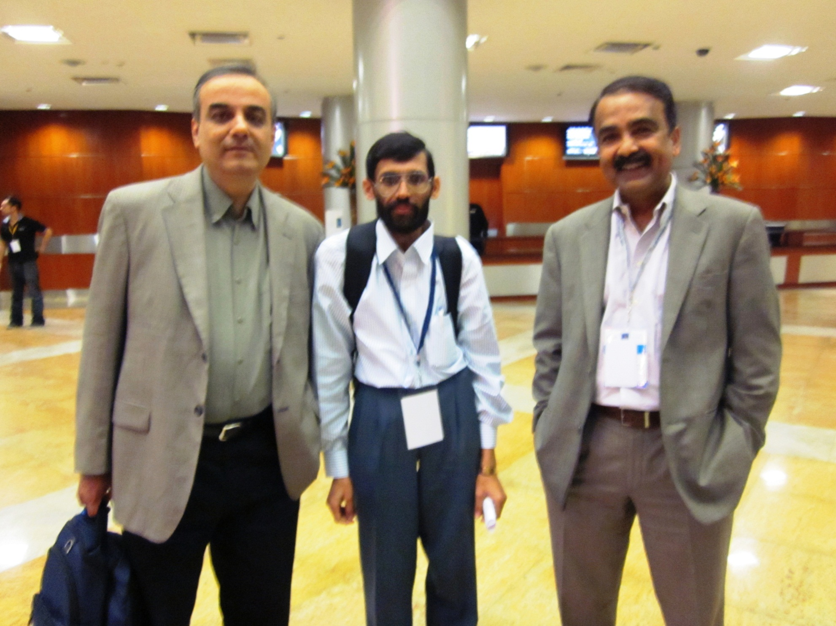

Slide 50
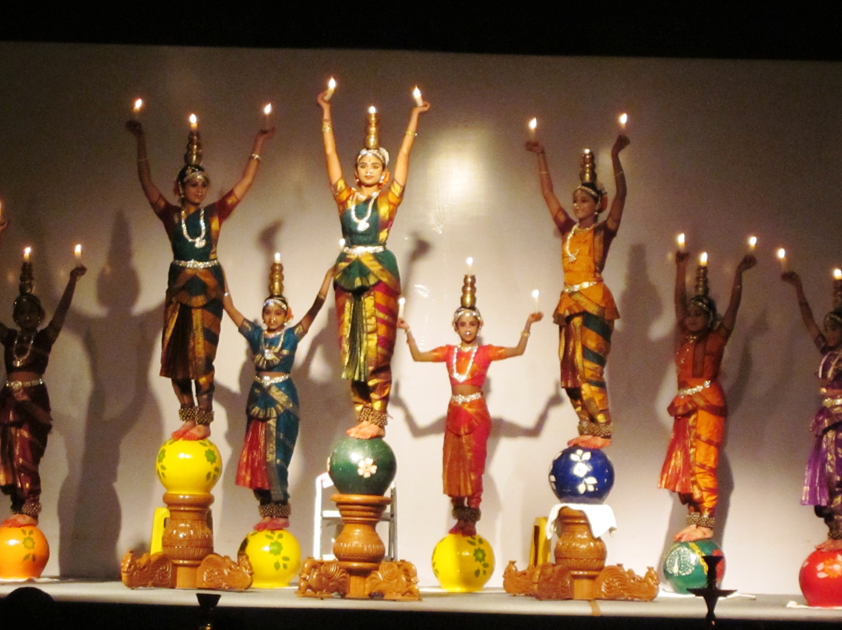

Slide 51
