Slide 1
Dual Voltage Design for Minimum Energy Using Gate Slack
Kyungseok Kim and Vishwani D. Agrawal
ECE Dept. Auburn University
Auburn, AL 36849, USA
IEEE ICIT-SSST Conference
Auburn, March 14, 2011

Slide 2
Low Power Design Using Dual-V_{dd}
Apply V_{DDH} to gates on critical paths to maintain performance, while V_{DDL} to gates on non-critical paths to reduce power:
Clustered Voltage Scaling (CVS) [1]
Extended Clustered Voltage Scaling (ECVS) [2]
Time complexity of two heuristic algorithms [3]:
Worst case O(n²), n is total number of gates in a circuit
LC
FF
LCFF
FF
LCFF
VDDH
CVS
ECVS
VDDL

Slide 3
Motivation
MILP (Mixed Integer Linear Program) algorithms for dual-Vdd design give a global optimal solution, but they cannot be applied to very large circuits due to huge run-time cost [5,6].
Time complexity O(n²) of the published heuristic algorithms for dual-Vdd design also may not have affordable run-time for very large modern SoC.
Gate slack analysis has linear time complexity in number of gates in a circuit; this is different from the all-path slack analysis that can be exponential .

Slide 4
Gate Slack
TPI (i)
TPO (i)
gate i
TPI (i): longest time for an event to arrive at gate i from PI
TPO (i): longest time for an event from gate i to reach PO
Delay of the longest path through gate i [4]:
Dp,i = TPI(i) + TPO(i)
Slack time for gate i: Si = Tc – Dp,i
where Tc = Maxi { Dp,i } for all i

Slide 5
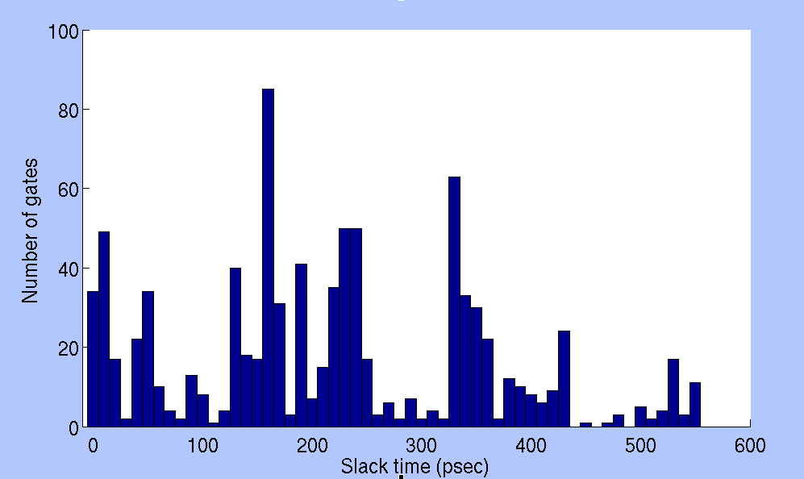
Gate Slack Distribution (C2670)
Total number of gates = 901
Nominal Vdd = 1.2V for PTM 90nm CMOS
Critical path delay Tc = 564.2 ps

Slide 6
Upper Slack Time (Su)
Su is minimum slack of a gate such that it can tolerate VDDL assignment:
Su = $\frac{β−1}{β}∙$Tc where β = $\frac{\text{D}\text{’}\text{p}\text{,}\text{i}}{\text{D}\text{p}\text{,}\text{i}}$ ≈ $\frac{\text{T}\text{’}\text{c}}{\text{T}\text{c} }$
≥ 1
Su=239ps
VDDH=1.2V
VDDL=0.69V
S’u=0
VDDL Gates

Slide 7
Lower Slack Time (Sl)
≥ 1
Sl=7ps
VDDH=1.2V
VDDL=0.69V
VDDH
Gates

Slide 8
Classification for Positive Slack (C2670)
VDDH Gates
VDDH = 1.2V
Possible
VDDL Gates
VDDL Gates
VDDL= 0.69V
Sl = 7ps
Su = 239ps

Slide 9
ISCAS’85 Benchmark (Subtheshold)
Circuit | Total gate | Activity α | V_{DDH} (V) | V_{DDL} (V) | V_{DDL} gates (%) | E_{sing.} (fJ) | E_{dual} (fJ) | Reduc. (%) | MILP[5] (s)** | Slack (s)**
C432 | 154 | 0.19 | 0.25 | 0.23 | 5.2 | 7.9 | 7.8 | 1.1 | 0.3 | 2.5
C499 | 493 | 0.21 | 0.22 | 0.18 | 9.7 | 20.2 | 19.8 | 2.0 | 0.3 | 19.2
C880 | 360 | 0.18 | 0.24 | 0.18 | 46.4 | 14.4 | 11.2 | 22.2 | 5.8 | 17.9
C1355 | 469 | 0.21 | 0.21 | 0.18 | 10.2 | 19.5 | 19.0 | 2.5 | 0.2 | 13.3
C1908 | 584 | 0.20 | 0.24 | 0.21 | 24.3 | 26.5 | 25.0 | 5.8 | 3.2 | 47.6
C2670 | 901 | 0.16 | 0.25 | 0.21 | 46.4 | 32.8 | 28.0 | 14.8 | 35.9 | 134.4
C3540 | 1270 | 0.33 | 0.23 | 0.14 | 7.0 | 88.0 | 84.6 | 3.8 | 3.2 | 256.5
C5315 | 2077 | 0.26 | 0.24 | 0.19 | 47.1 | 116.8 | 98.0 | 16.1 | 852.3 | 692.0
C6288 | 2407 | 0.28 | 0.29 | 0.18 | 2.7 | 165.4 | 162.0 | 2.1 | 2.6 | 1293.7
C7552 | 2823 | 0.20 | 0.25 | 0.21 | 42.3 | 131.7 | 117.1 | 11.1 | 1452.2 | 1408.3
** CPU Time : Intel Core 2 Duo 3.06GHz, 4GB RAM

Slide 10
Selected ISCAS’85 (Nominal)
Circuit | Single |  | MILP [5] |  |  |  | Slack-time Algorithm
 | V_{DDH} (V) | E_{sing.} (fJ) | V_{DDL} (V) | V_{DDL} gates (%) | E_{dual} reduc. (%) | CPU time (s)** | V_{DDL} (V) | V_{DDL} gates (%) | E_{dual} reduc. (%) | CPU time (s)**
C432 | 1.2 | 160.1 | 0.75 | 5.2 | 3.9 | 0.6 | 0.75 | 5.2 | 3.9 | 15.8
C499 | 1.2 | 460.6 | 0.79 | 19.5 | 5.9 | 403.8 | 0.79 | 19.5 | 5.9 | 194.4
C880 | 1.2 | 277.6 | 0.59 | 56.9 | 51.0 | 455.0 | 0.60 | 57.5 | 50.8 | 62.1
C1355 | 1.2 | 453.0 | 0.69 | 13.6 | 4.3 | 340.2 | 0.69 | 13.6 | 4.3 | 132.0
C1908 | 1.2 | 496.5 | 0.67 | 26.9 | 19.0 | 2146.9 | 0.67 | 26.9 | 19.0 | 247.8
C2670 | 1.2 | 647.6 | 0.69 | 57.9 | 47.8 | 20848.9 | 0.69 | 57.9 | 47.8 | 480.7
C3540 | 1.2 | 1844.0 | 0.70 | 11.6 | 9.6 | 601.0 | 0.70 | 11.6 | 9.6 | 1243.5
C6288 | 1.2 | 3066.0 | 1.18 | 53.1 | 2.9 | 10523.7 | 0.47 | 2.9 | 2.6 | 6128.0
** Intel Core 2 Duo 3.06GHz, 4GB RAM

Slide 11
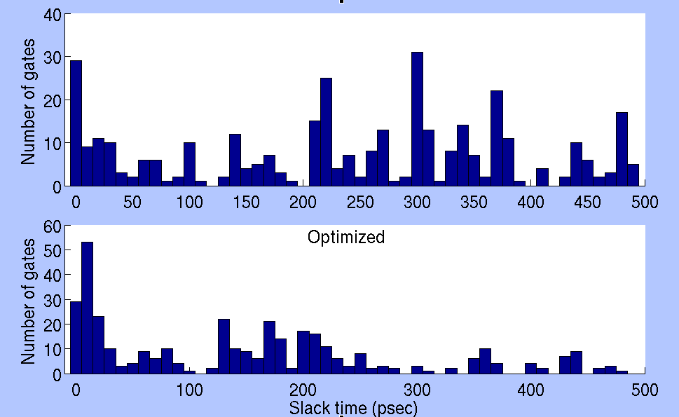
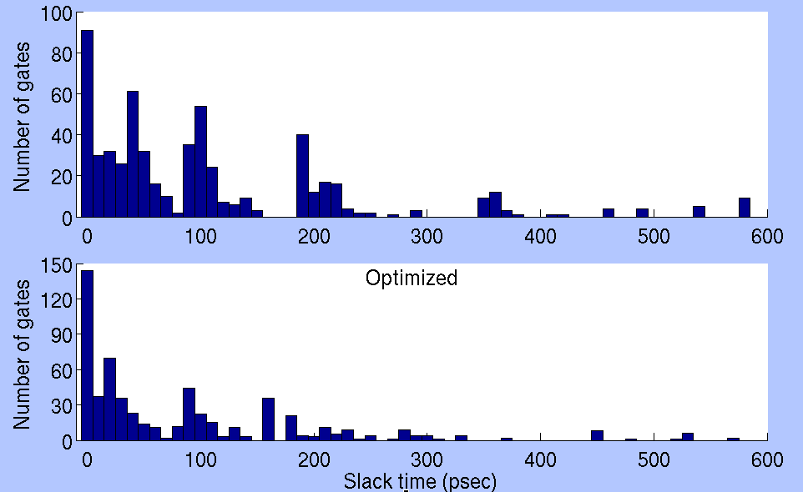
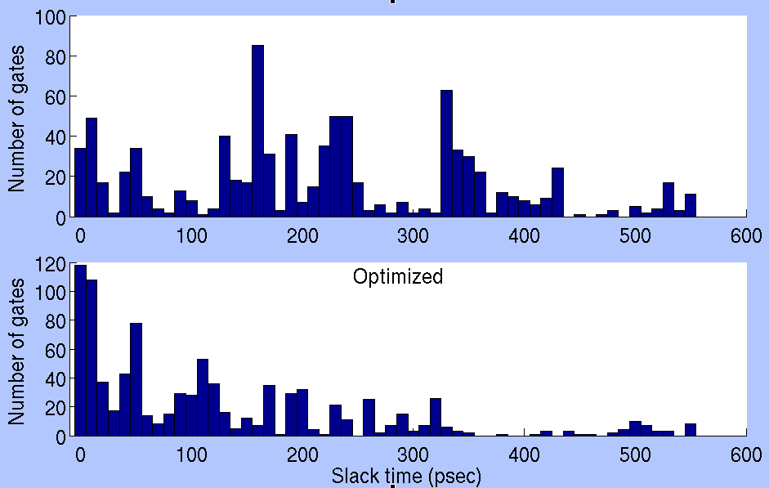
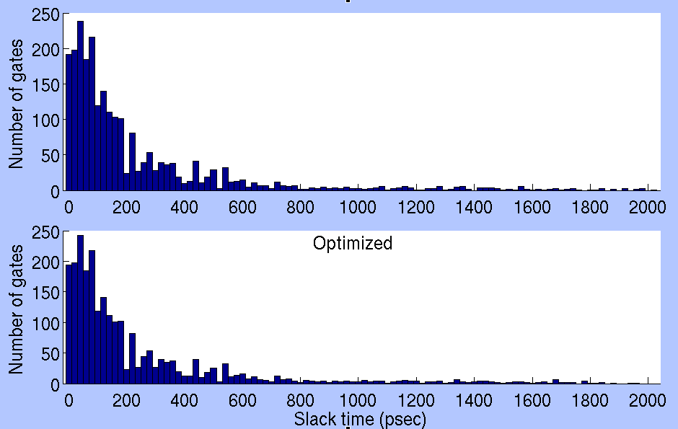
Gate Slack Distribution (Nominal)
C880
C1908
Optimized
Optimized
C2670
C6288
Optimized
Optimized

Slide 12
Conclusion and Future Work
Proposed slack analysis classifies all gates into VDDL, possible VDDL, and VDDH gates.
New slack-based algorithm for dual-Vdd has a linear time complexity, O(n), for n gates in the circuit.
The methodology of slack classification can be applied to other power optimization disciplines, such as dual-Vth.
A hybrid (MILP + slack analysis) algorithm for dual-Vdd design (ECVS) is being investigated to achieve both fast run-time and best optimal solution.

Slide 13
References
[1] K. Usami and M. Horowitz, “Clustered Voltage Scaling Technique for Low- Power Design,” Proc. International Symposium on Low Power Design, 1995, pp. 3–8.
[2] K. Usami, M. Igarashi, F. Minami, T. Ishikawa, M. Kanzawa,M. Ichida and K. Nogami, “Automated Low-Power Technique Exploiting Multiple Supply Voltages Applied to a Media Processor,” IEEE Journal of Solid-State Circuits, vol. 33, no. 3, pp. 463–472, 1998.
[3] D. Chinnery and K. Keutzer, Closing the Power Gap Between ASIC & Custom: Tools and Techniques for Low Power Design. Springer, 2007.
[4] A. K. Majhi , V. D. Agrawal, J. Jacob and L. M. Patnaik, “Line Coverage of Path Delay Faults,” IEEE Trans. VLSI Systems, vol. 8, no. 5, pp. 610–614.
[5] K. Kim and V. D. Agrawal, “True Minimum Energy Design Using Dual Below-Threshold Supply Voltages,” Proc. 24th International Conference on VLSI Design, Jan. 2011.
[6] K. Kim and V. D. Agrawal, “Minimum Energy CMOS Design with Dual Subthreshold Supply and Multiple Logic-Level Gates,” Proc.12th International Symposium on Quality Electronic Design, Mar. 2011.

Slide 14
Thank you!!
&
Questions?

