Slide 1
Dynamic SCAN Clock control In BIST Circuits
Priyadharshini Shanmugasundaram
Vishwani D. Agrawal
vagrawal@eng.auburn.edu

Slide 2
Problem Statement
Reduce test time without exceeding power budget
Test power and test time are known problems
Increasing test frequency increases test power - undesirable

Slide 3
A Built-In Self-Test (BIST) Architecture

Slide 4
Test Power Considerations
Circuit activity increases during testing and leads to high test power dissipation
Drop in power supply voltage due to IR drop
Drop in voltage lowers current flowing through transistor
Time taken to charge load capacitor increases
Causes stuck and delay faults
Ground bounce
Increase in ground voltage
Incorrect operation of transistors
Causes stuck and delay faults
Excessive heating
Permanent damage in circuit
Good chip labeled bad → yield loss
Test clock frequency lowered to reduce power dissipation

Slide 5
Main Idea
Different test vector bits consume different amounts of power
Test frequency chosen based on peak test power consumption
All test vector bits applied at same frequency
Test vector bits consuming lower power can be applied at higher frequencies without exceeding power budget of the chip

Slide 6
Speeding Up Scan Clock
Power
budget
Cycle power
Clock periods
Power
budget
Cycle power
Clock periods

Slide 7
A Dynamic Scan Architecture

Slide 8
Dynamic Control of Scan Clock
Monitor number of transitions in scan chain
Speed-up scan clock when activity in scan chain is low or slow-down scan clock when activity in scan chain is high
Scan-in time
Without dynamic control
$4T∗8 = 32T$
With dynamic control
$4T∗4+3T∗2+2T∗2=26T$
Reduction
$\frac{(32T−26T)}{32T}∗100=18.75\%$
Example: Dynamic control of scan clock
Non-transition: Present bit in scan chain identical to previous bit (00 or 11)

Slide 9
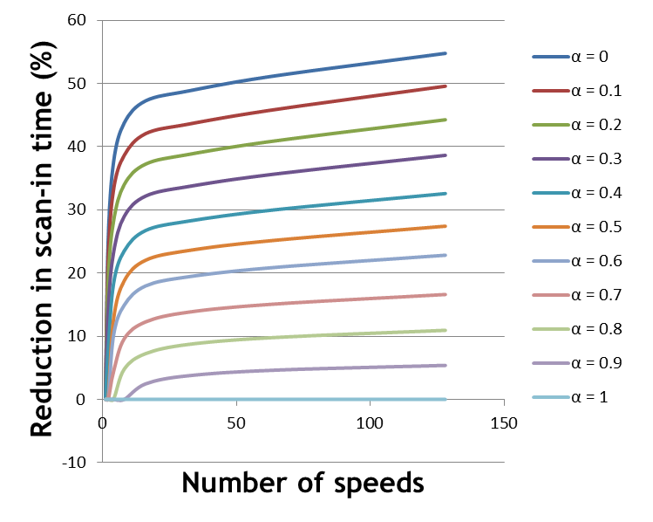
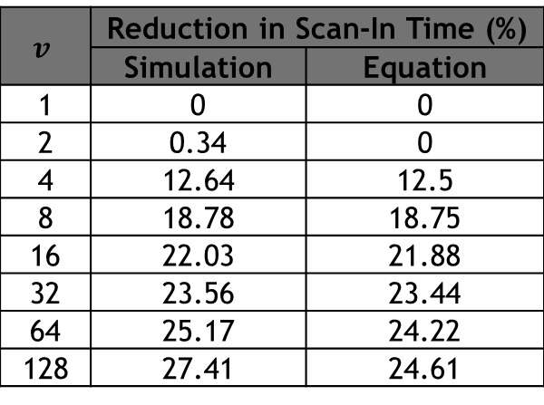
Mathematical Analysis - $αpeak=1$
Verified with simulations
C program to generate random vectors, N=1000, $α_{peak}=1$
Reduction in scan-in time vs. $v (α_{in} = 0.5)$
$$v$$ | Reduction in Scan-In Time (%)
 | Simulation | Equation
1 | 0 | 0
2 | 0.34 | 0
4 | 12.64 | 12.5
8 | 18.78 | 18.75
16 | 22.03 | 21.88
32 | 23.56 | 23.44
64 | 25.17 | 24.22
128 | 27.41 | 24.61
Variation of scan-in time reduction with $v$ for different values of $α$
Reduction in scan-in time higher for lower $αin$

Slide 10
Experimental Results - $αpeak=1$
Flip-flops added at primary inputs and outputs of Test-per-scan BIST model and chained together
Total number of scan flip-flops = Number of primary inputs + Number of D-type flip-flops + Number of primary outputs
Circuits built with and without Dynamic Scan Clock Control
MentorGraphics ModelSim used to find testing time in both cases
Synopsys DesignCompiler used to estimate area
Synopsys PrimeTime PX used for power (activity per unit time) analysis
Test-per-scan BIST model

Slide 11
Experimental Results - $α_{peak} = 1$
Reduction in test time in ISCAS89 benchmark circuits – single scan chain, self tested
Circuit | Number of scan flip-flops | Number of frequencies | Reduction in time (%) | Increase in area (%)
s27 | 8 | 2 | 7.49 | 14.72
s386 | 20 | 4 | 15.25 | 15.29
s838 | 67 | 4 | 13.51 | 11.73
s5378 | 263 | 4 | 13.03 | 6.65
s13207 | 852 | 8 | 19.00 | 3.98
s35932 | 2083 | 8 | 18.74 | 2.55
s38584 | 1768 | 8 | 18.91 | 2.13
Single scan vector
$α_{in}=0.25$
Test time reduction
22.5%
Activity per unit time closer to peak limit using dynamic scan clock technique
Peak limit never exceeded
Activity per unit time analysis (Synopsys PrimeTime PX) – s386 circuit

Slide 12
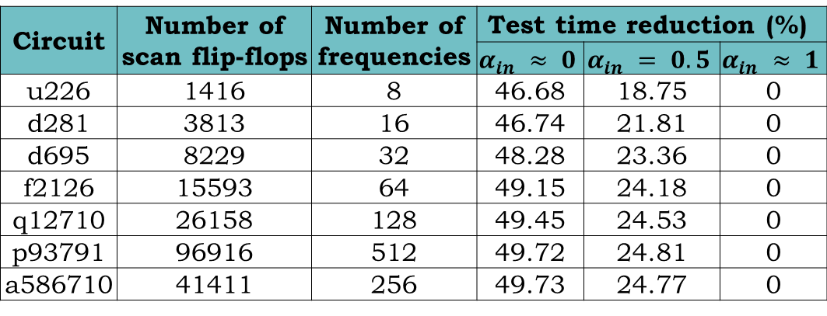
Experimental Results - $α_{peak} = 1$
Reduction in test time in ITC02 benchmark circuits
Circuit | Number of scan flip-flops | Number of frequencies | Test time reduction (%)
 |  |  | $$α_{in} ≈ 0$$ | $$α_{in} = 0.5$$ | $$α_{in} ≈ 1$$
u226 | 1416 | 8 | 46.68 | 18.75 | 0
d281 | 3813 | 16 | 46.74 | 21.81 | 0
d695 | 8229 | 32 | 48.28 | 23.36 | 0
f2126 | 15593 | 64 | 49.15 | 24.18 | 0
q12710 | 26158 | 128 | 49.45 | 24.53 | 0
p93791 | 96916 | 512 | 49.72 | 24.81 | 0
a586710 | 41411 | 256 | 49.73 | 24.77 | 0
a) without don’t care bits (961 vectors)
b) with don’t care bits (14196 vectors)
Distribution of activity factor for test vectors of s38584 circuit

Slide 13
Improved Dynamic Clock

Slide 14
Conclusion
Dynamic control of scan clock frequency is proposed
Reduces testing time without exceeding power budget
On-chip activity monitor for self testing circuits to keep track of activity in scan chain
Vectors with low average scan-in activity and much higher peak activity give high reduction in test time.
Up to 50% reduction in test time may be possible.
Other references:
P. Shanmugasundaram, Test Time Optimization in Scan Circuits, Master’s Thesis, Department of ECE, Auburn University, Auburn, Alabama, December 2010.
P. Shanmugasundaram and V. D. Agrawal, “Dynamic Scan Clock Control for Test Time Reduction Maintaining Peak Power Limit,” Proc. VLSI Test Symposium, May 2011.
P. Shanmugasundaram and V. D. Agrawal, “Dynamic Scan Clock Control in BIST Circuits,” Proc. International Conference on Industrial Electronics, Mar 2011.

