Slide 1
Multivalued Logic for Reduced Pin Count and Multi-Site SoC Testing
Baohu Li and Vishwani D. Agrawal
Auburn University, ECE Dept., Auburn, AL 36849, USA
24th IEEE North Atlantic Test Workshop
Johnson City, NY, May 11-13, 2015

Slide 2
Outline
Problem statement and motivation
Background
MVL test channel for reduced pin-count SoCs
Hardware and test flow design for MVL test data application
Experimental setup and results
Conclusion and future work

Slide 3
Problem Statement and Motivation
Problem statement
Multi-site test has a high demand on pin reduction for DUTs;
Serialization/deserialization of test data is a popular pin reduction technique but it sacrifices test speed.
The reduction in test speed for such schemes gets worse for multi-core SoCs.
Motivation
To find a way to send test data with fewer test pins for SoCs without compromising test speed.

Slide 4
Background
Multi-site testing and pin reduction
Multi-site testing aims at best utilizing the ATE resources to test many DUTs at the same time.
Reduction of test pins uses fewer ATE resources to test a DUT, helping solve bandwidth mismatch problem and increase parallelism in multi-site testing.
Serialization/deserialization of test data
A commonly implemented scheme to reduce test pins
Scan test with three pins, J. Moreau et al., [ITC 09]
Scan architecture using SerDes in GPU chips, A. Sang. et al., [VTS11]
SmartScan, K. Chakravadhanula et al., [ITC13]
Test Data are serially sent by ATE with fewer test channels and deserialized in DUTs.

Slide 5
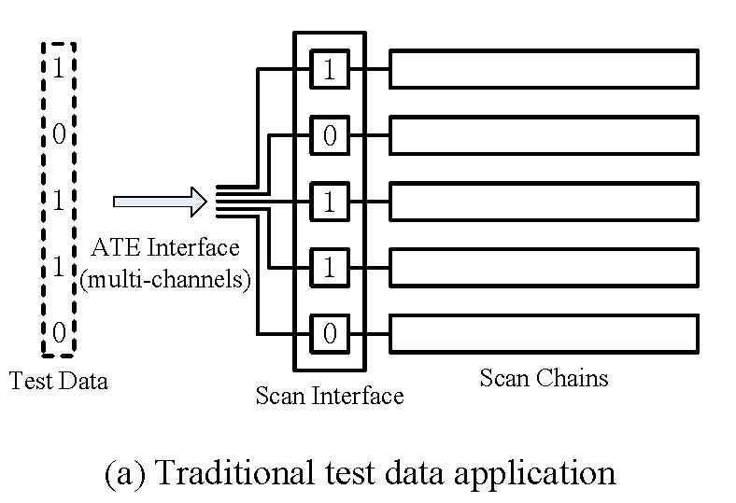
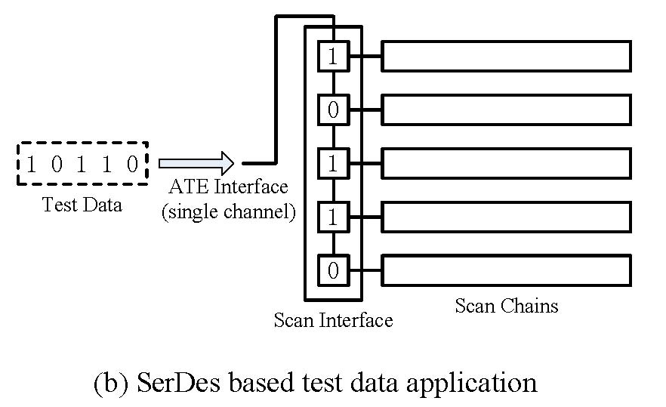
Background
Serialization/deserialization of test data
In this example, to send 5 bits of test data, the SerDes using a single wire needs 5 cycles, compared to 1 cycle in the traditional 5-wire case (sacrifice test speed).

Slide 6
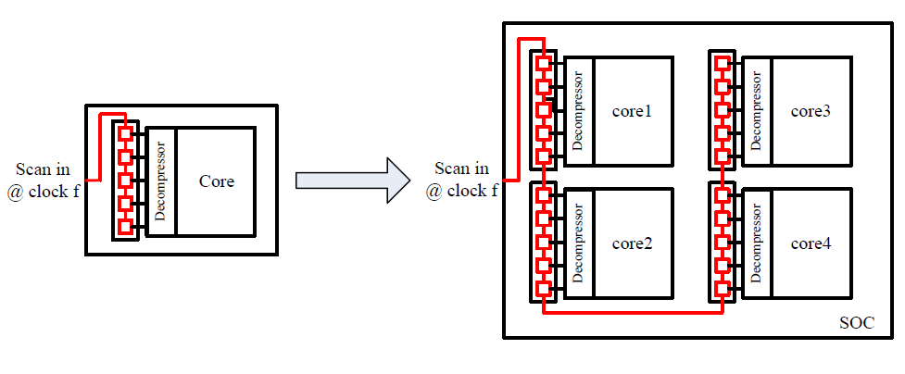
Background
Problem gets worse with multi-core SoCs
Scan speed: 1/5 of clock f → 1/20 of clock f
Limited by the data rate of single channel

Slide 7
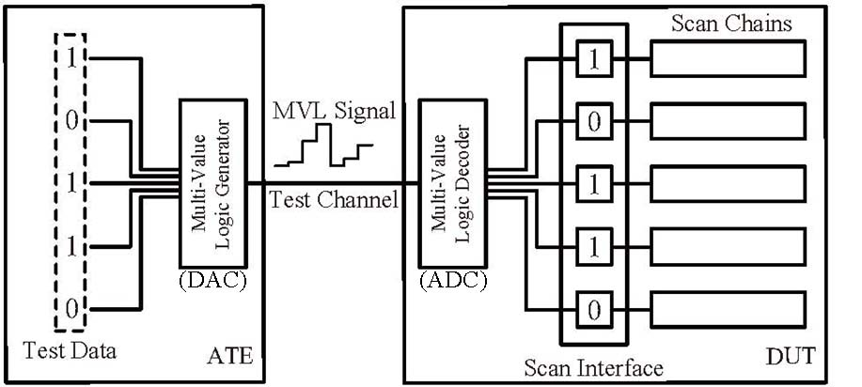
Previous Work: Adopting MVL Signal to Increase Test Channel Capacity
Testing with MVL channel is proposed in our recent work:
- MVL test application [LATS 15]
2⁵ = 32 levels
Data Rate = clock f x log₂N
Enhancement

Slide 8
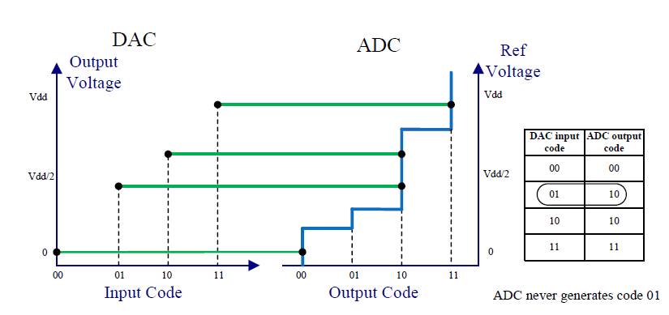
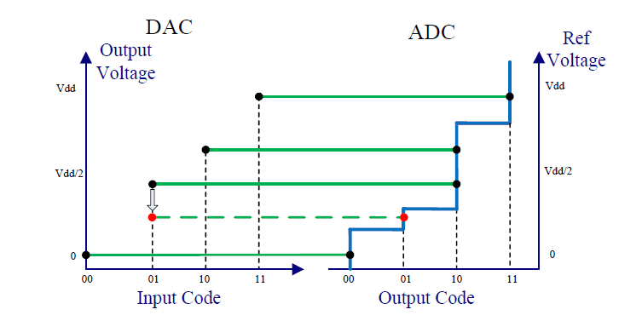
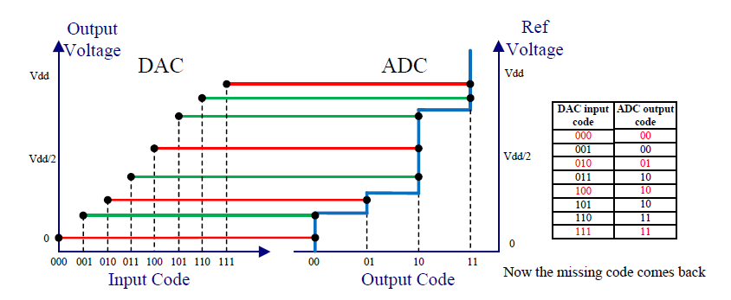
Previous Work: Assuring Error-Free MVL Test Data Application
Two potential error sources for MVL test application
ADC nonlinearities;
Noise effect.
Solutions
Calibration of ADC nonlinearities (use higher resolution DAC to generate calibrated MVL signal)
Error detection and test data reapply. (Error detection circuitry and test flow with repeated test)
Proposed in MVL test application [LATS 15]

Slide 9
MVL Test Channel for Reduced Pin-Count SoCs
How MVL test application resolves test speed sacrifice in RPCT scheme
Scan speed: 1/20 of clock f → 1/5 of clock f
Speed increases by data rate enhancement of MVL channel (log₂16)

Slide 10
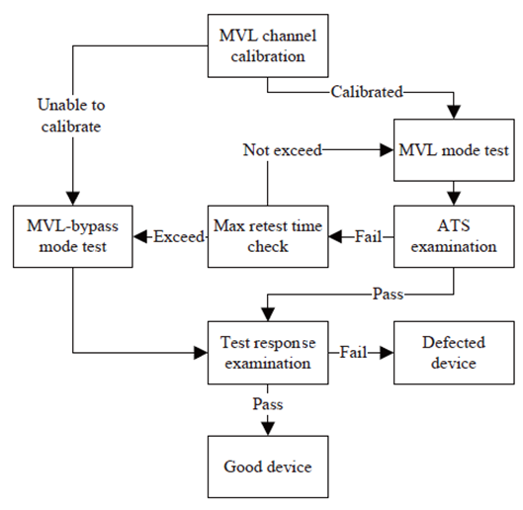
A Test Flow
Requirements on MVL-compatible test flow
Calibration procedure
Applied test data verification
Retest mechanism
MVL-bypass mode test

Slide 11
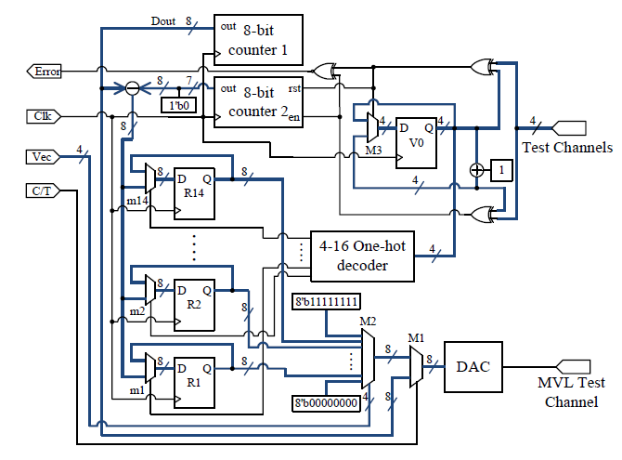
Hardware Design of 4-bit MVL Channel with 8-bit DAC
RTL diagram
Be able to:
Generate MVL signal;
Run ADC calibration.

Slide 12
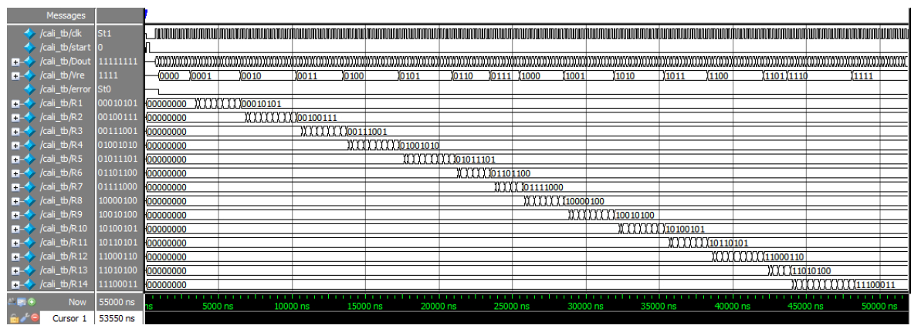
Hardware Design of 4-bit MVL Channel with 8-bit DAC
Simulation result of calibration procedure
Dout is the ramp-up DAC inputs for calibration;
Vre is the captured ADC output, corresponding to Dout;
R1-R14 store the calibrated result.

Slide 13
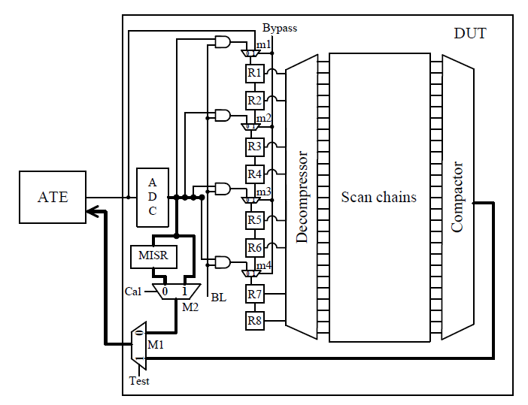
Hardware Design of MVL-Compatible DUT
RTL diagram
Be able to:
Decode MVL signal;
Generate ATS for applied
test data verification;
Switch between MVL test
and MVL-bypass mode.
Mode | Test | BL | Cal | Bypass
ADC Nonlinearity Calibration | 0 | 0 | 1 | 0
MVL Test | 1 | 1 | X | 0
ATS Capture | 0 | 0 | 0 | X
Binary Test | 1 | 0 | X | 1

Slide 14
Experimental Setup and Results
Setup of ATE based experiment
Advanrest T2000GS tester builds MVL test channel
An ADC and a DE2 FPGA board build MVL-compatible DUT with RPCT interface and test decompresser.
Experiments conducted
Apply scan test with compressed test data through RPCT interface using MVL signal
Justify the test speed improvement with MVL channel

Slide 15
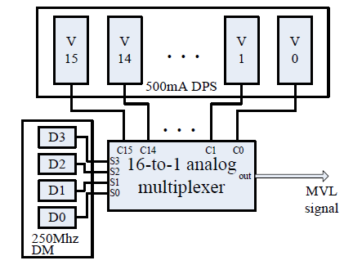
Experimental Setup
Build MVL channel with Advantest T2000GS

Slide 16
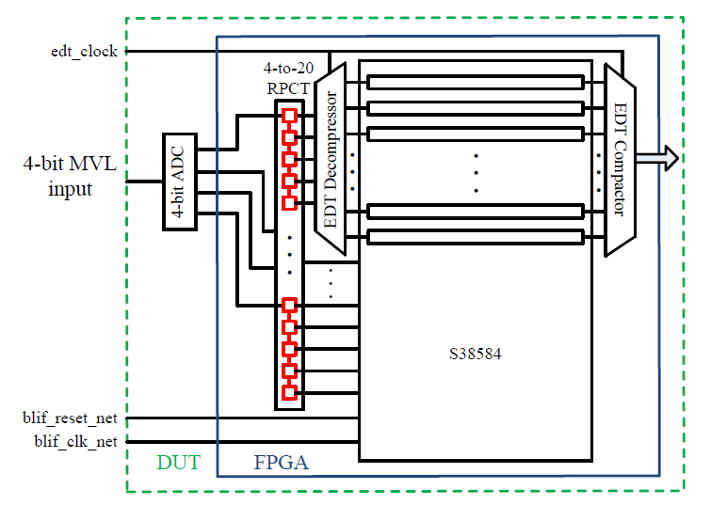
Experimental Setup
Build MVL-compatible device with RPCT and decompresser

Slide 17
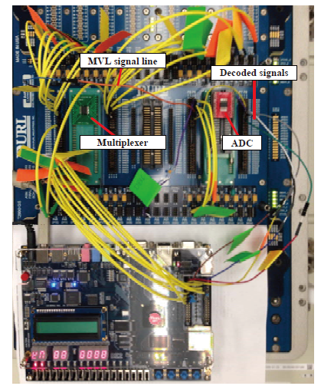
Experimental Setup
Hardware setup

Slide 18
Test Result and Speed Improvement
20 inputs, including EDT channel inputs and other primary inputs, are sent in 4-bit MVL format; clocks and reset remain binary.
Test channels are reduced from 23 to 4.
MVL test feasibility is established by obtaining test result identical to another test case using binary channel and a 1-to-20 RPCT interface.
Test time with MVL channel is 30.88ms, compared to 123.51ms with binary channel (clock f = 2MHz).

Slide 19
Conclusion
Application of MVL test channel on RPCT with test compression is proposed.
Reliability issues and proposed solutions are discussed in previous work [LATS 15]; Hardware and a test flow are proposed in this work.
ATE-based experiments show notable test speed improvement with RPCT.
Overhead remains an issue but will be helped as data converter techniques evolve.

Slide 20
Future Work
Device with integrated ADC should be tested for feasibility.
An experiment to validate ADC calibration scheme should be conducted.
Test flow should be examined with experiments.

Slide 21
Reference
[VTS 11] A. Sanghani et al., “Design and Implementation of A Time-Division Multiplexing Scan Architecture Using Serializer and Deserializer in GPU Chips,” Proc. 29th IEEE VLSI Test Symp., 2011, pp. 219-224.
[ITC 13] K. Chakravadhanula, et al., “SmartScan - Hierarchical Test Compression for Pin-limited Low Power Designs,” Proc. International Test Conf., 2013. Paper 4.2.
[ITC 09] J. Moreau et al., “Running scan test on three pins: yes we can!,” Proc. International Test Conf., 2009, pp. 1-10.
[LATS 15] B. Li et al., Adopting Multi-Valued Logic for Reduced Pin-Count Testing," Proc. 16th Latin-American Test Symposium, 2015.

