Slide 1
Specification Test Minimization for Given Defect Level
Suraj Sindia
Intel Corporation, Hillsboro, OR 97124, USA
szs0063@auburn.edu
Vishwani D. Agrawal
Auburn University, Auburn, AL 36849, USA
vagrawal@eng.auburn.edu
15th IEEE Latin-American Test Workshop
Fortaleza, Brazil
March 13, 2014

Slide 2
Problem Statement
Given a set of complete specification-based tests for an analog or RF circuit, and
An acceptable defect level (DL),
Find the smallest set of tests that should be used.

Slide 3
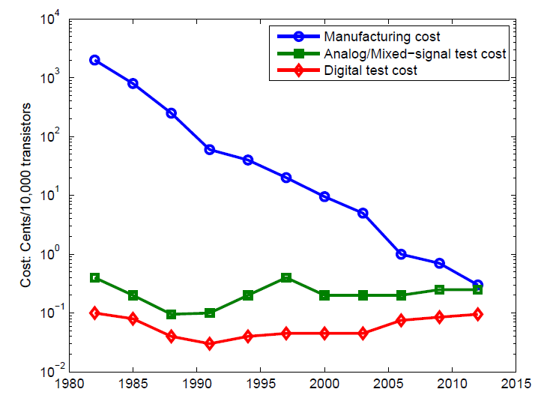
Motivation
International Technology Roadmap for Semiconductors (ITRS) 2009 http://www.itrs.net/Links/2009ITRS/Home2009.htm

Slide 4
What is Defect Level?
Good chip
Bad chip
Tested good
Defect level:
DL = 2/21
Yield loss:
YL = 1/30
Tested bad
True yield:
Y = 20/30
All fabricated chips

Slide 5
Definitions and Assumption
Specification S_{i} is tested by test T_{i}.
Probability of testing S_{j} by T_{i} Is p_{ij}.
Assume that specification tests have zero defect level:
p₁₁ = p₂₂ = ● ● ● = 1.0
This is perhaps the reason why the users and manufacturers of VLSI have more confidence in specification tests than in alternate tests.
This assumption can be relaxed in the future work.

Slide 6
A Bipartite Graph
Tests
T₁
T₂
T₃
T₄
p₁₂
p₃₃
p₁₁
p₂₂
p₁₃
p₄₄
p₄₂
p₂₁
p₃₄
S₁
S₂
S₃
S₄
Specifications

Slide 7
An Integer Linear Program (ILP)
Consider k specifications and k tests.
Define k integer [0,1] variables {x_{i}} for tests {T_{i} }:
Discard T_{i} if x_{i} = 0, else retain T_{i}
Define objective function:
k
minimize ∑ x_{i}
i=1
Next, need linear constraints to stay within given defect level.

Slide 8
Defect Level: A Faulty Device Passes
Defect level is probability of a faulty device passing all tests, i.e.,
Prob{All tests pass | device is faulty}
For given defect level (dl), this conditional probability should not exceed dl, i.e.,
k
1 – ∏ P(S_{j}) ≤ dl
j=1
Where, P(S_{j}) = Probability of testing specification S_{j}
k
= 1 – ∏ (1 – p_{ij})^{x}i
i=1

Slide 9
Giving Equal Weight per Specification
Assume that each specification weighs equally in determining defect level,
P(S₁) = P(S₂) = ● ● ● = P(S_{k})
or 1 – [P(S_{j})]^{k} ≤ dl
or (1 – dl)^{1/k} ≤ P(S_{j}), j = 1, 2, ● ● ● , k
k
or (1 – dl)^{1/k} ≤ P(S_{j}) = 1 – ∏ (1 – p_{ij})^{x}i
i=1
j = 1, 2, ● ● ● , k

Slide 10
Linear Constraints
We derive k linear constraint relations for variables x_{i} and constant dl:
k
(1 – dl)^{1/k} ≤ 1 – ∏ (1 – p_{ij})^{x}i, j = 1, 2, ● ● ● , k
i=1
Therefore,
k
∑ x_{i} ln(1 – p_{ij}) ≤ ln[1 – (1 – dl)^{1/k}],
i=1 j = 1, 2, ● ● ● , k

Slide 11
Operational Amplifier: TI LM741

Slide 12
LM741 Specifications
Test | Specification | Values |  |  | Unit
 | Description | Min. | Nom. | Max.
T₁ | DC gain | 50 | 200 |  | V/mV
T₂ | Slew rate | 0.3 | 0.5 |  | V/μs
T₃ | 3-dB bandwidth | 0.4 | 1.5 |  | MHz
T₄ | Input referred offset voltage |  | ±10 | ±15 | mV
T₅ | Power supply rejection ratio | 86 | 96 |  | dB
T₆ | Common mode rejection ratio | 80 | 95 |  | dB
T₇ | Input bias current |  | 30 | 80 | nA

Slide 13
Monte Carlo Simulation
Simulate sample circuits for tests T₁ through T₇ using spice.
5,000 circuit samples generated:
5% random deviation around nominal value of each components (12 resistors and 1 capacitor)
10% random deviation in DC gain of each BJT

Slide 14
Compute probabilities p_{ij}
X = circuits failing T_{i}
Y = circuits failing T_{j}
Z = circuits failing both T_{i} and T_{j}
p_{ij} = Prob{Test T_{j} fails | spec S_{i} is faulty} = Z/Y
Example:
45 circuits had spec. S₁ failure, detected by T₁
81 circuits had spec. S₂ failure, detected by T₂
17 circuits had both failures
p₁₂ = 17/81 = 0.21, p₂₁ = 17/45 = 0.38, p₁₁ = p₂₂ = 1.0

Slide 15
Spice Simulation of 5,000 Samples
Samples failing T₁
p₁₂ = 17/81
= 0.21
p₂₁ = 17/45
= 0.38

Slide 16
Probabilities p_{ij} for LM741
p_{ij} | T₁ | T₂ | T₃ | T₄ | T₅ | T₆ | T₇
S₁ | 1.00 | 0.38 | 0.78 | 0.51 | 0.76 | 0.93 | 0.98
S₂ | 0.21 | 1.00 | 0.75 | 0.20 | 0.27 | 0.35 | 0.27
S₃ | 0.56 | 0.97 | 1.00 | 0.19 | 0.21 | 0.51 | 0.38
S₄ | 0.92 | 0.64 | 0.48 | 1.00 | 0.84 | 0.76 | 1.00
S₅ | 0.92 | 0.59 | 0.35 | 0.57 | 1.00 | 0.59 | 0.84
S₆ | 0.80 | 0.54 | 0.62 | 0.37 | 0.42 | 1.00 | 0.87
S₇ | 0.61 | 0.31 | 0.33 | 0.35 | 0.43 | 0.63 | 1.00

Slide 17
ILP
Define x_{i} ε [0,1], such that x_{i} = 0 ⇒ discard T_{i}.
Objective function:
7
minimize ∑ x_{i}
i=1
Subject to:
7
∑ x_{i} ln(1 – p_{ij}) ≤ ln[1 – (1 – dl)^{1/7}],
i=1 j = 1, 2, ● ● ● , 7
where dl = defect level

Slide 18
Test Minimization
DL PPM | ILP solution |  |  |  |  |  |  | Tests selected | Test size reduction
 | x₁ | x₂ | x₃ | x₄ | x₅ | x₆ | x₇
0 | 1 | 1 | 1 | 1 | 1 | 1 | 1 | 7 | 0%
1 | 1 | 1 | 1 | 0 | 1 | 1 | 1 | 6 | 14%
100 | 1 | 1 | 1 | 0 | 1 | 1 | 1 | 6 | 14%
1,000 | 0 | 1 | 1 | 0 | 1 | 1 | 1 | 5 | 29%
10,000 | 0 | 1 | 0 | 0 | 1 | 1 | 1 | 4 | 43%

Slide 19
Conclusion
ILP provides an effective tradeoff between test cost (test time) and quality (defect level).
Test time may further reduce if shorter tests are favored in the cost function.
The assumption of equal weight for each specification can be removed by adding weight to critical specifications.
Defect introduction in Monte Carlo samples need careful examination.
Diagnostic tests may need to preserve diagnostic resolution rather than defect level.
Applications to alternate test could be a useful extension.

