Slide 1
Minimum Energy CMOS Design with Dual Subthrehold Supply and Multiple Logic-Level Gates
Kyungseok Kim and Vishwani D. Agrawal
ECE Dept. Auburn University
Auburn, AL 36849, USA
ISQED 2011, Santa Clara, CA, USA
March 16, 2011

Slide 2
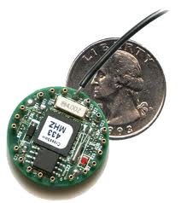
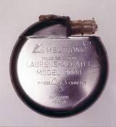
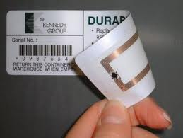
Subthreshold Circuits
Vdd < Vth
Emin
Low
to Medium
Speed
Micro-sensor networks, Pacemakers, RFID tags, and Portable devices

Slide 3
Motivation
Energy budget is more stringent for long battery life.
Minimum energy operation has a huge penalty in system performance, limiting its applications to niche market.
Utilizing time slack for low power design is common at above-threshold, but has not been explored in subthreshold regime.
Sizing affects functional failure [1] and multi-Vth may not be adequate to utilize time slack in subthreshold region [2].
Two supply voltages are manageable and acceptable in modern VLSI systems.

Slide 4
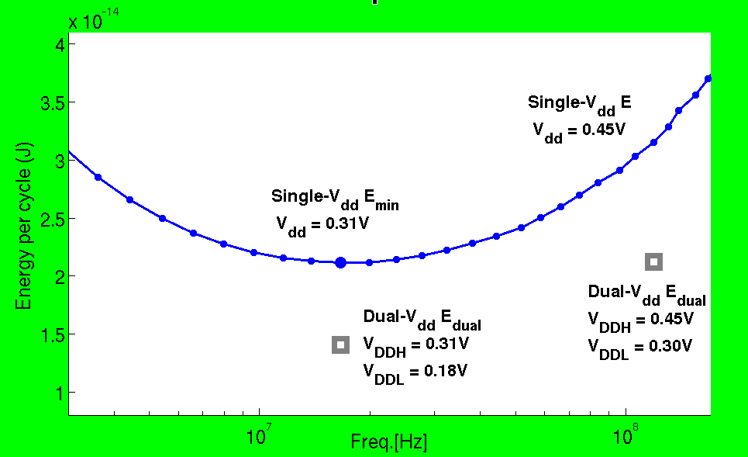
32-bit Ripple Carry Adder*
0.67X
7.17X
* SPICE Simulation of PTM 90nm CMOS

Slide 5
Low Power Design Using Dual-V_{dd}
CVS Structure [3]
FF
FF/
LCFF
LC
ECVS Structure [4]
FF
FF/
LCFF
VDDH
VDDL

Slide 6
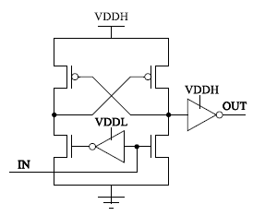
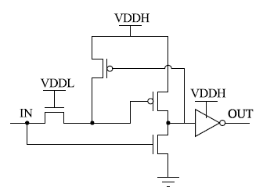
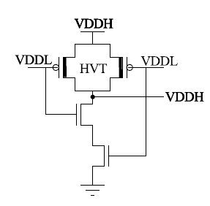
Multiple Logic-Level Gates (Delay)
ALCs | V_{DDH} = 300mV V_{DDL} = 230mV | Norm to INV(FO4) V_{dd} = V_{in} = 300mV
DCVS | 79.1ns | 60.4
PG | 37.6ns | 28.7
** Optimized Delay by Sizing
with HSPICE
DCVS
PG
Multiple Logic-Level Gates V_{VDDH} = 300mV V_{VDDL} = 230mV | Norm to INV(FO4) V_{dd} = V_{in} = 300mV
INV | 1.3
NAND2 | 2.3
NAND3 | 3.1
NOR2 | 3.9
Multiple Logic-Level NAND2 [5]
** SPICE Simulation for PTM 90nm CMOS

Slide 7
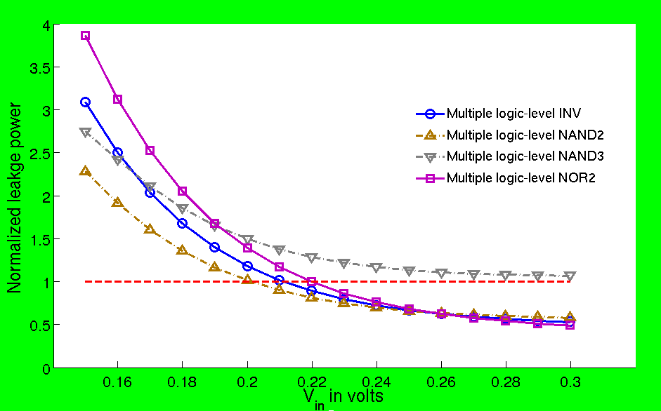
Multiple Logic-Level Gates (Pleak)
Vdd = 300mV
Normalized to a standard INV with Vdd = Vin = 300mV
** SPICE Simulation for PTM 90nm CMOS

Slide 8
MILP for Minimum Energy Design
Objective Function:
Total Energy per cycle
$$Minimize\sum_{i}{\left[ \sum_{v∈V}{\left(α_{i}{∙C}_{i,v}∙V_{dd,v}^{2}+P_{leak,i,v}∙T_{c}\right)}∙X_{i,v}+\sum_{v∈V_{L}}{P_{leako,i,v}∙T_{c}∙}P_{i,v} \right]}, ∀i ∈all gates$$
$$V_{min}≤V≤V_{VDDH}, V_{low} ≤V_{L}≤V_{DDH}$$
Leakage energy penalty
from multiple logic-level gates
**Integer variable Xi,v and Pi,v

Slide 9
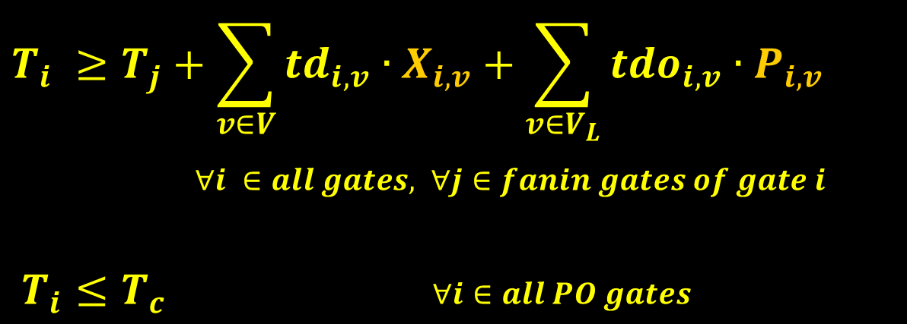
Timing Constraints
Delay penalty from multiple logic-level gates
$$T_{i} ≥T_{j}+\sum_{v∈V}{{td}_{i,v}}∙X_{i,v}+\sum_{v∈V_{L}}{{tdo}_{i,v}}∙P_{i,v}$$
$∀i ∈all gates, ∀j∈fanin gates of gate i$
$T_{i}≤T_{c}$ $∀i∈all PO gates$
Ti is the latest arrival time at the output of gate i
from PI events

Slide 10
Penalty Constraints
$$F_{i,v}+X_{i,VDDH}≥2∙P_{i,v} ∀i ∈all gates$$
$F_{i,v}+X_{i,VDDH}≤2∙P_{i,v}+1$ $∀v∈ V_{L}$
Boolean AND
$$\sum_{j}{X_{j,v}}≤N_{i}∙F_{i,v} ∀j ∈fanin gates of gate i$$
$$\sum_{j}{X_{j,v}}≥N_{i}∙F_{i,v}−\left(N_{i}−1\right) ∀i ∈all gates , ∀v∈V_{L}$$
Boolean OR
$$\sum_{v∈V}{V_{dd,v}}∙X_{i,v}≤\sum_{v∈V}{V_{dd,v}}∙X_{j,v}+\sum_{v∈V_{L}}{V_{nom}}∙P_{i,v}$$
$∀j ∈fanin gates of gate i$

Slide 11
Dual Supply Voltages Selection
$$\sum_{v∈V}{V_{v}}=2 V_{VDDH}=1$$
$$\sum_{v∈V}{X_{i,v}}=1 ∀i ∈all gates , ∀v∈V_{L}$$
$$\sum_{i}{X_{i,v}}≤G_{tot}∙V_{v}$$
Bin-packing [6]

Slide 12
ISCAS’85 Benchmark
Bench mark | Total gate | Activity α | V_{DDH} (V) | V_{DDL} (V) | V_{DDL} gates (%) | Multiple logic-level gates(#) | E_{sing.} (fJ) | E_{dual} (fJ) | Freq. (MHz)
C432 | 154 | 0.19 | 0.25 | 0.23 | 5.2 | 0 | 7.9 | 7.8 | 14.4
C499 | 493 | 0.21 | 0.22 | 0.18 | 9.7 | 0 | 20.2 | 19.8 | 11.9
C880 | 360 | 0.18 | 0.24 | 0.19 | 56.7 | 23 | 14.4 | 10.9 | 13.6
C1355 | 469 | 0.21 | 0.21 | 0.18 | 10.2 | 0 | 19.5 | 19.0 | 9.8
C1908 | 584 | 0.20 | 0.24 | 0.21 | 27.6 | 71 | 26.5 | 23.2 | 11.8
C2670 | 901 | 0.16 | 0.25 | 0.19 | 40.2 | 41 | 32.8 | 26.9 | 17.4
C3540 | 1270 | 0.33 | 0.23 | 0.16 | 40.8 | 69 | 88.0 | 70.8 | 7.2
C5315 | 2077 | 0.26 | 0.24 | 0.19 | 60.5 | 62 | 116.8 | 92.2 | 9.8
C6288 | 2407 | 0.28 | 0.29 | 0.19 | 4.7 | 20 | 165.4 | 159.1 | 9.4
C7552 | 2823 | 0.20 | 0.25 | 0.21 | 51.6 | 201 | 131.7 | 112.1 | 13.6
** PTM 90nm CMOS

Slide 13
Total Energy Saving (%)

Slide 14
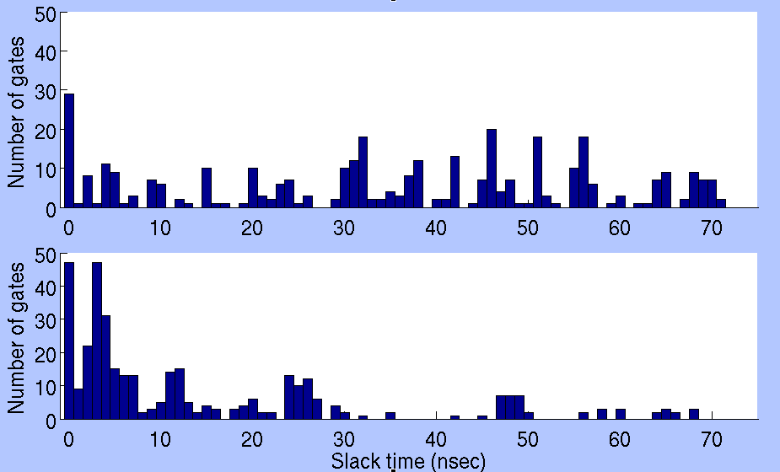
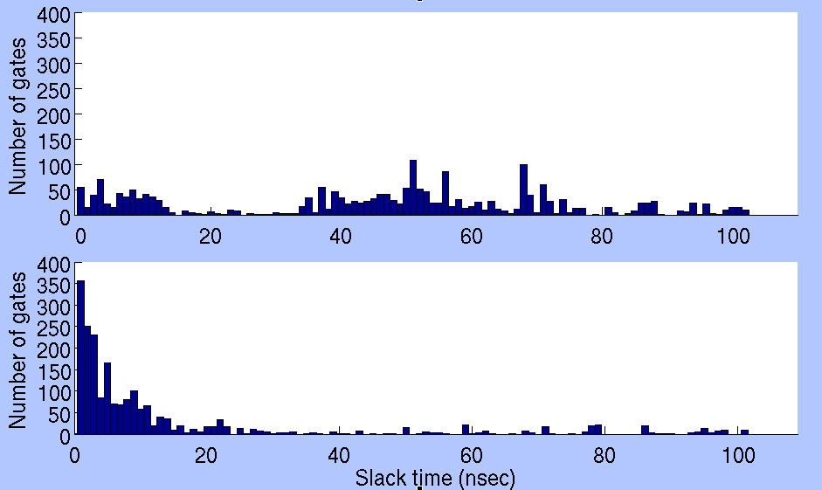
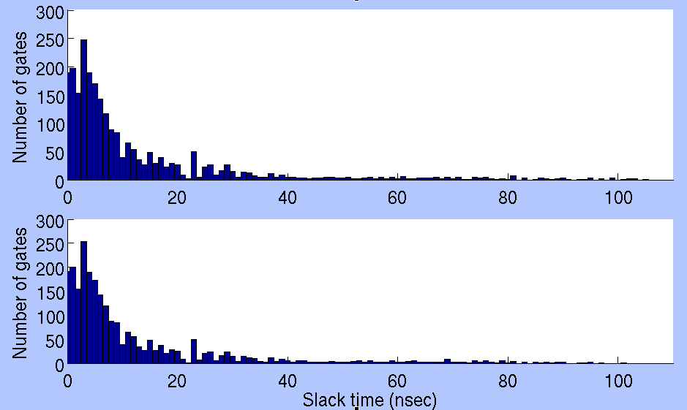
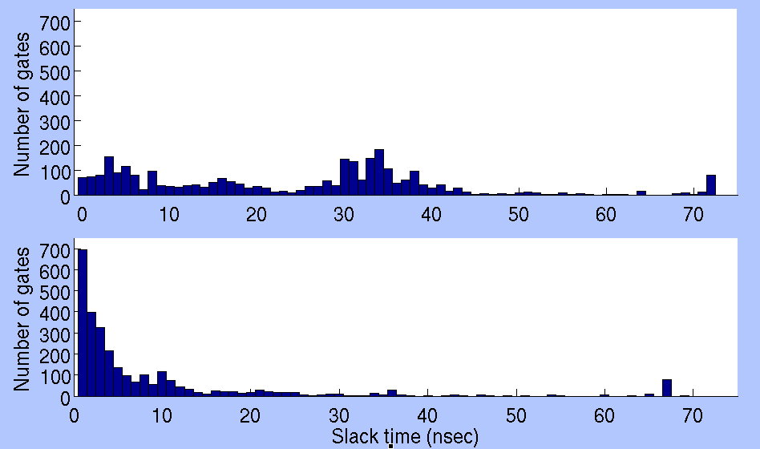
Gate Slack Distribution
c880
c5315
Optimized
Optimized
c6288
c7552
Optimized
Optimized

Slide 15
Conclusion & Future Work
Dual Vdd design is valid for energy reduction below the minimum energy point in a single Vdd as well as for substantial speed-up within tight energy budget of a bulk CMOS subthreshold circuit.
Use of a conventional level converter is not affordable by huge delay penalty for dual-Vdd design in subthreshold regime.
Delay of a subthreshold circuit is susceptible to process variation and accounting for that aspect is needed.
Runtime of MILP is too expensive and gate slack analysis can reduce the exponential time complexity of MILP to linear.

Slide 16
References
[1] A.Wang, B. H. Calhoun, and A. P. Chandrakasan, Sub-Threshold Design for Ultra Low-Power Systems. Springer, 2006..
[2] D. Bol, D. Flandre, and J.-D. Legat, “Technology Flavor Selection and Adaptive Techniques for Timing-Constrained 45nm Subthreshold Circuits,” in Proceedings of the 14th ACM/IEEE International Symposium on Low Power Electronics and Design, 2009, pp. 21–26.
[3] K. Usami and M. Horowitz, “Clustered Voltage Scaling Technique for Low-Power Design,” in Proc. International Symposium on Low Power Design, 1995, pp. 3–8.
[4] K. Usami, M. Igarashi, F. Minami, T. Ishikawa, M. Kanzawa,M. Ichida, and K. Nogami, “Automated Low-Power Technique Exploiting Multiple Supply Voltages Applied to a Media Processor,” IEEE Journal of Solid-State Circuits, vol. 33, no. 3, pp. 463–472, 1998.
[5] A. U. Diril, Y. S. Dhillon, A. Chatterjee, and A. D. Singh, “Level-Shifter Free Design of Low Power Dual Supply Voltage CMOS Circuits Using Dual Threshold Voltages,” IEEE Trans. on VLSI Systems, vol. 13, no. 9, pp. 1103–1107, Sept. 2005.
[6] M. Anis, S. Areibi, M. Mahmoud, and M. Elmasry, “Dynamic and Leakage Power Reduction in MTCMOS Circuits using an Automated Efficient Gate Clustering Technique,” in Proc. 39th Design Automation Conf., 2002, pp. 480–485.
[7] K. Kim and V. D. Agrawal, “True Minimum Energy Design Using Dual Below-Threshold Supply Voltages,” in Proc. 24th International Conference on VLSI Design, Jan. 2011.

Slide 17
Thank you!!
&
Questions?

