Slide 1

Power-Aware System-On-Chip Test Optimization
General Exam
Vijay Sheshadri
Committee Chair: Dr. Prathima Agrawal
Committee Members: Dr. Vishwani D. Agrawal
Dr. Adit Singh
Dept. of Electrical and Computer Engineering
Auburn University, AL 36849, USA

Slide 2
Outline
Introduction
Problem Statement
ILP-based Optimization
  Results
Heuristic-based Optimization
  Results
Conclusion
Future Work

Slide 3
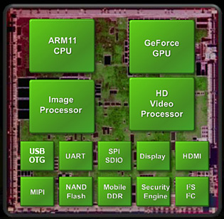
Introduction
What is System-on-Chip?
  A complete system integrated onto a single chip.
*http://www.xbitlabs.com/news/mobile/display/20080603141353_Nvidia_Unleashes_Tegra_System_on_Chip_for_Handheld_Devices.html

Slide 4
Introduction
SoC & Smartphone
  SoCs are backbone of Smartphone growth
Single-core, 1GHz
Quad-core, 1.5 GHz
2004
2008
2009
2010
2011
2012
2013
Dual-core, 1–1.5 GHz
Octa-core, 1.6 GHz
Single-core, 400-800 MHz
*Compiled from: http://en.wikipedia.org/wiki/Comparison_of_smartphones#2004

Slide 5
Introduction
SoC advantages:
  Small area
  Low power
  Modularity

Slide 6
Introduction
Testing a SoC
  Modular testing – individual (often independent) core tests
Core ‘A’
Test Source
T_In
T_Out
Test
Test Sink
Test
Test Bus
Data
T_In
T_Out
Data
Core ‘B’
SoC

Slide 7
Introduction
Testing a SoC
  More cores → larger test data → longer test time
Test multiple cores simultaneously
  Increased power consumption

Slide 8
Problem Statement
Given an SoC with N core tests and a peak power budget, find a test schedule to:
  Test all cores
  Reduce overall test time
  Conform to SoC test power budget

Slide 9
Integer Linear Program (ILP)
Given:
  Power budget for SoC, P_{max}
  N core tests for an SoC
    t_{i} = test time and p_{i} = test power of i^{th} test
  N core tests grouped into K test sessions
    Test time of j^{th} session is, T_{j} = max{t_{i}}
    Test power of j^{th} session is, P_{j} = ∑ (p_{i})
Subset of K sessions form the SoC test schedule

Slide 10
ILP formulation
Objective:
      Minimize , where
Subject to:
  Power constraint:
  Test completeness constraint:

Slide 11
Variable Test Clock Frequency
Test time and power linearly dependent on test clock rate
Increasing test clock frequency by a factor f =>
Test time, and Test power,
Proper choice f for each test session can optimize overall test time

Slide 12
Frequency factor
Scaling factor to vary test clock frequency per session
  Reference/Nominal case: constant clock rate for entire test schedule
Frequency factor limited by:
  P_{max} (Power Budget)
  Max. clock rate of individual cores

Slide 13
Core Frequency Constraints
Each core’s max. clock rate decided by:
  Max. power limit of core (power constraint)
  Critical path delay (structure constraint)
Both constraints also influenced by V_{DD}.
  Power Constraint:
  Structure constraint:
(Alpha power law*)
* T. Sakurai and A. R. Newton, “Alpha-Power Law MOSFET Model and its Applications to CMOS Inverter Delay and Other Formulas,” IEEE Journal of Solid-State Circuits, vol. 25, no. 2, pp. 584–594, Apr. 1990.

Slide 14
Influence of V_{DD} on Test time
Power constrained test:
Structure constrained test:
An optimal V_{DD} can balance the two constraints.

Slide 15
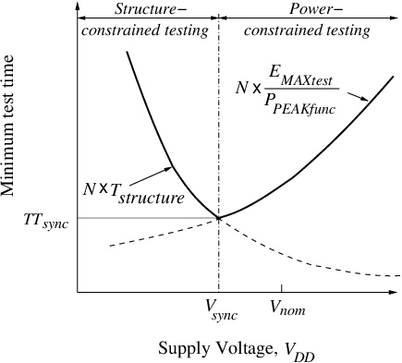
Optimum V_{DD} point
P. Venkataramani , S. Sindhia and V. D. Agrawal, “A Test Time Theorem and Its Applications,” Proc. 14th IEEE Latin-American Test Workshop, Apr. 2013.

Slide 16
Mixed-Integer Linear Program (MILP)
Objective:
      Minimize
      , where
Voltage range divided into small steps
  Binary variable selects voltage
  Real-valued variable for frequency factor

Slide 17
MILP Formulation
Subject to:
  Power Budget Constraint:
  Session power pre-calculated for each voltage step

Slide 18
MILP Formulation
Subject to:
  Clock Constraint
    Power constraint:
    Structure constraint:
  F_{p} = limit imposed by core’s max. power limit
  F_{s} = limit imposed by core’s critical path

Slide 19
MILP Formulation
Subject to:
  Other constraints:
    Test completeness constraint
Non-linear Model: Linearized with simple substitution*.
V. Sheshadri, V. D. Agrawal and P. Agrawal, “SoC test time minimization by per-session assignment of VDD and clock," submitted to ICCAD 2013

Slide 20
MILP - Results
Results compared:
  Case 1: V_{DD} and test clock fixed at nominal value (nominal case)
  Case 2: Nominal V_{DD} ; test clock optimized per session
  Case 3: V_{DD} and test clock optimized per session (this work)
Assumptions:
  V_{DD} range = [1.0V. 0.6V]
  V_{TH} = 0.5V, α = 1.0

Slide 21
MILP - Results
Example benchmark: ASIC Z^{[1]}
  Previously published optimal test time of 300 units^{[2]}
RAM 2
(61,241)
RAM 3
(38,213)
Random logic 1 (134, 295)
Random logic 2 (160, 352)
Blocks of ASIC Z, and their test time (in a.u.) and test power (in mW)
ROM 1
(102,279)
ROM 2
(102,279)
RAM 4
(23,96)
RAM 1
(69,282)
Reg. file
(10,95)
P_{max}= 900
Block
(test time, power)
[1] Y. Zorian, “A distributed control scheme for complex VLSI devices,” Proc. VTS, Apr. 1993, pp. 4–9.
[2] E. Larsson and Z. Peng, “Test Scheduling and scan-chain division under power constraint,” Proc. ATS, Nov. 2001, pp 259-264

Slide 22
MILP - Results
ASIC Z:
  Case 1: Nominal case = 300 units
Case 2
Session | Freq. factor | Test time
RAM1, ROM1 | 1.5 | 68
RAM2, RAM3 | 1.98 | 30.771
RAM4, RF | 4.712 | 4.881
ROM2, RL1, RL2 | 0.972 | 164.622
Total Test time = |  | 268.274
Case 3
Session | Freq. factor | VDD | Test time
RF | 12.5 | 0.8V | 0.8
RAM 1,2,3,4 | 2.56 | 0.65V | 26.95
ROM 1,2, RL 1,2 | 1.3278 | 0.75V | 120.5
Total Test time = |  |  | 148.25

Slide 23
MILP - Results
Test times for other benchmarks
    Test times normalized with respect to Case 1
Test time reduction:
50-70% over Case 1
40-45% over Case 2
[1] E. Larsson , Introduction to Advanced System-on-Chip Test Design and Optimization, Springer, 2005
[2] V. Muresan et al, “A Comparison of Classical Scheduling Approaches in Power-Constrained Block-Test Scheduling,” Proc. ITC’00, pp. 882–891
[3] J. Pouget et al,“An Efficient Approach to SoC Wrapper Design, TAM Configuration and Test Scheduling,” Proc. IEEE ETW’03, pp. 51–56.

Slide 24
Heterogeneous SoC
Modern SoCs are heterogeneous
  Combination of AMS circuits, memory blocks, logic blocks
  Separate voltage and clock requirements
  Optimizer needs to adapt to individual core’s specification
  To reflect this requirement, dual voltage range assigned
    [1.5V, 1.2V] with nominal VDD = 1.5V
    [1.0V, 0.6V] with nominal VDD = 1.0V

Slide 25
MILP - Results
Test time minimization for ASIC Z
 |  | Case 1 | Case 2 |  | Case 3
VDD Range | Session | Test time | Freq. Factor | Test time | Freq. Factor | VDD | Test time
[1.0V, 0.6V] | RAM 3,4, | 38 | 2.91 | 13.05 | 5.19 | 0.7V | 7.317
 | RAM1, ROM2,RL1 | 134 | 1.05 | 127.45 | 1.72 | 0.75V | 77.83
[1.5V, 1.2V] | RF, | 10 | 8.0 | 1.25 | 12.5 | 1.2V | 0.8
 | RAM2, ROM1,RL2 | 160 | 1.0 | 160 | 1.33 | 1.3V | 120.17
Total Test time |  | 342 |  | 301.75 |  |  | 206.117

Slide 26
MILP - Results
Test times for other benchmarks
    Test times normalized with respect to Case 1
Test time reduction:
40-65% over Case 1
30-40% over Case 2
[1] E. Larsson , Introduction to Advanced System-on-Chip Test Design and Optimization, Springer, 2005
[2] V. Muresan et al, “A Comparison of Classical Scheduling Approaches in Power-Constrained Block-Test Scheduling,” Proc. ITC’00, pp. 882–891
[3] J. Pouget et al,“An Efficient Approach to SoC Wrapper Design, TAM Configuration and Test Scheduling,” Proc. IEEE ETW’03, pp. 51–56.

Slide 27
Heuristic Algorithms
ILP methods are NP-hard*
  Problem size grows quickly with no. of cores
  Large amounts of CPU time
Heuristic methods offer better alternative
  Often based on greedy approach
  Capable of near-optimal solutions
  Less CPU time than ILP method
* K. Chakrabarty, “Test Scheduling for Core-Based Systems,” Proc. IEEE/ACM ICCAD, Nov. 1999, pp.391–394.

Slide 28
Heuristic for Session-based Testing
list1 = list of core tests to be scheduled {initially contains all core tests}
t_{sch} = test time of the test schedule
Start
Initialize list1, t_{sch}
List1 empty?
Yes
Stop
No
Initialize list2
list2 = list of core tests currently run {initially empty}
t_{sch} = t_{sch} +max{t_{i}}, where i Є list2
No
P' < P_{max}?
Yes
Test time of longest test in session
Randomly select test from list1
Add test to list2
Update freq. factor(F),
test power (P).
P’ = PF

Slide 29
Heuristic for Session-based Testing
Results
  Experiments on ITC02 benchmarks*
Benchmark | no. of cores | Test time |  |  | CPU time (secs)
 |  | ILP | heur | % diff | ILP | heur
a586710 | 7 | 13011131 | 13011131 | 0 | 0.17 | 0.71
h953 | 8 | 121715.3 | 121715.3 | 0 | 0.44 | 0.85
ASIC Z | 9 | 268.274 | 269.5 | -0.457 | 1.47 | 1.08
d695 | 10 | 12730.74 | 12939.59 | -1.62 | 5.13 | 1.3
g1023 | 14 | 19888.7 | 19888.7 | 0 | 1480 | 4.53
* ITC 2002 SOC Benchmarking Initiative: http://www.extra.research.philips.com/itc02socbenchm
Power profile for benchmarks from: S. K. Millican and K. K. Saluja (http://homepages.cae.wisc.edu/~millican/bench/)

Slide 30
Heuristic for Session-based Testing
Runtime comparison of ILP vs Heuristic*
    Simulations performed on a Dell workstation with a 3.4 GHz Intel Pentium processor and 2GB memory
* V. Sheshadri, V. D. Agrawal and P. Agrawal, “Session-Based and Session-Less SoC Test Schedules with Frequency Scaling”, submitted to ITC 2013.

Slide 31
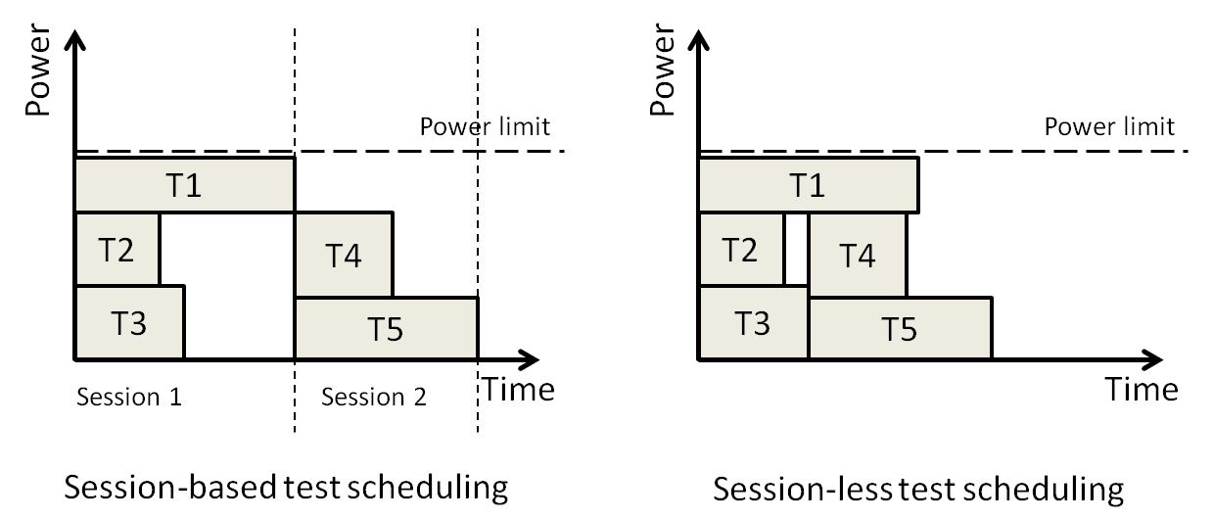
Heuristic for Session-less Testing
Session-less testing:
  New tests scheduled immediately after completion of old tests
  No session boundaries

Slide 32
Heuristic for Session-less Testing
Session-less testing further divided into:
  Preemptive* – Test can be interrupted or restarted anytime
  Non Preemptive – Tests cannot be interrupted
Test ‘X’
Test ‘X1’
Test ‘X2’
Test time = t
Test time = t1
t2
(t1 + t2 = t)
* V. Iyengar and K. Chakrabarty, ”Precedence-Based, Preemptive and Power Constrained Test Scheduling for System-on-Chip,” Proc. VTS’02, pp 253-258

Slide 33
Heuristic for Session-less Testing
list1 = list of core tests to be scheduled {initially contains all core tests}
t_{sch} = test time of the test schedule
Start
Initialize list1, t_{sch}
List1 empty?
Yes
Stop
No
Initialize list2
list2 = list of core tests currently run {initially empty}
Test time of completed test
t_{sch} = t_{sch} +min{t_{i}}, where i Є list2
No
P' < P_{max}?
Yes
Preempt unfinished tests.
Add as new tests to list1
Randomly select test from list1
Add test to list2
Update freq. factor(F),
test power (P).
P’ = PF

Slide 34
Heuristic for Session-less Testing
list1 = list of core tests to be scheduled {initially contains all core tests}
t_{sch} = test time of the test schedule
Start
Initialize
list1, list2, t_{sch}
list2 = list of core tests currently run {initially empty}
list1 & list2 empty?
Stop
Yes
Test time of completed test
No
t_{sch} = t_{sch} +min{t_{i}}, where i Є list2
No
P' < P_{max}?
Yes
Randomly select test from list1
Add test to list2
Retain unfinished tests in list2
Update freq. factor(F),
test power (P).
P’ = PF

Slide 35
Heuristic for Session-less Testing
Results
  Test times compared with session-based testing
Benchmark | Test time for session-based testing | Test time for session-less testing
 |  | Pre-emptive | % | Non pre-emptive | %
a586710 | 13011130.62 | 12501982 | 3.91 | 12501982 | 3.91
h953 | 121715.34 | 96716.29 | 20.54 | 96716.29 | 20.54
ASIC Z | 268.274 | 238.58 | 11.07 | 239.47 | 10.74
d695 | 12730.738 | 10005.8 | 21.4 | 9875.6 | 22.43
g1023 | 19888.7 | 14070.95 | 29.25 | 13989 | 29.66

Slide 36
Ongoing Task
Heuristic for VDD Optimization
After populating
list2
list2 = list of currently running core tests
Reduce VDD by one step
Update freq. factor (F)
Find t_{sch}
t_{sch} = test time of the test schedule
Yes
Is t_{sch} lower?
No
Increase VDD by one step
Update freq. factor (F) and t_{sch}

Slide 37
Conclusion
Main contribution: Optimal selection of V_{DD} and clock rate for power-aware SoC test optimization
  Exact (MILP) and heuristic methods presented
  MILP method: Up to 70% reduction in test time
  Heuristic solutions comparable to ILP
    Large savings on CPU time for higher number of cores
  Heuristics also capable of session-less scheduling
    Up to 30% reduction in test time compared to session-based testing

Slide 38
Future work
Directed Search based heuristic
  Heuristic based on random search not efficient
    More data points required for better optimization results as SoC size increases
Test scheduling for SoCs with IEEE P1687 interface
  Proposed standard with flexible scan architecture
ILP method for Session-less test scheduling

Slide 39
Publications
  V. Sheshadri, V. D. Agrawal, and P. Agrawal, “Optimal power-constrained SoC test schedules with customizable clock rates,” Proc. 25th IEEE System-On-Chip Conf., Sep 2012, pp. 271–276.
  V. Sheshadri, V. D. Agrawal and P. Agrawal, “Optimum Test Schedules for SoC with Specified Clock Frequencies and Supply Voltages”, Proc. International Conference on VLSI Design, Jan 2013, pp. 267-272.
  V. Sheshadri, V. D. Agrawal and P. Agrawal, “Session-Less SoC Test Scheduling with Frequency Scaling”, to be presented at NATW, May 2013.
  V. Sheshadri, V. D. Agrawal and P. Agrawal, “Session-Based and Session-Less SoC Test Schedules with Frequency Scaling”, submitted to ITC 2013.
  V. Sheshadri, V. D. Agrawal and P. Agrawal, “SoC test time minimization by per-session assignment of VDD and clock”, submitted to ICCAD 2013.

Slide 40
Thank you

