Slide 1
Reducing ATE Test Time BY Voltage and Frequency SCALING
By Praveen Venkataramani
Committee
Prof. Vishwani D. Agrawal (Advisor)
Prof. Adit D. Singh
Prof. Fa Foster Dai

Slide 2
Agenda
Background
Problem statement
Prior work
A test time theorem
Test time reduction methods
Summary
Future work
Notes:
We are going to go through

Slide 3
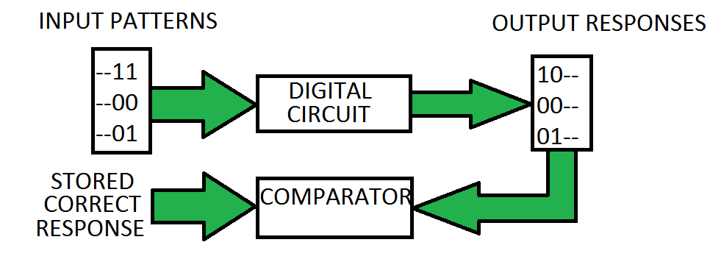
TEST
Notes:
Figure illustrates the basic principle of digital testing. The test vectors are applied to the inputs of the circuit.
The response of the circuit is compared with the expected response that is stored in a memory internal or external to the circuit under test
Circuit pass the test if the response match else it fails the test.

Slide 4
Background: methods of testing
Testing can be perform using
  Built In Self Test (BIST)
    Circuit tests itself.
    Contains test pattern generator and output response analyzer.
    Test per scan or Test per clock
  External Test – Automated Test Equipment, Bench Test.
    Patterns are applied externally to the circuit under test.
    Circuit response is captured and analyzed externally
Notes:
Test per scan: the test is applied and verified after each scan cycle = to the length of scan chain.
Test per clock: the test is applied and verified every clock cycle.

Slide 5
Background: Scan Test
Combinational
logic
PO
Sequential devices are hard to test.
Sequential devices are tested as combinational circuits by inserting scan flip flops.
Scan test consists of a shift mode and a capture mode.
PI
SO
DFF
DFF
SI
SE

Slide 6
Background: Scan test procedure
Test pattern is shifted serially, setting scan enable (SE) high, through the scan flip flops during scan shift.
Circuit is configured to capture by setting SE to low for one cycle.
Captured response is shifted out in the next cycle
Number of scan shift cycles depends on the length of the scan chain
Each flip flop may toggle during scan shift and capture.

Slide 7
Problem Statement
Power consumption during test must not exceed the specified budget often implying increased test time.
Long test time increases cost; test time can be very long for scan based testing.
Need to reduce test time without exceeding power budget.
Notes:
Large test time is expensive
Low power devices use large number of test patterns that are modified to dissipate less power during test to achieve high fault coverage.
Clock frequency is limited by the power dissipated due to large number signal transitions that normally do not occur in functional operation.

Slide 8
Prior Work
Pattern overlapping - Reduce unwanted scan operations by using similar patterns. [Chloupek’12]
Reusable scan chains - Unwanted scan shifts are avoided. [Lai’93]
Activity monitor in BIST circuits - Monitor the activity in the vector from LFSR to manipulate the clock period dynamically. [Shanmugasundaram’12]
Employing both BIST and ATE - Use BIST for easy-to-detect faults and then the ATE to identify the hard-to-detect faults. [Hashempour’02]
Simultaneous testing – Two or more cores are tested in parallel. [Zhao’03]
Notes:
Various methods have been researched over years and few references are given here that talks about the corresponding methods
Pattern overlapping – find a test vector that would share bit values from the test vector start with the scan-chains bit values at the end.
Reusable scan chains – Similar to pattern overlapping method, in the referenced paper they also use a two phase method where in first phase the circuit is tested as a scanless circuit for easy-to-detect faults and in the second phase they use the scan path to detect the hard-to-detect faults.
Simultaneous testing is becoming prevalent in multicore chips and soc where two or more cores are tested together

Slide 9
Test Time
Combinational
logic
PO
During scan shift/capture all flip flops may toggle.
Increase power dissipation during test.
Test time is affected by the number of patterns, the size of the scan chain and slow test clock frequency.
Rated power limits the maximum test clock frequency
PI
SO
DFF
DFF
SI
SE
Notes:
Like I mentioned earlier, scan operation consists of both scan shift and scan capture. While the vectors are being shifted or captured by the scan flip flops, flip flops may toggle based on their previous states and hence increases power dissipation during test. Test time is affected by the number of patterns, the size of the scan chain and slow test clock frequency. The rated power limits the maximum test clock frequency. It is common that the test power is normally 2-4times the rated power and hence the clock frequency during shift might be atleast half the frequency during normal operation.

Slide 10
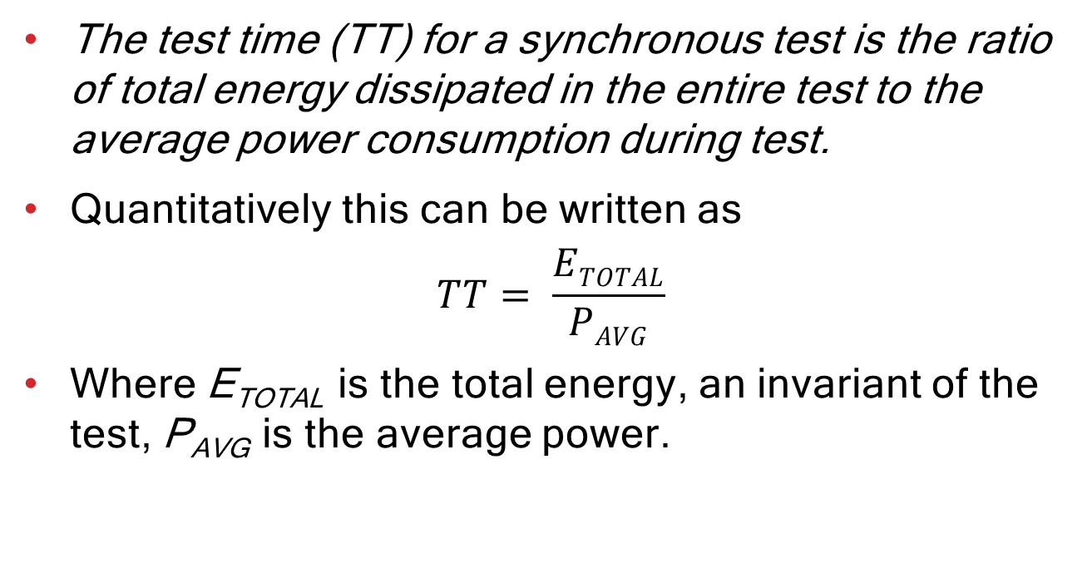
Test Time - Theorem
The test time (TT) for a synchronous test is the ratio of total energy dissipated in the entire test to the average power consumption during test.
Quantitatively this can be written as
$$TT= \frac{ETOTAL}{PAVG}$$
Where E_{TOTAL} is the total energy, an invariant of the test, P_{AVG} is the average power.
Notes:
I use this relation for rest of my work which is explained in the following slides.

Slide 11
Power Metrics [Patrick’10]
Energy: Energy is estimated as the total switching activity generated during test application.
Power: Defined for a clock cycle is the energy dissipated divided by the clock period.
Average Power: It is the average of power over the entire test.
Maximum Power: It is the maximum power dissipated in any clock cycle during the entire test.
Notes:
Test power calculation :
Gate level power estimators
RTL level power estimators
Weighted transition metric = $\sum{(Scan Chain length −Transition Position)}$

Slide 12
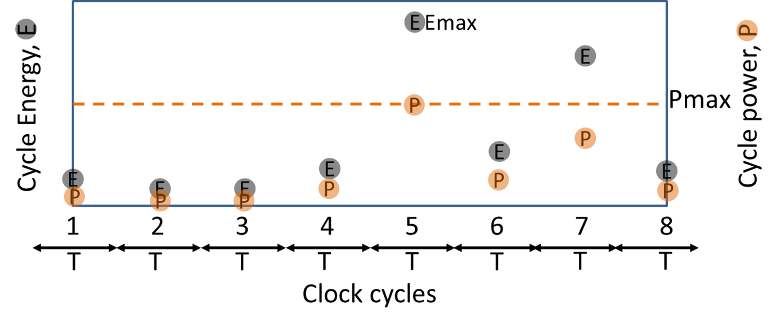
Observations
Dynamic energy is not consumed evenly throughout the entire test.
Reducing the voltage reduces power.
Power dissipated is dependent on the clock period.

Slide 13
Test Time Reduction
To reduce test time we can
  Scale the supply voltage, increase the frequency to maintain the power dissipation.
  Dissipate the energy at varying rate to maintain the same power dissipation.
  Implement scaled supply voltage and varying rate.
Clock period is constrained
  Structure: The period of the clock must not be shorter than the delay of the critical path.
  Power: The period of the clock must not let the power dissipation exceed the design specification.

Slide 14
Scaling Supply Voltage
Conventional method to perform test uses synchronous clock, i.e., uses fixed clock period
Test produces more signal transitions than functional operation, thus dissipate more power than the circuit is designed for.
The rated power determines the test clock period.
Effects of reducing voltage
  Test power reduces
  Critical path slows down

Slide 15
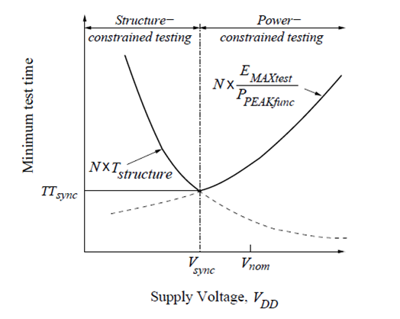
Scaling Supply Voltage
Notes:
Illustration shows the effect of voltage on test time at different voltage levels. The curve on the right shows the minimum test time, if the test is carried at the fastest structural frequency, while the curve on the right shows the minimum test time at each voltage level when ran using the frequency allowed by the power limit. We observe a point at which the two curves intersect, this will be the optimum voltage at which the test runs fastest.

Slide 16
Scaling Supply Voltage - Results
Circuit (180nm CMOS) | PMAX per Cycle (mW) | 1.8V Test Freq. (MHz) | Test Voltage (volts) | Test Clock Freq. (MHz) | Test Time Reduction (%)
s298 | 1.2 | 187 | 1.07 | 500 | 63.0
s382 | 2.9 | 300 | 1.35 | 563 | 46.5
s713 | 2.7 | 136 | 1.45 | 263 | 48.0
s1423 | 4.5 | 141 | 1.70 | 158 | 11.0
s13207 | 21.3 | 110 | 1.45 | 165 | 40.3
s15850 | 178.1 | 182 | 1.65 | 222 | 18.0
s38417 | 73.7 | 122 | 1.50 | 175 | 30.5
s38584 | 110.6 | 129 | 1.50 | 187 | 31.0
Notes:
Pmax is the rated power and normally a design specification. In our work we determine this by simulating the circuit in normal mode for 1000 random vectors.
Gate level simulations were done using nanosim and the energy per cycle is measured.
Results show that when the circuit is run at a lower voltage identified using our method the test time is significantly reduced
In some cases since the power chosen was closer to the test power the reduction is not that vast.

Slide 17
Varying Clock Period
In a synchronous test each period depends on the maximum power dissipated.
Each period may not dissipate same amount of power.
Periods can be varied based on the power dissipated.
This is achieved by asynchronous test.
Notes:
Periods can be varied such that the cycles that dissipate lower power can be shrunk to match the rated power, while the cycle that have large power dissipation runs at a wider period.

Slide 18
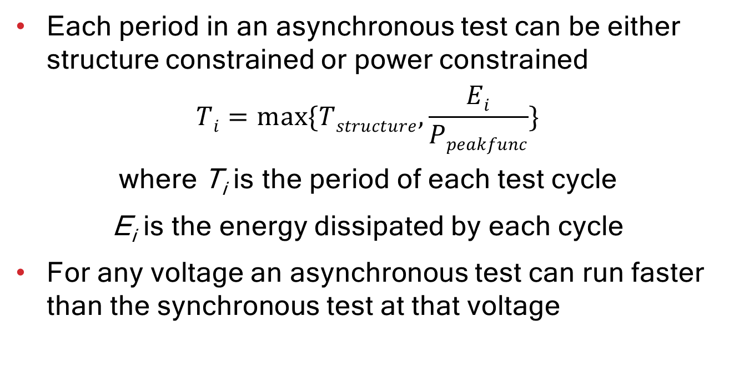
Varying Clock Period
Each period in an asynchronous test can be either structure constrained or power constrained
$$Ti=\max{\{Tstructure, \frac{Ei}{Ppeakfunc}\}}$$
where T_{i} is the period of each test cycle
E_{i} is the energy dissipated by each cycle
  For any voltage an asynchronous test can run faster than the synchronous test at that voltage

Slide 19
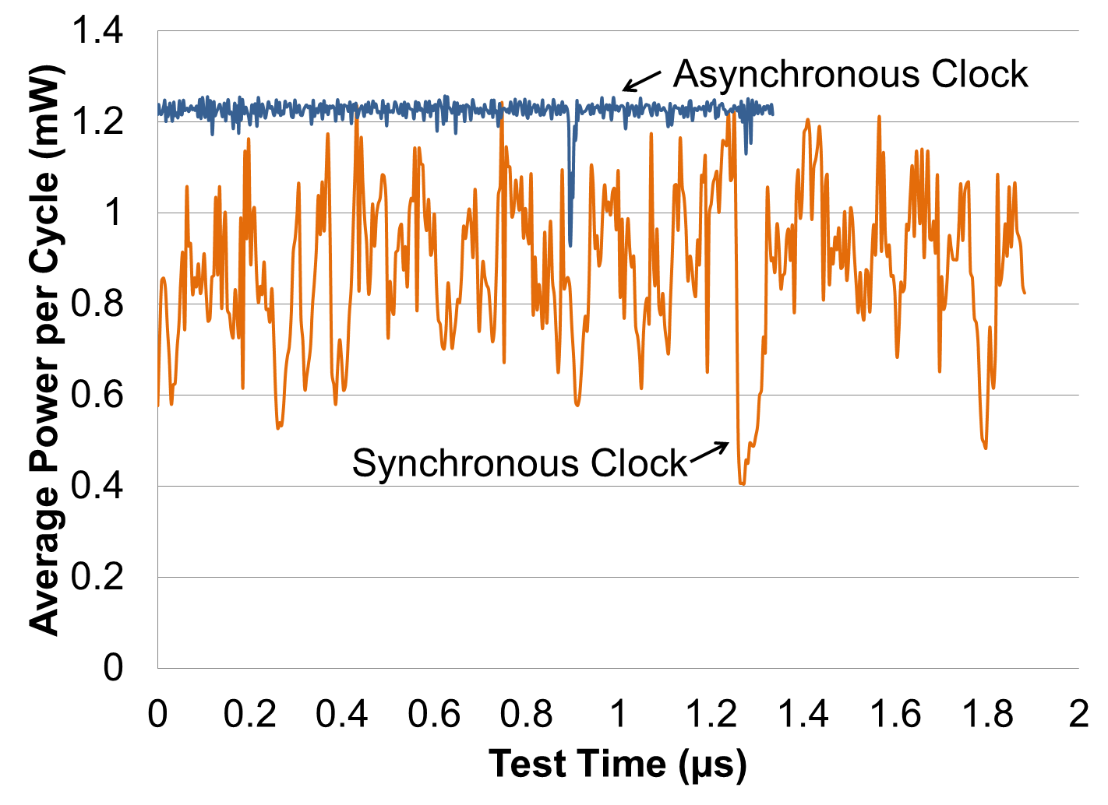
Asynchronous Clock – s298 Example
Notes:
Synchronous and asynchronous simulation of 450-cycle scan test of ISCAS’89 benchmark circuit s298. Synchronous test clock frequency is 240MHz and test time is 1.87us. Asynchronous test time is 1.31us.

Slide 20
Asynchronous test on ATE
Experimental Setup
  The test was implemented on the Advantest T2000GS ATE at Auburn University.
  Maximum clock speed of 250 MHz
  CUT is an FPGA configured for ISCAS‘89 benchmark circuit.
  FPGA is configured on the run using the ATE.
  All clock periods for asynchronous test are determined prior to external test based on the amount of energy dissipated during each cycle.
Limitations in tester framework sets few margins to the clock periods and the granularity in their variations
  Only 4 unique clock periods can be provided for each test flow

Slide 21
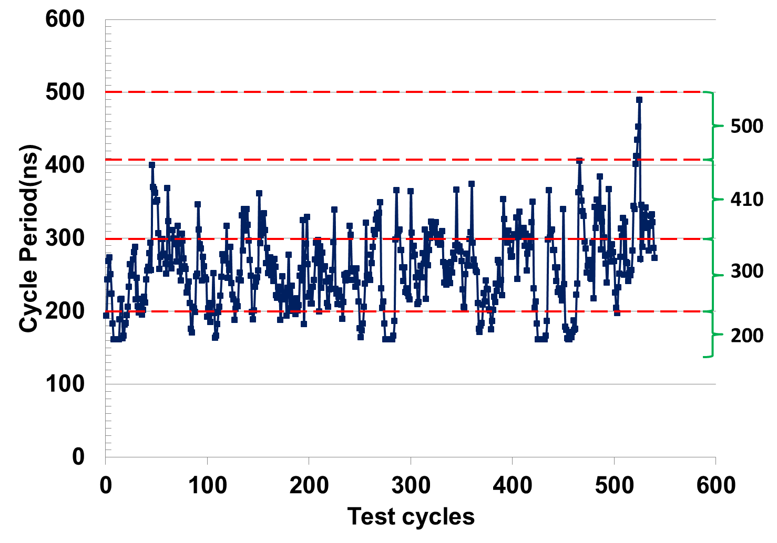
Selecting Asynchronous Periods
The clock periods were grouped into 4 sets.
Each set contains patterns of one clock period.
For synchronous test the maximum period is used as the fixed clock period.
The figure shows the cycle periods determined for each test cycle.
Test cycle will use the clock (dotted line) just above the period

Slide 22
ATE Test Program
Test plan is programmed using the native Open Test Programming Language (OTPL).
Four unique periods and the corresponding information about the signal behavior at each pin is provided in a timing file.
For each period, the input waveform of the clock is set to have a 50% duty cycle.
The output is probed at the end of each period.
Within each period there is a time gap to apply primary inputs (PI) and the clock edge to avoid race condition.
Period for each cycle is specified along with patterns.
Scan patterns are supplied sequentially bit by bit.

Slide 23
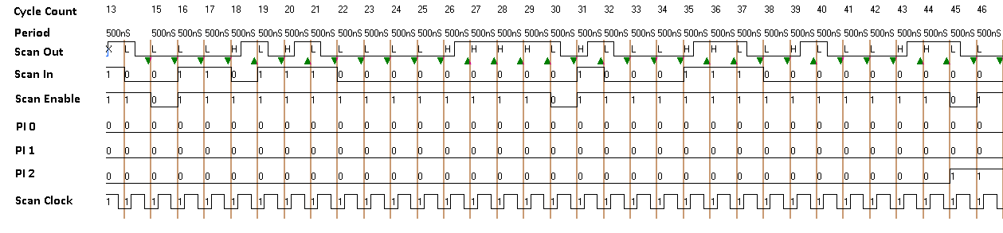
ATE Functional Test Using Synchronous Clock
Figure shows the waveforms for 33 cycles of the 540 cycles in total test.
The synchronous clock used is 500ns
The time frame to accommodate 33 cycles using synchronous clock is 16.5µs
Total test time for 540 cycles = 540 x .5 µs = 270 µs
Notes:
We performed two test on the ATE – first is the synchronous test using the fixed clock frequency

Slide 24
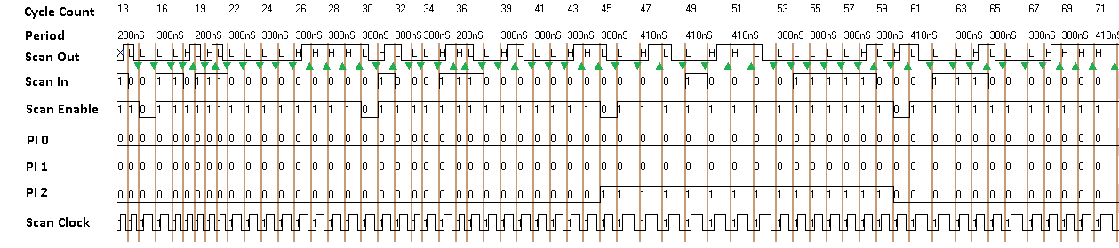
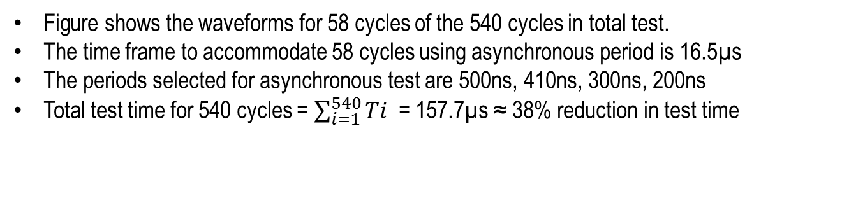
ATE Functional Test Using Asynchronous Clock
Figure shows the waveforms for 58 cycles of the 540 cycles in total test.
The time frame to accommodate 58 cycles using asynchronous period is 16.5µs
The periods selected for asynchronous test are 500ns, 410ns, 300ns, 200ns
Total test time for 540 cycles = $\sum_{i=1}^{540}{Ti }$ = 157.7µs ≈ 38% reduction in test time
Notes:
Hence we see that the test time is significantly reduced using asynchronous clock method.

Slide 25
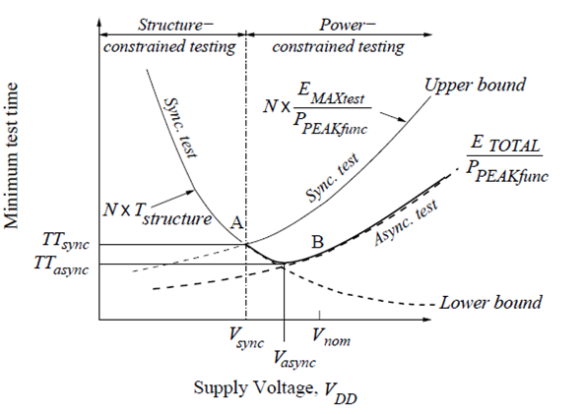
Scaling Supply voltage
Notes:
A minimum optimum voltage can be found for asynchronous test at which the test runs fastest.
As supply voltage is reduced energies of the cycles reduced and hence their periods can be shrunk
At some low voltage some periods of low energy cycles become structure constrained and can no longer be shrunk
There would be a mixture of both power and structure constrained cycles.
The minimum point at which there are majority of low energy cycles that have periods less than the power constrained cycles gives the optimum voltage for asynchronous test.

Slide 26
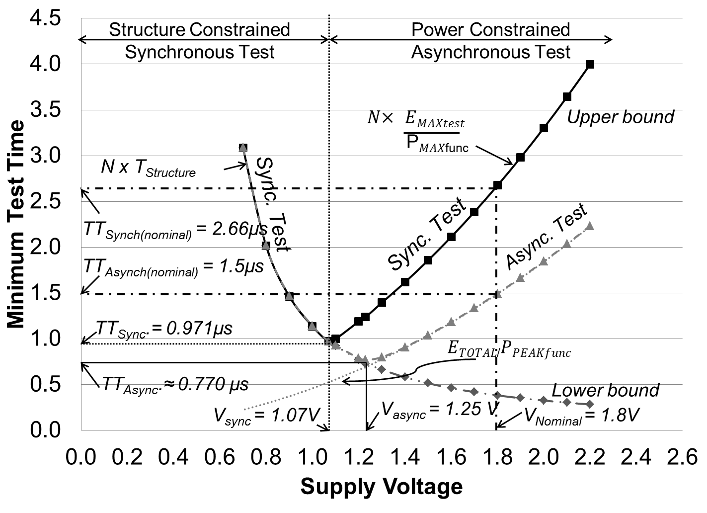
Scaling Supply Voltage – s298
Notes:
Figures shows minimum test time at each voltage using synchronous and asynchronous test for s298 benchmark circuit.
Using an optimum voltage in synchronous test at voltage 1.07V completes at 0.971µs which is approximately 63% reduction.
An asynchronous test at nominal voltage of 1.8V completes at 1.5µs which is approximately 43.6% reduction.
However if we combine both frequency and voltage scaling using asynchronous test at an optimum voltage 1.25V the test completes at 0.77µs which is a 71% reduction!

Slide 27
Summary
Synchronous test time is reduced by
  Scaling supply voltage down
  Scaling cycle frequency upward
Asynchronous test produces lower test time at any voltage as long as there are some test cycles that are power constrained.
According to the test time theorem, asynchronous test time is always less than or equal to the synchronous test time.

Slide 28
Future Work
Consider the effect of supply voltage scaling on leakage power.
Study test time reduction for high leakage technologies.
Examine delay testing.

Slide 29
Conference Submissions
V. D. Agrawal, “Pre-Computed Asynchronous Scan,” Invited Talk, LATW, April 2012.
P. Venkataramani and V. D. Agrawal, “Test Time Reduction in ATE Using Asynchronous Clocking,” Poster, DFM&Y Workshop, June 2012.
V. D. Agrawal, “Reduced Voltage Test Can be Faster,” Elevator Talk, ITC, Nov 2012.
P. Venkataramani and V. D. Agrawal, “Reducing ATE Time for Power Constrained Scan Test by Asynchronous Clocking,” Poster, ITC, Nov 2012.
P. Venkataramani and V. D. Agrawal, “Reducing Test Time of Power Constrained Test by Optimal Selection of Supply Voltage,” Proc. 26th International Conf. VLSI Design, Jan 2013.
P. Venkataramani, S. Sindia and V. D. Agrawal, “Test Time Theorem and Applications,” Proc. LATW, Apr 2013.
P. Venkataramani, S. Sindia and V. D. Agrawal, “Finding Best Voltage and Frequency to Shorten Power-Constrained Test Time,” Proc. VTS, Apr 2013.
P. Venkataramani and V. D. Agrawal, “Test Programming for Power Constrained Devices,” Proc. NATW, May 2013.
P. Venkataramani and V. D. Agrawal, “ATE Test Time Reduction Using Asynchronous Clocking,” submitted to ITC, Sep 2013.

Slide 30
References
[Chloupek’12] M. Chloupek, O. Novak, and J. Jenicek, “On Test Time Reduction Using Pattern Overlapping, Broadcasting and On-Chip Decompression,” in Proc. IEEE 15th International Symp. on Design and Diagnostics of Electronic Circuits Systems (DDECS), Apr. 2012, pp. 300–305.
[Hashempour’02] H. Hashempour, F. J. Meyer, and F. Lombardi, “Test Time Reduction in a Manufacturing Environment by Combining BIST and ATE,” in Proc. 17th IEEE International Symposium on Defect and Fault Tolerance in VLSI Systems, 2002, pp. 186– 194.
[Lai’93] W.-J. Lai, C.-P. Kung, and C.-S. Lin, “Test Time Reduction in Scan Designed Circuits,” in Proc. 4th European Conference on Design Automation, Feb. 1993, pp. 489–493.
[Patrick’10] P. Girard, N. Nicolici, and X. Wen“ Power Aware Testing and Test Strategies for Low Power Devices” Springer Publications 2010, New York, ISBN-978-1-4419-0927
[Shanmugasundaram’12] P. Shanmugasundaram and V. D. Agrawal, “Externally Tested Scan Circuit with Built-In Activity Monitor and Adaptive Test Clock,” in Proc. 25th International Conf. VLSI Design, Jan. 2012, pp. 448–453.
[Zhao’03] D. Zhao.; S. Upadhyaya., "Power Constrained Test Scheduling with Dynamically Varied TAM," VLSI Test Symposium, 2003. Proceedings. 21st , vol., no., pp.273,278, 27 April-1 May 2003

Slide 31
Thank you

