Slide 1
Architectural Power Management for Battery Lifetime Optimization in Portable Systems
Manish Kulkarni
Vishwani D. Agrawal
Department of Electrical and Computer Engineering
Auburn University, Auburn, AL 36849, USA

Slide 2
Outline
Recent work and publications
Summary of tutorial on battery modeling and efficiency (VDAT’10)
Energy source optimization methods
Functional management
Hardware modes for power reduction
Power gating example
Power savings in components of a processor
SLOP implementation in a pipeline
Power and energy savings
Conclusion
References

Slide 3
Recent Work and Publications
Khushaboo Sheth, “A Hardware-Software Processor Architecture using Pipeline Stalls for Leakage Power Management,” Master’s Thesis, Auburn University, ECE Dept.,Dec. 2008.
M. Kulkarni and V. D. Agrawal, “Matching Power Source to Electronic System: A Tutorial on Battery Simulation,” Proc. VLSI Design and Test Symposium, July 2010.
M. Kulkarni, “Energy Source Lifetime Optimization for a Digital System through Power Management,” Master’s Thesis, Auburn University, ECE Dept., Dec. 2010.
M. Kulkarni and V. D. Agrawal, “Energy Source Lifetime Optimization for a Digital System through Power Management,” Proc. 43rd IEEE Southeastern Symp. System Theory, Mar. 2011, pp. 75–80.
M. Kulkarni, K. Sheth, and V. D. Agrawal, “Architectural Power Management for High Leakage Technologies,” Proc. 43rd IEEE Southeastern Symp. System Theory, Mar. 2011, pp. 69–74.

Slide 4
An Electronic System Model for Dynamic Voltage and Frequency Scaling (DVFS)
VDD
4.2 V to 3.5 V Lithium- ion
Battery
DC – DC
Voltage Converter [9]
Electronic
System
Decoupling Capacitor
GND
Electronic systems are not always required to be in highest performance mode
Frequency and voltage can be varied
Multi-voltage domains can be created which can use DVFS or power shutdown

Slide 5
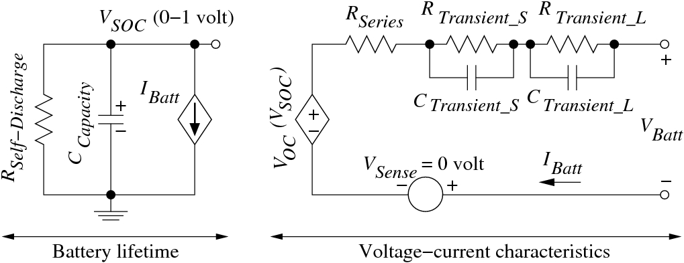
Battery Simulation Model
Lithium-ion battery, unit cell capacity: N = 1 (400mAh)
Battery sizes, N = 2 (800mAh), N = 3 (1.2Ah), etc.
[3] M. Chen and G. A. Rincón-Mora, “Accurate Electrical Battery Model Capable of Predicting Runtime and I-V Performance,” IEEE Transactions on Energy Conversion, vol. 21, no. 2, pp. 504–511, June 2006.

Slide 6
Simulation of 70-Million Gate SOC With 400mAh Battery
DVFS
Higher Circuit Speed,
Lower Battery Efficiency
619 Giga Cycles
or
50 minutes
Higher Battery Lifetime,
Lower Circuit Speed
0.098 0.560 3.860 23.00 88.00 199.0 325.0 446.0 557.0 657.0 (MHz)

Slide 7
Summary of Battery Tutorial
Battery size |  | VDD = 0.6V, 200MHz |  |  | VDD = 0.3V*, 3.86MHz
 |  | Effici. % | Lifetime |  | Effici. % | Lifetime
N | mAh |  | x10³ seconds | X10 ⁹ cycles |  | x10³ seconds | X10 ⁹ cycles
1 | 400 | 98 | 3 | 619 | 100+ | 430 | 1660
4 | 1600 | 100+ | 12.7 | 2540 | 100+ | 1717 | 6630
> two-times
Battery size should match the current need and satisfy the lifetime requirement of the system:
Undersize battery has poor efficiency.
Oversize battery is bulky and expensive.
Minimum energy mode can significantly increase battery lifetime.
A practical case of application where a miniature (undersized) battery is required is discussed in [9].
* Operation of circuits in sub-threshold voltage range (below 200 mV) have been verified [12][13]

Slide 8
Energy Source Optimization Methods
Dynamic Voltage Management
Multi-Voltage design
Clock Rate Management
Functional Management
Voltage Management
Clock Rate Management
Functional Management
Voltage Management
Dynamic Voltage and Frequency
Scaling (DVFS)
Dynamic Frequency Management
Retiming
Fetch Throttling
Dynamic Task Scheduling
Instruction Slowdown
Low Power solutions to common operations e.g. Low Power FSMs, Bus Encoding etc
Parallel and Multi-core Architectures

Slide 9
Functional Management
Low Power Design Techniques
Dynamic voltage and frequency scaling (DVFS)
Scale Voltage and Frequency depending on throughput requirement.
Use of multi-voltage domains and multiple clocks.
Frequency scaling at constant voltage (Clock Slowdown)
Increase in leakage energy in high leakage technologies
Voltage scaling has a limit.
22nm bulk CMOS, Vnom = 0.8 V, Vth = 0.32 V [4]
High power delivered at low voltages causes higher IR drops in power rails in chips.
Proposed method
Instruction slowdown [8]
Voltage and Frequency are kept constant.
Specialized instructions called Slowdown for LOw Power (SLOP) are inserted in the pipeline.
Additional control is provided in the data path to execute Clock Gating (CG) or Power Gating (PG) of idle units in the pipeline.

Slide 10
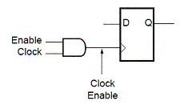
Hardware Modes for Power Reduction
Header Switch
Power gating (PG)
Used primarily for combinational logic
Header or footer switches to reduce leakage power
Clock gating (CG)
Used for flip flops and registers
Reduces switching activity; data is retained
No need for state retention
Drowsy mode
Used for caches, memories and register files
Memory cells are put in low voltage mode
Address decoders and sense amplifiers in power gated mode
Sleep
Virtual Supply
Logic
Block
Figure: Power Gating
Figure: Clock Gating

Slide 11
Example of Power Gating
VDD
Data 1
32 - bit
ALU
(Low V_{t})
32
Data 2
Data Out
32
32
Add / Sub
GND_V
 | Normal Mode X 10 ⁻⁶(W) | Sleep Mode X 10 ⁻⁶(W) | Power Saving (%)
Avg. Dynamic Power | 660.0 | 0.322 | 99.95 %
Avg. Leakage Power | 34.01 | 0.241 | 99.29 %
Peak Power | 5040.5 | 1.361 | 99.79 %
Minimum Power | 29.254 | 127.4 | 99.56 %
Sleep Transistor Network
(High V_{t})
Sleep
Results obtained by Simulation of a 32-bit, ALU using HSPICE [5] with PTM bulk CMOS models [4]

Slide 12
Power Savings in Processor Blocks
Hardware block | Power mode during SLOP | Power consumed (%)*
 |  | Dynamic | Static
PC | CG | 25 | 100
Instruction and Data cache | Drowsy | 25 | 25
Register file | CG | 30 | 100
Forwarding, hazard unit | PG | ≈0 | ≈0
ALU, FPU, comparators, branch decoders | PG | ≈0 | ≈0
Control Unit | Normal | 100 | 100
Pipeline registers | CG | 50 | 100
Multiplexers, other adders | PG | ≈0 | ≈0
*Normal mode power consumption for each block is 100%
PG – Power gating, CG – Clock gating

Slide 13
Normal Mode Operation
CC1
CC2
CC3
CC4
CC5
CC6
CC7
LW $8, 0($7)
ADD $9, $8, $2
SW $9, 0($7)

Slide 14
Operation With One SLOP
CC1
CC2
CC3
CC4
CC5
CC6
CC7
CC8
CC9
LW $8, 0($7)
SLOP
ADD $9, $8, $2
SLOP
SW $9, 0($7)

Slide 15
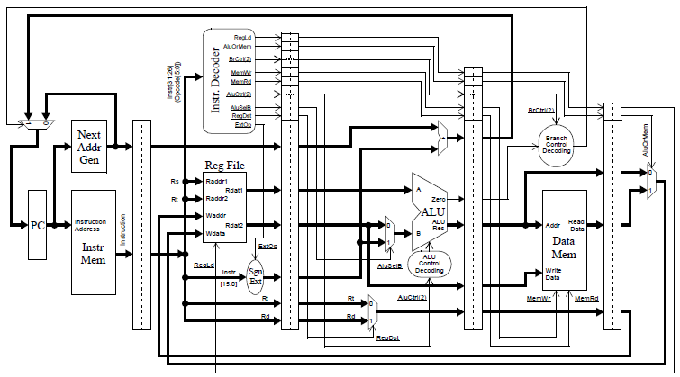
IF
ID
EX
DM
WB
PG
PG
PG
PG
Drowsy
CG
Drowsy
PG
CG
PG
PG
PG
PG
Ref. Patterson and Hennessey.

Slide 16
Normal
Dynamic Power
Instantaneous Power
0
T
1
2
3
4
Freq. Scaling
(Clock Slowdown)
Leakage Power
0
1
2
3
4
T
Instruction Slowdown
SLOP
SLOP
T
0
1
2
3
4

Slide 17
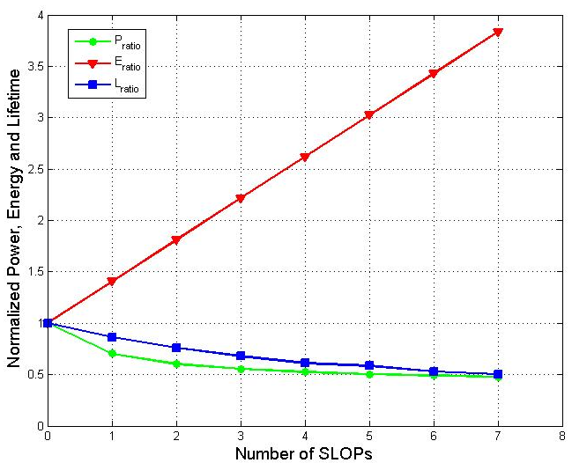
Power, Energy and Lifetime Ratios
For 32 nm bulk CMOS models
Ideal Battery of 800 mAh Capacity
Power, energy and lifetimes are normalized to their values with zero SLOPs inserted, i.e., normal mode of operation.

Slide 18
Battery Lifetime Improvement
For 32 nm bulk CMOS models
Battery of 800 mAh Capacity

Slide 19
Conclusion
The proposed architectural power management method is demonstrated to be beneficial towards power optimization and energy source efficiency in high leakage technologies.
SLOP insertion method offers a unique opportunity in hardware and software management for energy efficiency. SLOPs may additionally eliminate pipeline hazards.
Use of SLOPs in superscalers and out-of-order processors can be further studied and analyzed.

Slide 20
References
M. Pedram and Q. Wu, “Design Considerations for Battery-Powered Electronics,” Proc. 36th Design Automation Conference, June 1999, pp. 861–866.
L. Benini, G. Castelli, A. Macii, E. Macii, M. Poncino, and R. Scarsi, “A Discrete-Time Battery Model for High-Level Power Estimation,” Proc. Conference on Design, Automation and Test in Europe, Mar. 2000, pp. 35–41.
M. Chen and G. A. Rincón-Mora, “Accurate Electrical Battery Model Capable of Predicting Runtime and I-V Performance,” IEEE Transactions on Energy Conversion, vol. 21, no. 2, pp. 504–511, June 2006.
Simulation model: 45nm bulk CMOS, predictive technology model (PTM), http://ptm.asu.edu/
Simulator: Synopsys HSPICE, www.synopsys.com/Tools/Verification/AMSVerification/CircuitSimulation/HSPICE/Documents/hspice ds.pdf
M. Kulkarni and V. D. Agrawal, “Matching Power Source to Electronic System: A Tutorial on Battery Simulation,” Proc. VLSI Design and Test Symposium, July 2010.
K. Sheth, “A Hardware-Software Processor Architecture using Pipeline Stalls for Leakage Power Management,” Master’s Thesis, Auburn University, ECE Dept., Dec. 2008.
M. Kulkarni, “Energy Source Lifetime Optimization for a Digital System through Power Management,” Master’s Thesis, Auburn University, ECE Dept., Dec. 2010.
M. Kulkarni and V. D. Agrawal, “Energy Source Lifetime Optimization for a Digital System through Power Management,” Proc. 43rd IEEE Southeastern Symp. System Theory, Mar. 2011, pp. 75–80.
M. Kulkarni, K. Sheth, and V. D. Agrawal, “Architectural Power Management for High Leakage Technologies,” Proc. 43rd IEEE Southeastern Symp. System Theory, Mar. 2011, pp. 69–74.
S. Hanson, B. Zhai, M. Seok, B. Cline, K. Zhou, M. Singhal, M. Minuth, J. Olson, L. Nazhandali, T. Austin, D. Sylvester, and D. S. Blaauw, “Performance and variability optimization strategies in a sub-200 mV, 3.5 pJ/inst, 11 nW subthreshold processor,” Symp. VLSI Circuits Digest, Jun. 2007, pp. 152–153.
B. Zhai, S. Hanson, D. Blaauw, and D. Sylvester, “A Variation-Tolerant Sub-200mV 6-T Subthreshold SRAM,” IEEE Journal of Solid-State Circuits, vol. 43, no. 10. pp. 2338-2348, Oct. 2008.

