Slide 1
Sessionless SoC Test Scheduling With Frequency Scaling
Vijay Sheshadri , Vishwani D. Agrawal, Prathima Agrawal
Dept. of Electrical and Computer Engineering
Auburn University, AL 36849, USA
Notes:
The slide guide is available in the following file:
slidesV16.2.ppt: PowerPoint, version 2003 format.
Note: We have saved this presentation in the older 2003 format, because PowerPoint 2003, 2007 and 2010 can read it.
For this year’s test conference we will use PowerPoint 2007 in our projection computers.

Slide 2
Outline
Introduction
Problem Statement
Heuristic-based Optimization
Preemptive test scheduling
Non Preemptive test scheduling
Results
Conclusion
Notes:
View it as a slide show first. It will highlight important aspects of your presentation, and give you an example of a presentation that lives up to ITC presentation standards and guidelines.
Virus checker: When we created this presentation guide it contained no known viruses. This file was checked by current anti-virus software before being distributed to authors. You should use a good, up to date virus checker on this file, and any other file you import from an outside source. Make sure your virus checker’s data files are up to date, too. Keep in mind: the version of this file you are reading may be different from the version we checked!
Confidentiality: We respect your copyright, and do not distribute your presentation before the conference. However, we cannot promise strict confidentiality of your presentation before the conference, because others have read access to our FTP sites. Do not include confidential information in your presentation.
Test Slide: A test slide is included as a “hidden slide” after the end of this presentation. If you want to do a trial projection, ensure that your projector projects the entire slide, and that aspect ratios are correct. We will use the same test slide at the conference for setup of our projection equipment.

Slide 3
Introduction
Technology scaling has led to more cores and increased complexity in SoC devices.
This has resulted in high test data volumes and longer test times.
Reducing test time is one of the major objectives in SoC testing

Slide 4
Introduction
Test multiple cores simultaneously
Results in high power consumption
Power consumption in test mode higher than system mode
Power aware test strategies needed for efficient power management

Slide 5
Introduction
Testing SoC – schedule core tests such that:
No resource conflict among tests sharing resources.
Power consumption does not exceed test power budget.
Test schedule can be optimized for better power and resource management and a quicker overall test time.

Slide 6
Problem Statement
Given an SoC with N core tests and a peak power budget, find a test schedule to:
Test all cores
Reduce overall test time
Conform to SoC test power budget
Notes:
Or more formally *read*

Slide 7
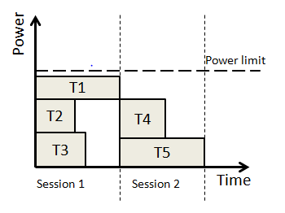
Test Scheduling
Session-based test scheduling :
Tests grouped into Test sessions.
Each block represents a core-test, with test time, t_{i} and test power, p_{i}

Slide 8
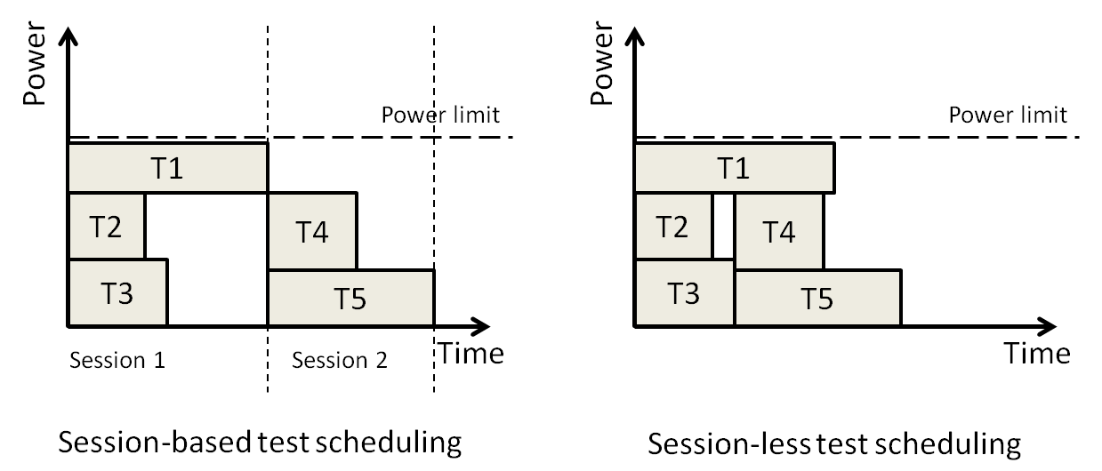
Test Scheduling
Session-less testing:
New tests scheduled immediately after completion of old tests.
No session boundaries.

Slide 9
Test Scheduling
Session-less testing further divided into:
Preemptive* – Test can be interrupted or restarted anytime.
Non Preemptive – Tests cannot be interrupted.
Test ‘X’
Test ‘X1’
Test ‘X2’
Test time = t
Test time = t1
t2
(t1 + t2 = t)
* V. Iyengar and K. Chakrabarty, ”Precedence-Based, Preemptive and Power Constrained Test Scheduling for System-on-Chip,” Proc. VTS’02, pp 253-258

Slide 10
Test Scheduling
This work:
Heuristic method for preemptive and non preemptive test scheduling.
Tests randomly selected for scheduling.
Dynamic frequency scaling to lower test time.

Slide 11
Dynamic Frequency Scaling
Test time and power linearly dependent on test clock rate
Increasing test clock frequency by a factor f => Test time, and Test power,
Proper choice of ‘f’ for each test session can optimize overall test time

Slide 12
Frequency factor
Scaling factor to vary test clock frequency per session
Reference/Nominal case: constant clock rate for entire test schedule
Frequency factor limited by:
P_{max} (Power Budget)
Max. clock rate of individual cores

Slide 13
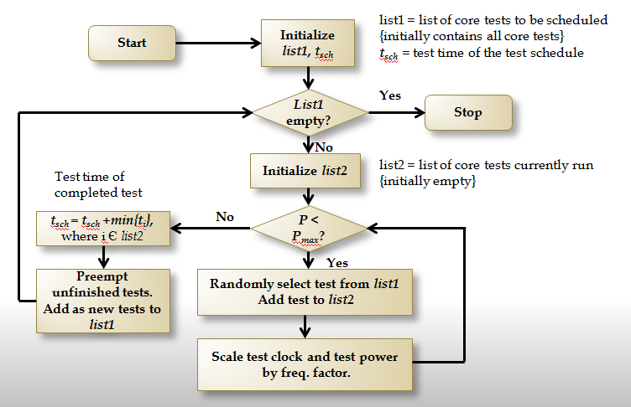
Heuristic for Preemptive Testing

Slide 14
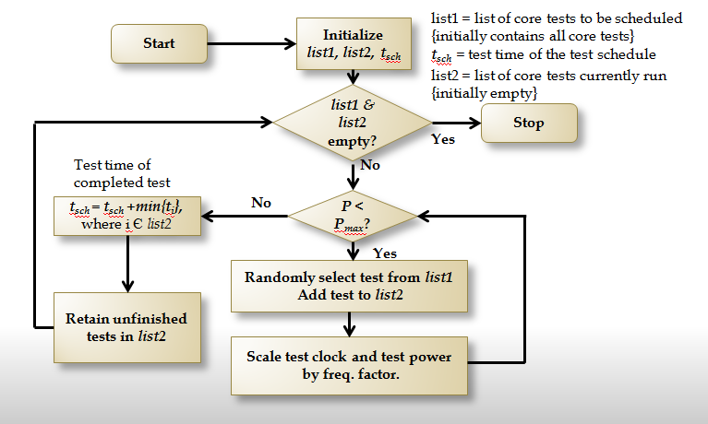
Heuristic for Non Preemptive Testing

Slide 15
Heuristic for Session-less Testing
Results
Experiments on ITC02 benchmarks*.
Stop criteria: No improvement on best soln. for 5000 consecutive runs.
Test times compared with session-based testing (ILP) .
Simulations performed on a Dell workstation with a 3.4 GHz Intel Pentium processor and 2GB memory.
* ITC 2002 SOC Benchmarking Initiative: http://www.extra.research.philips.com/itc02socbenchm
Power profile for benchmarks from: S. K. Millican and K. K. Saluja (http://homepages.cae.wisc.edu/~millican/bench/)

Slide 16
Heuristic for Session-less Testing
Results
Benchmark | Test time for session-based testing | Test time for session-less testing
 |  | Pre-emptive | % | Non pre-emptive | %
a586710 | 13011130.62 | 12501982 | 3.91 | 12501982 | 3.91
h953 | 121715.34 | 96716.29 | 20.54 | 96716.29 | 20.54
ASIC Z | 268.274 | 238.58 | 11.07 | 239.47 | 10.74
d695 | 12730.738 | 10005.8 | 21.4 | 9875.6 | 22.43
g1023 | 19888.7 | 14070.95 | 29.25 | 13989 | 29.66

Slide 17
Conclusion
Heuristic methods for sessionless test scheduling presented.
Employs dynamic frequency scaling to reduce test time.
Heuristic for preemptive and non preemptive testing.
Up to 30% reduction in test time compared to session-based testing.
Current research investigating dynamic voltage and frequency scaling.

Slide 18
Thank you

