Slide 1
A Diagnostic Test Generation System
Yu Zhang
Vishwani D. Agrawal
Auburn University, Auburn, Alabama 36849

Slide 2
Outline
Introduction: Diagnostic ATPG problem
Define diagnostic coverage
A diagnostic ATPG system
Exclusive test
Diagnostic fault simulation
Experimental results
Conclusion

Slide 3
Diagnostic ATPG Problem
Given a combinational circuit and a fault model, find:
Test vectors to distinguish between all, or most, fault-pairs.
Measure diagnostic coverage of vectors.
Present contributions:
Define a diagnostic coverage metric.
A diagnostic ATPG system using conventional fault-detection tools.

Slide 4
Fault Detection and Diagnosis
1
0
1
CUT
Fault
D
D
Fault
Fault detection: Need at least one vector that detects a target fault.
Fault diagnosis: Need at least one vector that produced different responses for every pair of faults.

Slide 5
Coverage
Fault coverage:
Number of detected faults
FC = ────────────────
Number of total faults
Diagnostic coverage:
Number of groups of detected faults
DC = ───────────────────────
Number of total faults
Where faults in a group produce the same test outputs.

Slide 6
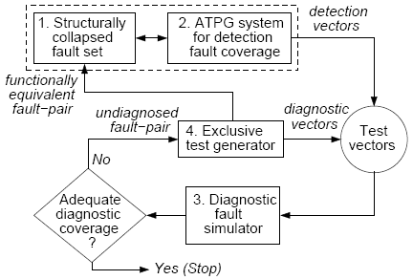
A Diagnostic Test Generation System

Slide 7
Exclusive Test
Given a fault pair, find a vector that either detects only one fault or detects them both at different outputs.
Previous work:
T. Grüning, U. Mahlstedt, and H. Koopmeiners, “DIATEST: A Fast Diagnostic Test Pattern Generator for Combinational Circuits,” Proc. IEEE/ACM Intl. Conf. Computer-Aided Design, pp. 194-197, Nov. 1991.
V. D. Agrawal and K. K. Saluja, “Antitest, Exclusive Test and Concurrent Test,” Unpublished 2002 manuscript, www.eng.auburn.edu/~vagrawal/TALKS/vts02.pdf .
V. D. Agrawal, D. H. Baik, Y. C. Kim, and K. K. Saluja, “Exclusive Test and its Applications to Fault Diagnosis,” Proc. 16th International Conf. VLSI Design, Jan. 2003, pp. 143–148.
A. Veneris, R. Chang, M. S. Abadir, and M. Amiri, “Fault Equivalence and Diagnostic Test Generation using ATPG,” Proc. Int. Symp. Circuits and Systems, 2004, pp. 221–224.
Other papers.

Slide 8
Exclusive Test ATPG
Use conventional single-fault ATPG and an ATPG model derived from Boolean difference analysis.
A test for a single stuck-at fault on this line is an exclusive test for the fault pair.
CUT
CUT
S-a-1
S-a-0

Slide 9
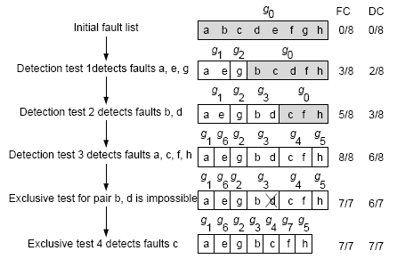
Diagnostic Fault Simulator (Example)
Y. Zhang and V. D. Agrawal, “Diagnostic Fault Simulation,” Proc. 11th
IEEE Latin American Test Workshop, March 28-31, 2010.

Slide 10
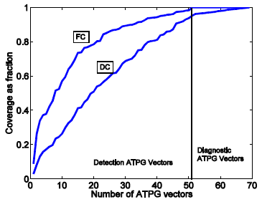
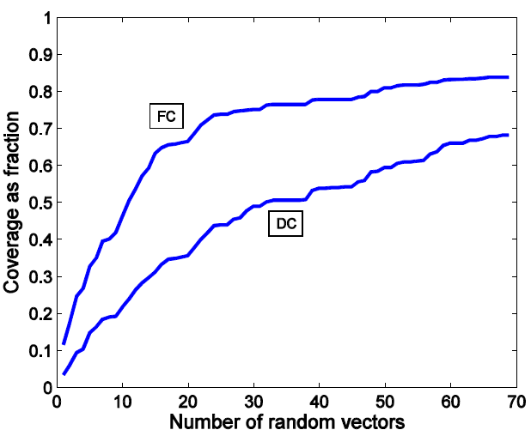
Experiment results
Simulation results for c432:
Notes:
In c432 all undistinguished fault pairs are identified as equivalent pairs.

Slide 11
ISCAS85 Benchmark Results
Circuit | Total faults | Detection test Generation |  |  |  | Diagnostic test Generation
 |  | ATPGvect. | FC % | CPU s* | DC % | Excl. Vec. | No test pairs | Equv. pairs | DC % | CPU s*
c17 | 22 | 7 | 100.00 | 0.031 | 95.45 | 1 | 0 | 0 | 100.0 | 0.030
c432 | 524 | 51 | 99.24 | 0.032 | 91.99 | 18 | 0 | 13 | 100.0 | 0.031
c499 | 758 | 53 | 100.00 | 0.032 | 97.36 | 0 | 12 | 0 | 98.40 | 0.031
c880 | 942 | 60 | 100.00 | 0.047 | 92.57 | 10 | 0 | 55 | 100.0 | 0.051
c1355 | 1574 | 85 | 100.00 | 0.046 | 58.90 | 2 | 453 | 287 | 72.57 | 0.131
c1908 | 1879 | 114 | 99.89 | 0.047 | 84.73 | 20 | 247 | 54 | 88.96 | 0.066
c2670 | 2747 | 107 | 98.84 | 0.110 | 79.10 | 43 | 397 | 98 | 89.62 | 0.336
c3540 | 3428 | 145 | 100.00 | 0.125 | 85.18 | 29 | 433 | 111 | 92.69 | 0.420
c6288 | 7744 | 29 | 99.56 | 0.220 | 85.32 | 108 | 842 | 172 | 86.87 | 7.599
c7552 | 7550 | 209 | 98.25 | 0.390 | 85.98 | 87 | 904 | 236 | 86.85 | 2.181
* Intel Core 2 Duo 2.66GHz, 3GB RAM

Slide 12
Conclusion
A diagnostic coverage metric is defined.
Diagnostic fault simulation uses conventional simulation and incorporates fault dropping.
Diagnostic test generation is no more
complex than ATPG for single fault.
Need efficient fault equivalence checking; similar to redundancy checking by single fault detection ATPG.

