Slide 1
ELEC 3040/ELEC 3050 Course Overview
Fall 2018
See syllabus for details!
(Click speaker icons for the recorded audio, and hit play/pause button.)

Slide 2
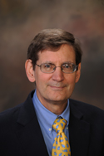
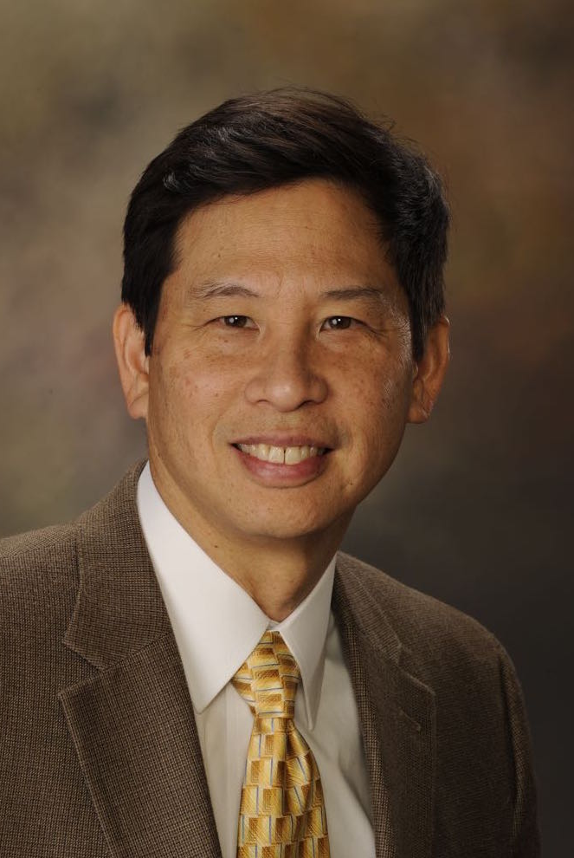
Instructors
Dr. Nelson
ofc: Broun 326
e: nelsovp@auburn.edu
Dr. Hung
ofc: Broun 227
e: hungjoh@auburn.edu

Slide 3
GTAs
Tuesday | Wednesday | Thursday
Section 005 3:30-5:20 p.m. Tyler Horton |  | Section 004 12:30-2:20 p.m. Daylon Hester
Section 003 3:30-5:20 p.m. Daylon Hester | Section 002 3:00-4:50 p.m. Andrew Cookston | Section 001 3:30-5:20 p.m. Daylon Hester
Email:
Andrew Cookston: atc0018@auburn.edu
Daylon Hester: dgh0010@auburn.edu
Tyler Horton: tch0014@auburn.edu

Slide 4
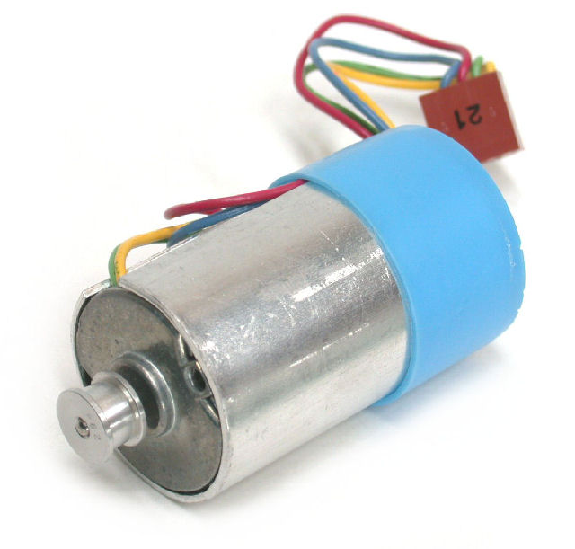
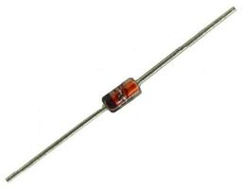
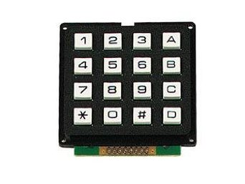
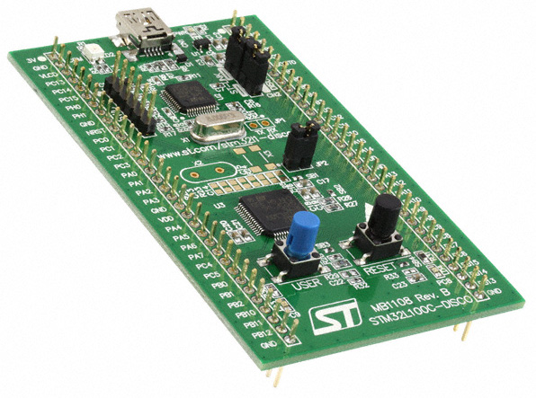
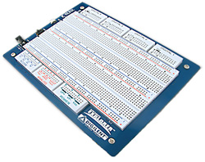
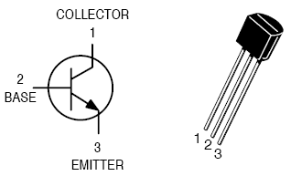
Technical Objective
Design of a SYSTEM
Solutions: hardware & software
Design tools: hardware & software
Experiments and data analysis

Slide 5
Course Grading
Technical Performance
Professional Practice
Lab notebook maintenance | 10%
In-lab work (assessed by GTA) | 10%
Overall progress (from memos) | 5%
Teamwork | 10%
Performance of designed system | 20%
Subtotal | 55%
Bi-weekly status reports | 5%
Midterm written report (draft) | 5%
Revised written report | 15%
Ethics case study report | 5%
Final oral presentation | 10%
General professional practice | 5%
Subtotal | 45%

Slide 6
A Typical Week for 3040/3050
1. Monday lecture
Overview of technical issues
Some design approaches
2. Pre-lab preparation
Record in notebook:
Designs
Plans for Experiments
3. Laboratory time
Implement & test designs
Gather experimental data
Submit lab notebook (as scheduled)
4. Documentation
Status report (as scheduled)
Other reports

Slide 7
2-person Team Composition
EE student + ECPE student (better)
EE student + EE student (acceptable)
ECPE student + ECPE student

Slide 8
Things to ask your teammate
Name
Preferred contact method (email? text? call?)
Best time to contact
How will we handle a week where one of us is gone (sick, travel, etc)
Agree: Teamwork is not 50-50, but 100-100
I am good at “X,” but need help with …
Neither of us is good at “Z,” so we need to …

Slide 9
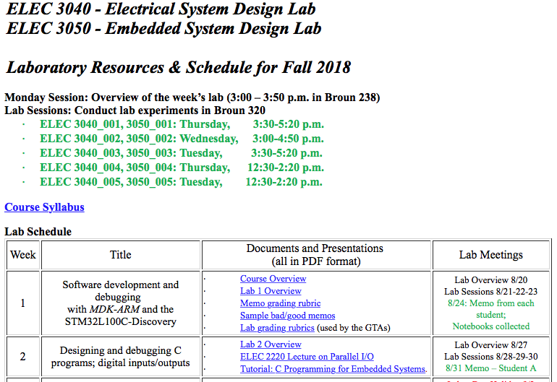
Course resources
http://www.eng.auburn.edu/~nelsovp/courses/elec3040_3050/
Syllabus!

Slide 10
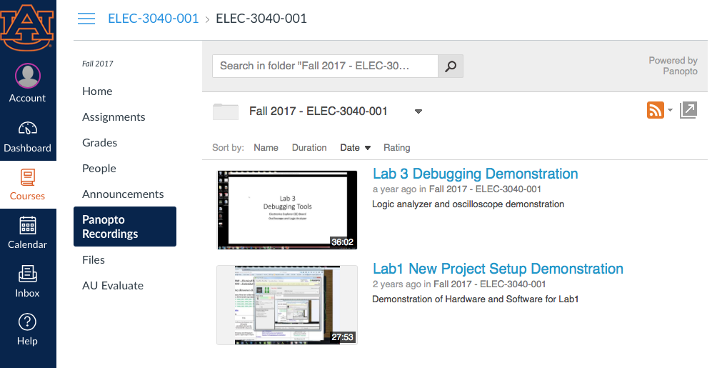
Labs #1, #3 Prep: Study Panopto recordings in CANVAS
Study for week of 9/3, Labor Day!

