Slide 1
DVF4: A Dual Vth Feedback Type 4-Transistor Level Converter
Master’s Defense Karthik Naishathrala Jayaraman
Thesis Advisor: Dr. Vishwani D. Agrawal
Thesis Committee: Dr. Victor P. Nelson and Dr. Adit Singh.
Department of Electrical and Computer Engineering
Auburn University, AL 36849 USA

Slide 2
Presentation Outline
Problem Statement
Motivation
Introduction and Background
Types of Level Converters
Level Converters
Proposed Level Converter
Design of Level Converter
Experimental Results
Conclusion

Slide 3
Problem Statement
To design a level converter which has less power consumption and reduced delay.
The average power and delay of one standard inverter as a target for the level converter.
To have a better energy saving by allowing the level converters overhead than energy saving obtained by using Dual-VDD design without allowing level converters.

Slide 4
Presentation Outline
Problem statement
Motivation
Introduction and Background
Types of Level Converters
Level Converters
Proposed Level Converter
Design of Level Converter
Experimental Results
Conclusion

Slide 5
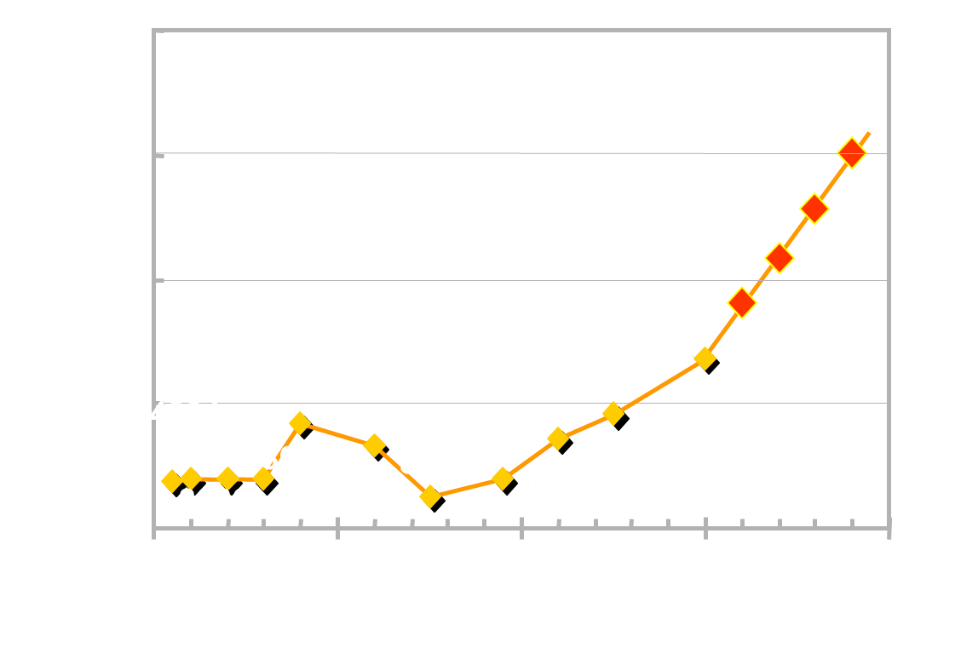
Motivation
Sun
Surface
Source: Patrick P. Gelsinger , Keynote, ISSCC, Feb. 2001

Slide 6
Motivation Continued..
Scaling of device features not only increases the performance of the devices, but also increases the leakage power. This is shown in the Figure below.
180nm 90nm 45nm 32nm

Slide 7
Presentation Outline
Problem Statement
Motivation
Introduction and Background
Types of Level Converters
Level Converters
Proposed Level Converter
Design of Level Converter
Experimental Results
Conclusion

Slide 8
Introduction and Background
Voltage scaling technique causes the reduction in supply voltage. This reduction causes a quadratic reduction in dynamic power. Leakage power also reduces since the gate leakage.
Dual VDD design technique exploits this concept in causing the reduction in power consumption.
Reduction in VDD causes the degrading in performance of the circuits.
In-order to maintain the performance in dual VDD designs, cells along the critical paths are assigned to be higher supply (VDDH). The cells along the non-critical paths are assigned to the lower power supply (VDDL).

Slide 9
Introduction and Background Continued..
The assigning of low voltage gates is based on two major algorithms
Clustered Voltage Scaling (CVS)
Extended Clustered Voltage Scaling (ECVS).
CVS: The cells driven by each power supply are grouped (clustered) together and level conversion is needed only at sequential elemental outputs.
ECVS: The cell assignment is flexible, allowing level conversion anywhere (not just at the sequential element outputs) in the circuit.
In case of Dual VDD designs level converters may be used to convert the low supply voltage to high supply voltage, to eliminate the undesirable static current that will flow when VDDL gates might feed the VDDH gates.

Slide 10
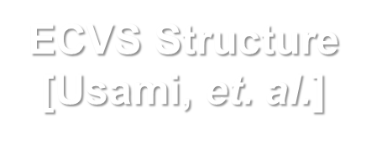
Introduction and Background Continued..
V_{DDL}
V_{DDH}
Level Converter
Ref. K. Usami and M. Horowitz, “Clustered Voltage Scaling Technique for Low-Power Design," in Proceedings of the International Symposium on Low Power Design, pp. 23-26, 1995.
Ref. K. Usami, et al.,“Automated Low-Power Technique Exploiting Multiple Supply Voltages Applied to a Media Processor," IEEE Journal of Solid-State Circuits, vol. 33, no. 3, pp. 463-472, Mar. 1998.

Slide 11
Presentation Outline
Problem Statement
Motivation
Introduction and Background
Types of Level Converters
Level Converters
Proposed Level Converter
Design of Level Converter
Experimental Results
Conclusion

Slide 12
Types of Level Converters
Level converters are of two types
Feedback based level converter
Differential cascaded voltage switched (standard level converter)
Pass transistor level converter.
Contention mitigated level converter
Multi-V_{th} based level converter
Dual V_{th} cascaded inverter level converter.
Multi- V_{th} level converter

Slide 13
Presentation Outline
Problem Statement
Motivation
Introduction and Background
Types of Level Converters
Level Converters
Proposed Level Converter
Design of Level Converter
Experimental Results
Conclusion

Slide 14
Level Converters
Level conversion (from VDDL to VDDH) becomes essential at boundaries where VDDL driven cell drives a VDDH supplied cell to eliminate the undesirable static current that will otherwise flow.
This current flows, since the logic “HIGH” signal of the VDDL driven cell, cannot completely turn off the pMOS pull-up network of the following VDDH cell.
We will describe some of the various published level converters ranging from standard level converter to the recently published best level converter.

Slide 15
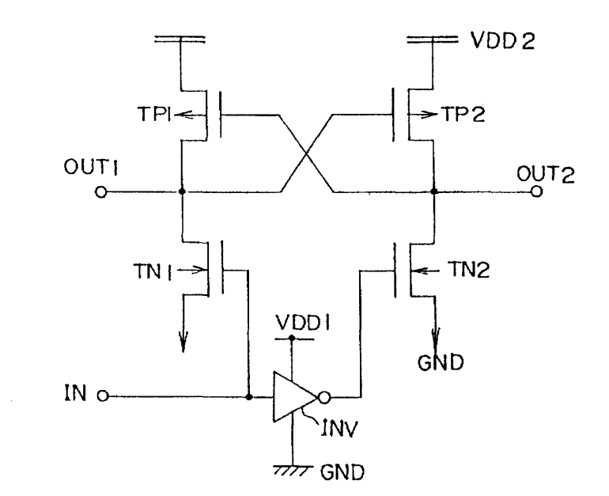
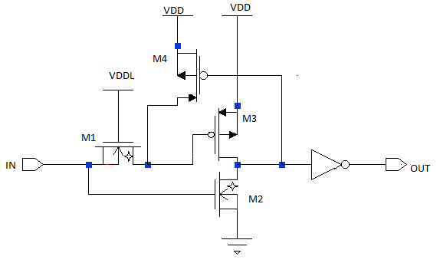
Level Converters Continued..
Standard Level Converter [Masaki et al., 97 ]
Pass Transistor Level Converter [M. Hamada, 98]
The standard level converter which (Differential cascade voltage switched) depends upon feedback circuitry. This converter consumes significant energy due to the contention at the points of connection of the cross- coupled pair and the pull-down nMOS network.
The pass transistor level converter depends on feedback and Dual V_{th} technique. The star in the transistor denotes the low-V_{th} devices. This level converter consumes less energy than the DCVS level converter due to its fewer devices and reduced contention.

Slide 16
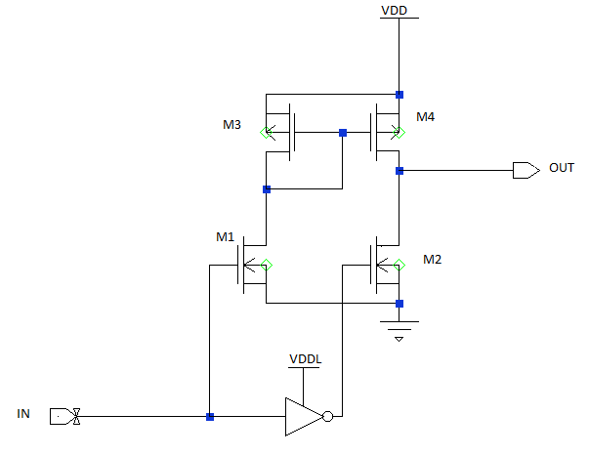
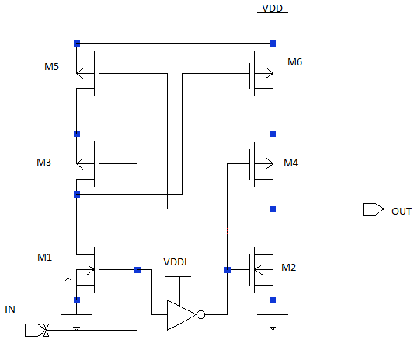
Level Converters Continued..
Conventional Type II [Wang, 01]
Contention Mitigated [Sakurai, 05]
Conventional Type II converters when compared to cross-coupled level-shifter this shows better performance in operating speed, within same size. To operate at low core voltage, the low to high level shifting M1and M2 need to be changed to thin gate-oxide transistor.
Contention Mitigated has a small delay. The power consumption of the CMLS is reduced because the contention reduction also brings in the crowbar current reduction, , but its power is relatively large because of stacked pMOS transistors

Slide 17
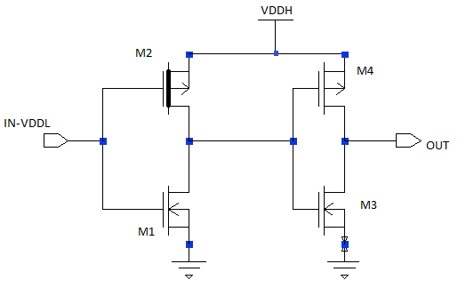
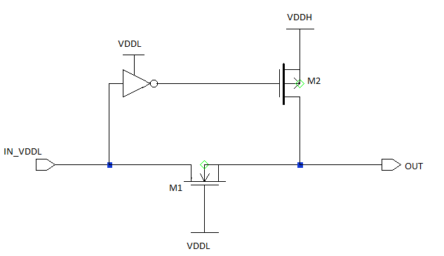
Level Converters Continued….
Dual V_{th} Cascaded Inverter [Tawfik, 07]
Multi- V_{th} Level Converter [Tawfik, 07]
The level converter is composed of two dual-Vth cascaded inverters. The Vth of M2 is high for avoiding static DC current in the first inverter, when the input is at VDDL. It has fewer transistors compared to the level converters discussed together causing the reduction in power consumption.
Multi-V_{th} level converter. M2 has higher Vth in order to eliminate the static DC current when the input is low (IN_VDDL). The speed is enhanced due to the shorter input-to-output signal propagation path and the elimination of the contention current during the output low-to-high transition.

Slide 18
Simulation setup
The level converters are simulated using 32nm PTM technology model in HSPICE. The simulation setup is shown in the figure.
The power consumption and the delay values are tabulated. The delay values are the average of rise and fall delay.

Slide 19
Average power in µW, VDDH = 1.0V.
VDDL values Ranging from 1.0V -0.4V
Level Converter | 1.0V | 0.9V | 0.8V | 0.7V | 0.6V | 0.5V | 0.4V
Standard | 0.457 | 0.430 | 0.409 | 0.452 | 0.508 | 0.755 | 2.247
Pass Transistor | 0.639 | 0.641 | 0.646 | 0.664 | 0.709 | 1.22 | 3.99
Contention Mitigated | 1.13 | 0.95 | 0.845 | 0.797 | 0.778 | 0.771 | 0.837
Conventional Type II | 32.6 | 31.7 | 30.78 | 28.77 | 24.85 | 19.14 | 12.9
Dual Vth Cascaded | 0.735 | 0.719 | 0.732 | 0.866 | 1.08 | 2.32 | 5.01
Multi-Vth | 0.225 | 0.162 | 0.171 | 0.332 | 0.403 | 1.89 | 4.73

Slide 20
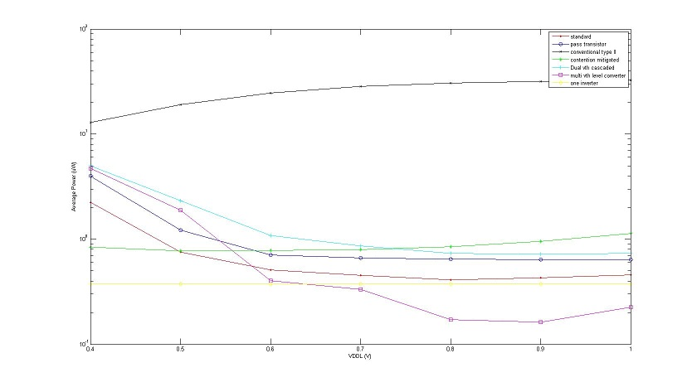
Average Power (µW) V/S VDDL (V)

Slide 21
Delay Values in ps , VDDH = 1.0V
VDDL values ranging from 1.0V – 0.4V
Level Converter | 1.0V | 0.9V | 0.8V | 0.7V | 0.6V | 0.5V | 0.4V
Standard | 17.05 | 19.15 | 24.2 | 34.5 | 55.35 | 126 | 695
Pass Transistor | 12.72 | 13.64 | 13.5 | 19.05 | 22.7 | 27 | 40.05
Conventional Type-II | 6.75 | 9.56 | 15.3 | 20.26 | 27.69 | 37 | 60.285
Contention Mitigated | 11.95 | 11.665 | 15.75 | 19.3 | 25.6 | 39.865 | 113.2
Dual V_{th} cascaded | 6.79 | 10.3 | 22.7 | 26.7 | 31.1 | 42.3 | 61.3
Multi- V_{th} | 6.679 | 6.735 | 7.09 | 13.885 | 14.335 | 17.59 | 22.835

Slide 22
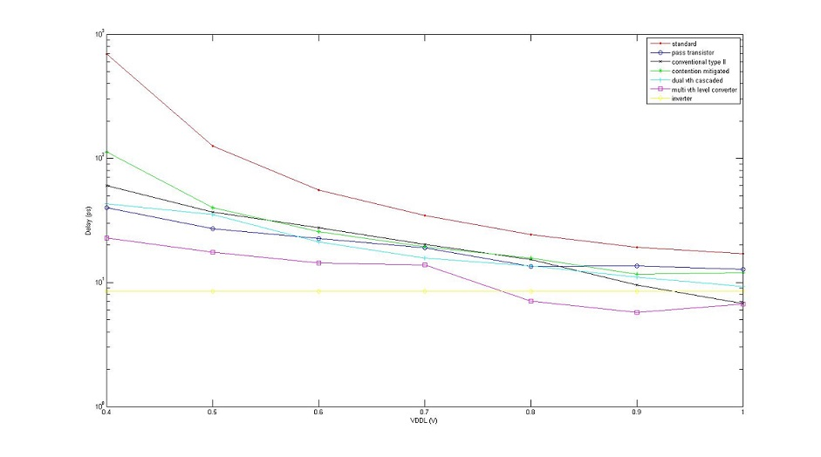
Delay (ps) versus VDDL (V)

Slide 23
Presentation Outline
Problem Statement
Motivation
Introduction and Background
Types of Level Converters
Level Converters
Proposed Level Converter
Design of Level Converter
Experimental Results
Conclusion

Slide 24
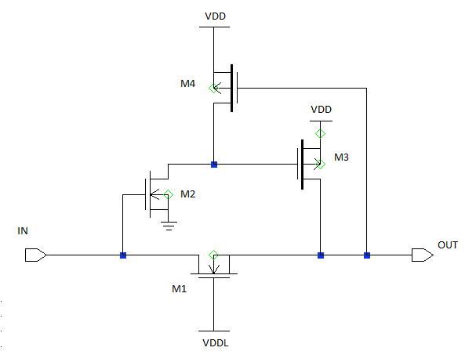
DVF4: A Dual V_{th} Feedback Based 4-Transistor Level Converter

Slide 25
DVF4: A Dual V_{th} Feedback based 4-Transistor Level Converter Continued…
In this work we propose a new level converter based on feedback technique and multi- V_{th} technique. “DVF4: Dual Vth Feedback based 4 Transistor Level Converter”.
DVF4 is composed of four pass transistors. The threshold voltage of M3 and M4 transistors are high to avoid the static DC current.
We have M4 transistor as a feedback circuitry which is needed to pull-down to logic ‘0’ when there is a ‘0’ at the input.

Slide 26
Presentation Outline
Problem Statement
Motivation
Introduction and Background
Types of Level Converters
Level Converters
Proposed Level Converter
Design of Level Converter
Experimental Results
Conclusion

Slide 27
DVF4 Level Converter
Design of Level Converter
The working of the level converter is as follows.
When there is VDDL on the input, M2 is ON forcing the drain of M2 to be `0'. This turns M3 ON, the output node goes to High (Logic `1'). A logic `1' on the output keeps M4 OFF making no change to the gate of M3. we have a stable `1'.
Now, when we have a logic `0' at the input of the Level Converter, the `0' is passed by the M1, since, M1 is always ON. A `0' at the output turns M4 ON, keeping the gate of M3 to be `1', so that M3 is OFF, providing a proper `0' at the input. If M4 is absent, then the gate of M3 will be at a intermediate voltage caused by the previous logic state, so we do not have a proper `0' at the output.

Slide 28
Design of Level Converter
The level converter is optimized using an optimizing program written in PERL for power consumption and delay, by changing the widths of transistors M3 and M4, and threshold voltages of M3 and M4 individually for each VDDL.
After the optimization is done the width of the M4 transistor was found to be approximately constant at 0.110u.
The level converters are simulated using 32nm PTM technology model in HSPICE. 100 vectors with the interval of critical delay is applied at the input
A load of inverter which is four times the standard inverter is connected at the output as simulation setup. The power consumption and the delay values are tabulated.

Slide 29
Power, Delay of DVF4 V/S Input Voltage (VDDL)
Input Voltage VDDL | M3 Width µ | M3 V_{thp} V | Average Power (µW) | Delay (ps) | Power Reduction % | Delay Reduction %
1.0 | 0.120 | -0.715 | 0.170 | 3.305 | 24.3 | 50.51
0.9 | 0.120 | -0.715 | 0.133 | 5.225 | 17.44 | 22.4
0.8 | 0.120 | -0.710 | 0.135 | 6.655 | 20.94 | 21.6
0.7 | 0.106 | -0.715 | 0.187 | 10.75 | 43.52 | 22.57
0.6 | 0.118 | -0.68 | 0.229 | 13.11 | 43.08 | 8.5
0.5 | 0.116 | -0.72 | 0.585 | 16.0 | 53.4 | -9.09
0.4 | 0.120 | -0.69 | 1.80 | 34.75 | 57.66 | -34.28

Slide 30
Presentation Outline
Problem Statement
Motivation
Introduction and Background
Types of Level Converters
Level Converters
Proposed Level Converter
Design of Level Converter
Experimental Results
Conclusion

Slide 31
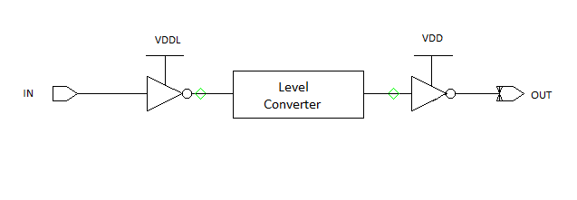
Experimental Results
The DVF4 level converter is compared with the previous best level converter. The simulation setup is depicted below.
The first inverter supplied by VDDL and the second inverter connected after the Level converter is supplied by VDDH.
The driver and load inverters are 4X the size of a minimum size inverter (Wn = 4Wmin and Wp = 10Wmin).
The simulations are done using the 32nm PTM model in HSPICE.

Slide 32
Comparison of DVF4 v/s Multi V_{th} Level Converter
- | DVF4 Level Converter |  | Multi V_{th} Level Converter |  | - | -
Input Voltage VDDL | Power µW | Delay ps | Power µW | Delay ps | Power Savings % | Delay Reduction %
1.0 | 2.90 | 28 | 4.23 | 26 | 31.44 | -7.69
0.9 | 2.20 | 35 | 3.48 | 38 | 36.7 | 8.5
0.8 | 1.71 | 33 | 3.10 | 50.32 | 44.83 | 52.4
0.7 | 1.47 | 48.8 | 2.92 | 62.6 | 49.65 | 28.27
0.6 | 1.435 | 72 | 2.90 | 822 | 50.5 | 14
0.5 | 1.54 | 113 | 3.62 | 104 | 57.4 | -8
0.4 | 2.03 | 252 | 8.66 | 159 | 76.55 | -58.4

Slide 33
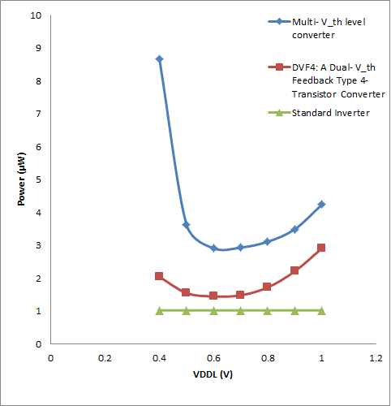
Average power of DVF4 V/S Multi V_{th} Level Converter

Slide 34
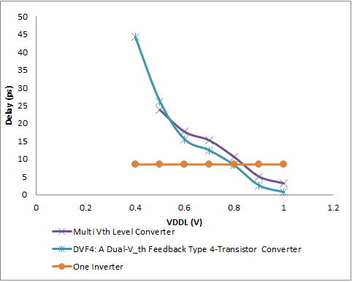
Delay of DVF4 V/S Multi V_{th} Level Converter

Slide 35
Dual Voltage and Level Converter Assignment
In this section we utilize the algorithm 4 for assigning Level Converter and algorithm 2 from Allani to find the optimum voltage (V_{L}) for various benchmark circuits.
We then use the DVF4 level converter for High to Low conversion in the places assigned by algorithm 4.
For simulations for ISCAS’85 Benchmark circuits we use 90nm PTM model in HSPICE. 100 random vectors at a period of the critical path were used for the simulations.
The motivation is to have better savings in energy by allowing level converters than by using only Dual VDD.

Slide 36
Dual Voltage Assignment with Level Converters
Circuit | Algorithm 2 V_{L} V | Total Gates | Algorithm 4 |  | Energy calculated by HSPICE
 |  |  | Gates in low voltage | Number of level shifters | E_{single VDD} fJ | E_{dual} With DVF4 fJ | E_{savg} % | E_{savg} with only Dual VDD %
C432 | 0.80 | 154 | 73 | 44 | 161.3 | 145.4 | 9.85 | 3.66
C499 | 0.91 | 493 | 247 | 101 | 463 | 396.9 | 20.1 | 7.8
C880 | 0.58 | 360 | 203 | 78 | 277.6 | 106.1 | 61.77 | 58.29
C1355 | 0.92 | 469 | 101 | 119 | 455.2 | 421.2 | 7.4 | 4.86
C1908 | 0.77 | 584 | 380 | 138 | 496.5 | 352.1 | 29.08 | 23.81
C3540 | 0.61 | 1270 | 881 | 232 | 1843 | 1437 | 22.02 | 12.23
C6288 | 0.73 | 2407 | 1183 | 98 | 1932 | 1855 | 3.98 | 3.26

Slide 37
Inverter Tree Combination
In order to determine whether the level converter can be used to reduce the power consumption in case of Dual VDD design and still maintain the critical delay of the circuit, we utilize the inverter tree circuit.
We can determine how many gates can be assigned VDDL and find the optimum low voltage (VDDL) at which the critical path delay can be maintained and still save the power consumption.
We then compare DVF4 with Multi V_{th} level converter. In order to determine the critical delay, an inverter tree is first simulated with VDD.

Slide 38
Inverter Tree Combination Setup & Results
The inverter tree is simulated for 100 cycles of toggling inputs with 100 vectors with critical delay as the period for each input vector.
The simulations are done using 32nm predictive technology model.
The power and delay values are calculated using HSPICE. The power savings is 0 in this case if level converters are not allowed .

Slide 39
Inverter Tree Combination Results
When the inverter tree chain is simulated with DVF4 level converter. The simulations are done using the voltage supplies as shown in the Figure. The number of VDDL gates is 6 and number of VDDH gates is 2.
The power values are obtained using HSPICE. The number of VDDL gates is determined by the critical delay found without level converters

Slide 40
Inverter Tree Combination Results
When the inverter tree chain is simulated with previous best Existing level converter. The simulations are done using the voltage supplies as shown in the Figure. The number of VDDL gates is 4 and number of VDDH gates is 4.
The power values are obtained using HSPICE. The number of VDDL gates is determined by the critical delay found without level converters.

Slide 41
Inverter Chain Comparison of DVF4 and Multi V_{th} Level Converter, VDDH =1.0V
Single Voltage VDD =1.0V |  | Dual Voltage, VDDH = 1.0V
 |  | With DVF4 |  |  |  | With Multi V_{th} Level Converter
Power (µW) | Delay (ps) | VDDL VL | Power (µW) | Delay (ps) | % Power Reduction | VDDL VL | Power (uW) | Delay (ps) | % Power Reduction
4.53 | 132.1 | 0.7 | 2.13 | 132.1 | 51.8 | 0.8 | 3.59 | 132.1 | 22.39

Slide 42
Presentation Outline
Problem Statement
Motivation
Introduction and Background
Types of Level Converters
Level Converters
Proposed Level Converter
Design of Level Converter
Experimental Results
Conclusion

Slide 43
Conclusion
The DVF4 level converter was compared to the multi-Vth level converter (best existing level converter) using various simulation setups and the results were obtained for different voltage supplies for multi-V DD systems.
The circuits were optimized and simulated at 32nm CMOS technology, the proposed level converters offer us a significant savings on power consumption of up to 58% and the delay savings up to 77%.
This level converter could be used and can produce lower power consumption in spite of the overhead, based on the data obtained from the simulations as discussed in this work.

Slide 44
References
M. Allani, “Polynomial-Time Algorithms for Designing Dual-Voltage Energy Efficient Circuits,” Master's thesis, Auburn University, Auburn, Alabama, Dec. 2011.
M. Allani and V. D. Agrawal, “Energy-Ecient Dual-Voltage Design Using Topological Constraints,” J. Low Power Electronics, vol. 9, no. 3, pp. 275-287, Oct. 2013.
A. P. Chandrakasan and R. W. Brodersen, Low Power Digital CMOS Design, Springer, 1995.
S. H. Kulkarni and D. Sylvester, “High Performance Level Conversion for Dual VDD Design,” IEEE Trans. VLSI Systems, vol. 12, no. 9, Sept. 2004.
S. H. Kulkarni, A. N. Srivastava, and D. Sylvester, “A New Algorithm for Improved VDD Assignment in Low Power Dual VDD Systems," in Proc. International Symp. Low Power Design, 2004, pp. 200-205.
S. H. Kulkarni and D. Sylvester, “Fast and Energy Efficient Asynchronous Level Converters for Multi-VDD Design [CMOS ICs]," in Proc. IEEE International System on Chip Conf.
M. Kumar, S. K. Arya, and S. Pandey, “Level Shifter Design for Low Power Applications,“ International Journal of Computer Science and Information Technology, vol. 2, no. 5, Oct. 2010.

Slide 45
References
S. Narendra and A. Chandrakasan, Leakage in Nanometer CMOS Technologies, Springer, 2006.
B. C. Paul, A. Agarwal, and K. Roy, “Low-Power Design Techniques for Scaled Technologies,” Integration, the VLSI Journal, vol. 39, no. 2, pp. 64-89, 2006.
M. Pedram and J. M. Rabaey, “Power Aware Design Methodologies”. Springer, 2002.
J. Rabaey, Low Power Design Essentials, Springer, 2009.
J. Rabaey, A. P. Chandrakasan, and B. Nikolic, Digital Integrated Circuit - A Design Perspective, Pearson Education, 2003.
S. A. Tawk and V. Kursun, “Multi-Vth Level Conversion Circuits for Multi-VDD Systems,” in Proc. International Symp. Circuits and Systems, May 2007, pp. 1397-1400.
K. Usami and M. Horowitz, “Clustered Voltage Scaling Technique for Low-Power Design," in Proc. International Symp. Low Power Electronics and Design, 1995, pp. 3-8.
K. Usami, M. Igarashi, F. Minami, T. Ishikawa, M. Kanzawa, M. Ichida, and K. Nogami, “Automated Low-Power Technique Exploiting Multiple Supply Voltages Applied to a Media Processor," IEEE Journal of Solid-State Circuits, vol. 33, no. 3, pp. 463-472, Mar. 1998.

Slide 46
THANK YOU!!!!

