Slide 1

Finding Best Voltage and Frequency to Shorten Power Constrained Test Time
Praveen Venkataramani
Suraj Sindia
Vishwani D. Agrawal

Slide 2
Introduction
ATPG generated scan patterns produce more circuit activity than the functional patterns.
Scan test cause high power dissipation during scan shift and capture.
Power Constrained Test:
  Limit the maximum power dissipation to stay within rated power for the device
    Slow down the clock
    Modify test vectors to reduce activity
  Result: A general increase in test time

Slide 3
Reducing Supply Voltage
Power reduces.
If power constrained, test clock may be speeded up to reduce test time.
Critical path delay increases.
Certain defects are more profound at low voltages.
Changes in critical paths possible.

Slide 4
Definitions
Power constraint
  Maximum power dissipated by test is limited by the maximum allowable power.
  Maximum activity test cycle determines the test clock frequency.
Structure constraint
  Clock frequency is determined by the critical path delay.
  Fastest test/functional clock period cannot be smaller than the critical path delay
  Test at lower voltage tends to become structure constrained.
Slowing the clock to reduce power increases test time.
Speeding up the clock increase power.

Slide 5
Power and Structure Constrained Testing
Structure-constrained
operation
11
Power-constrained
operation
Power-constrained clock
Peak per vector
power of test
Clock frequency
Power
+Δf
P_{MAXfunc}
Structure-constrained clock
Test clock
– ΔV_{DD}
Opt. V_{DD}
Nom. V_{DD}
Voltage, V_{DD}
From an ITC’12 Elevator Talk Reduced Voltage Test Can be Faster! by Vishwani Agrawal

Slide 6
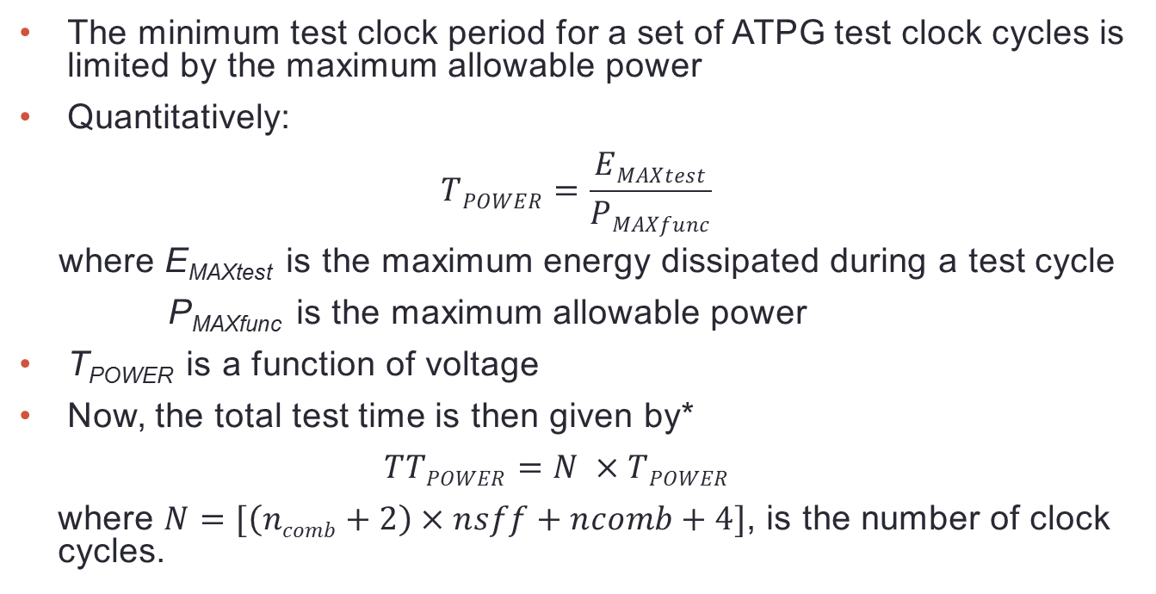
Analysis of Power Constrained Test
The minimum test clock period for a set of ATPG test clock cycles is limited by the maximum allowable power
Quantitatively:
  $$TPOWER=\frac{EMAXtest}{PMAXfunc}$$
  where E_{MAXtest} is the maximum energy dissipated during a test cycle
  P_{MAXfunc} is the maximum allowable power
T_{POWER} is a function of voltage
Now, the total test time is then given by*
  $$TTPOWER=N ×TPOWER$$
  where $N=[\left(ncomb+2\right)×nsff+ncomb+4]$, is the number of clock cycles.
* M. L. Bushnell and V. D. Agrawal, Essentials of Electronic Testing for Digital,
Memory and Mixed-Signal VLSI Circuits, Springer, 2000, Chapter 14.

Slide 7
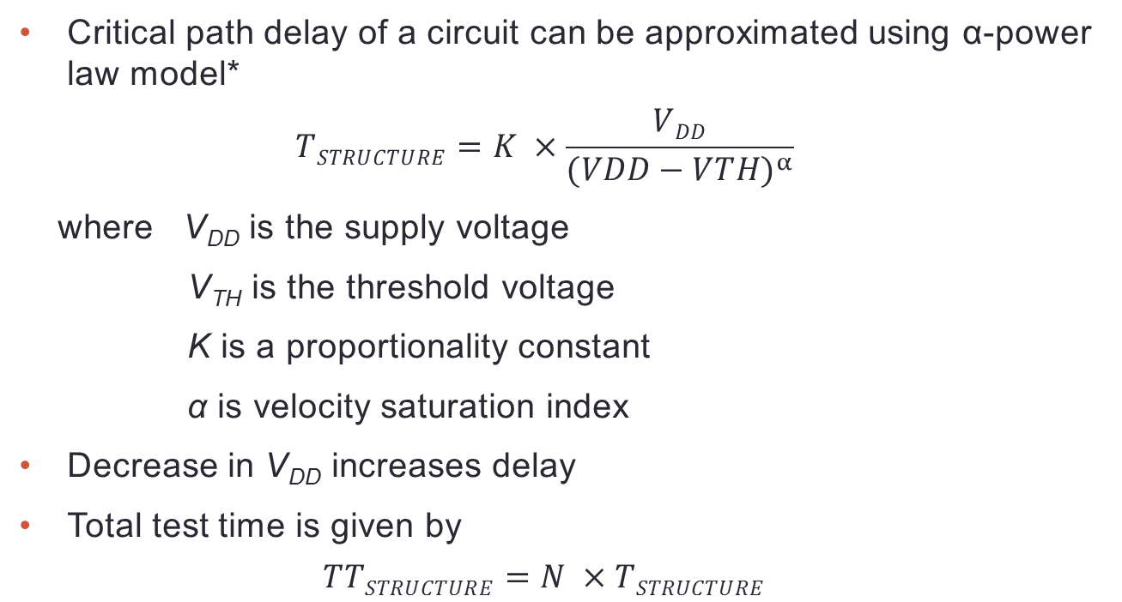
Analysis of Structure Constrained Test
Critical path delay of a circuit can be approximated using α-power law model*
  $$TSTRUCTURE=K ×\frac{VDD}{{(VDD−VTH)}^{α}}$$
  where V_{DD} is the supply voltage
  V_{TH} is the threshold voltage
  K is a proportionality constant
  α is velocity saturation index
Decrease in V_{DD} increases delay
Total test time is given by
  $$TTSTRUCTURE=N ×TSTRUCTURE$$
* T. Sakurai and A. R. Newton, “A Simple MOSFET Model for Circuit Analysis,”
IEEE Journal of Solid-State Circuits, Vol. 26, pp.122–131, Feb. 1991.

Slide 8
Assumptions
Critical path does not change as voltage is reduced; found valid for small voltage changes.
Threshold voltage remains constant.

Slide 9
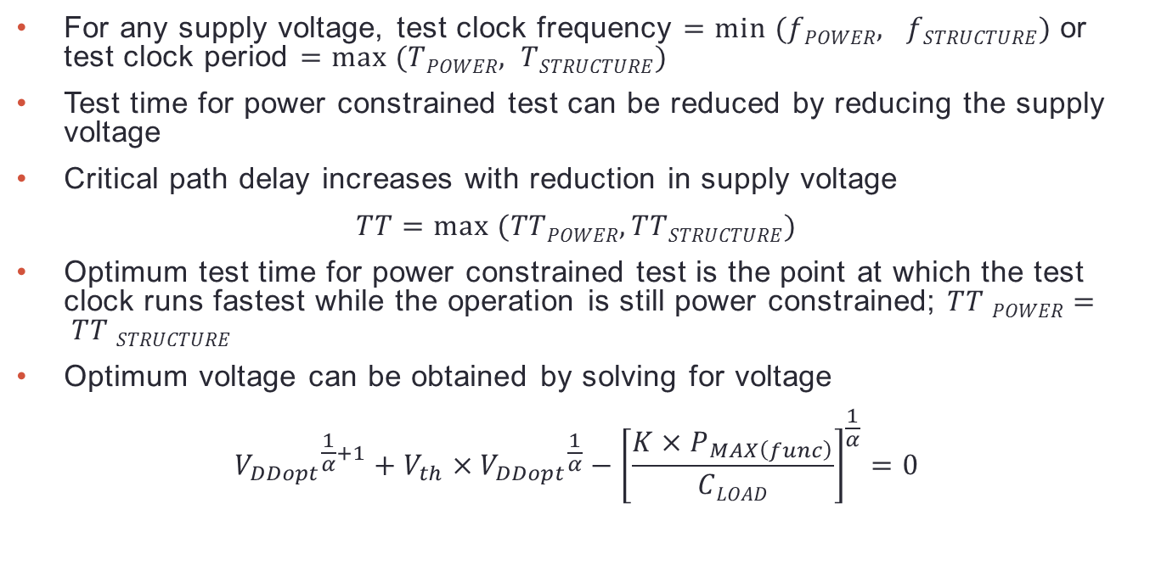
Optimum Test Time
For any supply voltage, test clock frequency $=min (fPOWER, fSTRUCTURE)$ or test clock period $=max (TPOWER, TSTRUCTURE)$
Test time for power constrained test can be reduced by reducing the supply voltage
Critical path delay increases with reduction in supply voltage
$$TT=max (TTPOWER, TTSTRUCTURE)$$
Optimum test time for power constrained test is the point at which the test clock runs fastest while the operation is still power constrained; $TT POWER= TT STRUCTURE$
Optimum voltage can be obtained by solving for voltage
$${V_{DDopt}}^{\frac{1}{α}+1}+V_{th}×{V_{DDopt}}^{\frac{1}{α}}−{\left[\frac{K×P_{MAX\left(func\right)}}{CLOAD}\right]}^{\frac{1}{α}}=0$$

Slide 10
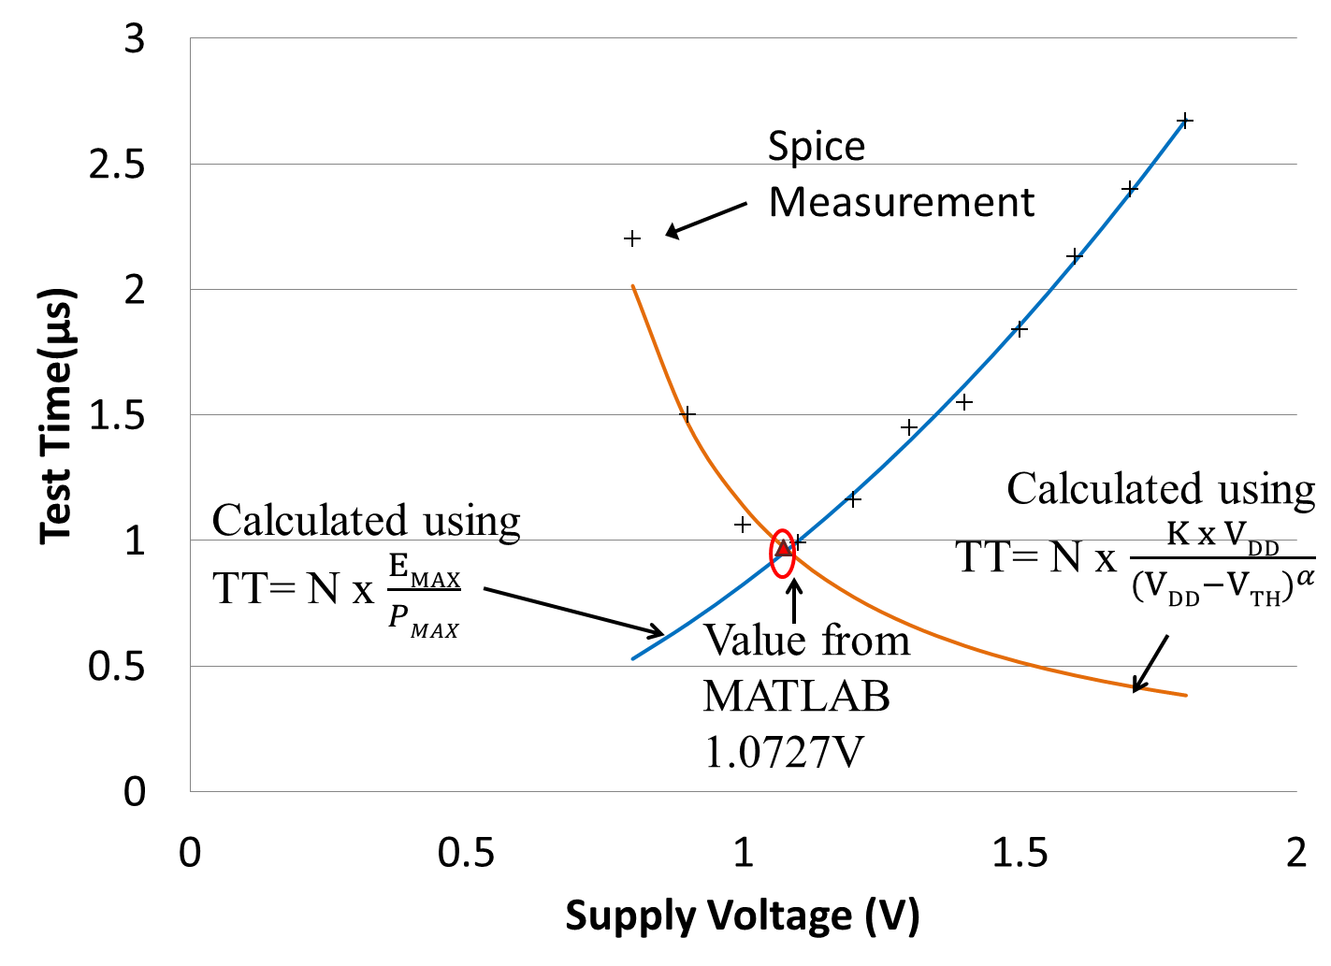
Example - s298

Slide 11
Optimum Test Time Results
Circuit 180nm CMOS | P_{MAXfunc} per cycle (mW) | Test frequency @ 1.8V (MHz) | Gate level simulation |  | Analytical method |  | Test time reduction (%)
 |  |  | Opt. test voltage (volts) | Test freq. (MHz) | Opt. test voltage (volts) | Test freq. (MHz)
s298 | 1.2 | 187 | 1.08 | 500 | 1.07 | 500 | 63
s382 | 2.9 | 300 | 1.35 | 521 | 1.34 | 532 | 44
s713 | 2.7 | 136 | 1.45 | 227 | 1.41 | 223 | 38
s1423 | 4.5 | 141 | 1.70 | 158 | 1.72 | 155 | 12
s13207 | 21.3 | 110 | 1.45 | 165 | 1.44 | 170 | 36
s15850 | 178.1 | 151 | 1.65 | 170 | 1.70 | 172 | 12
s38417 | 73.7 | 122 | 1.50 | 175 | 1.52 | 169 | 26
s38584 | 110.6 | 129 | 1.50 | 187 | 1.50 | 186 | 30

Slide 12
Conclusion
What we have achieved
  Optimum test time for power constrained test
  Optimum voltage and frequency for power constrained tests
Future explorations
  Consideration of separate critical paths for scan and functional logic
  Delay testing at reduced voltage
  Adaptive dynamic power supply
  Dynamic test frequency

