Slide 1
Reducing Test Time of Power Constrained Test by Optimal Selection of Supply Voltage
Praveen Venkataramani
pzv0006@auburn.edu
Vishwani D. AgrawaL
vagrawal@eng.auburn.edu
Auburn University, Dept. of ECE
Auburn, AL 36849, USA
26th International Conference on VLSI Design Pune, India, January 7, 2013

Slide 2
Outline
Introduction
Problem statement
Effects of reducing power supply
Power and structure constrained tests
Analyzing power constrained test
Analyzing structure constrained test
Finding an optimum test voltage
Results
Conclusion

Slide 3
Introduction
Signal transitions of scan ATPG patterns are higher than those of functional patterns
  Cause high power dissipation during scan shift and capture
    Peak power dissipation - IR drop failures
    Average power dissipation – Excessive heating
Power Constraint Test
  Limit the maximum scan test cycle power to the allowable peak power
    Slow down clock
    Generate or modify vector and scan structure to reduce activity
  Increased test time

Slide 4
Problem Statement
Limit maximum test power to the allowable peak power
Reduce scan test time
Proposed methodology
  Reduce supply voltage to reduce power dissipation during test
  Increase test clock frequency such that power dissipation meets the specification
  Find the optimum voltage that allows the maximum power-constrained clock frequency for test

Slide 5
Reducing Supply Voltage
Advantages
  Reduced test time
  Certain defects are more profound at lower voltages
    Resistive bridge fault
  Power supply noise reduces
Concerns to be investigated in the future
  Increased the critical path delay
  Possible changes in critical paths

Slide 6
Power and Structure Constrained Tests
Power Constraint
  Scan based test power dissipation can be more than functional power dissipation
  The maximum power dissipated by the test is limited by the maximum allowable power for the test.
  Maximum activity test cycle determines the test clock frequency
Structure Constraint
  Clock frequency is determined by the critical path delay
  Fastest test/functional clock period cannot be smaller than the critical path delay to avoid timing violation
  Test at lower voltages tends to become structure constrained
Trade Off
  Slower clock ⇒ Less power ⇒ Longer test time
  Faster clock ⇒ Higher power ⇒ Shorter test time

Slide 7
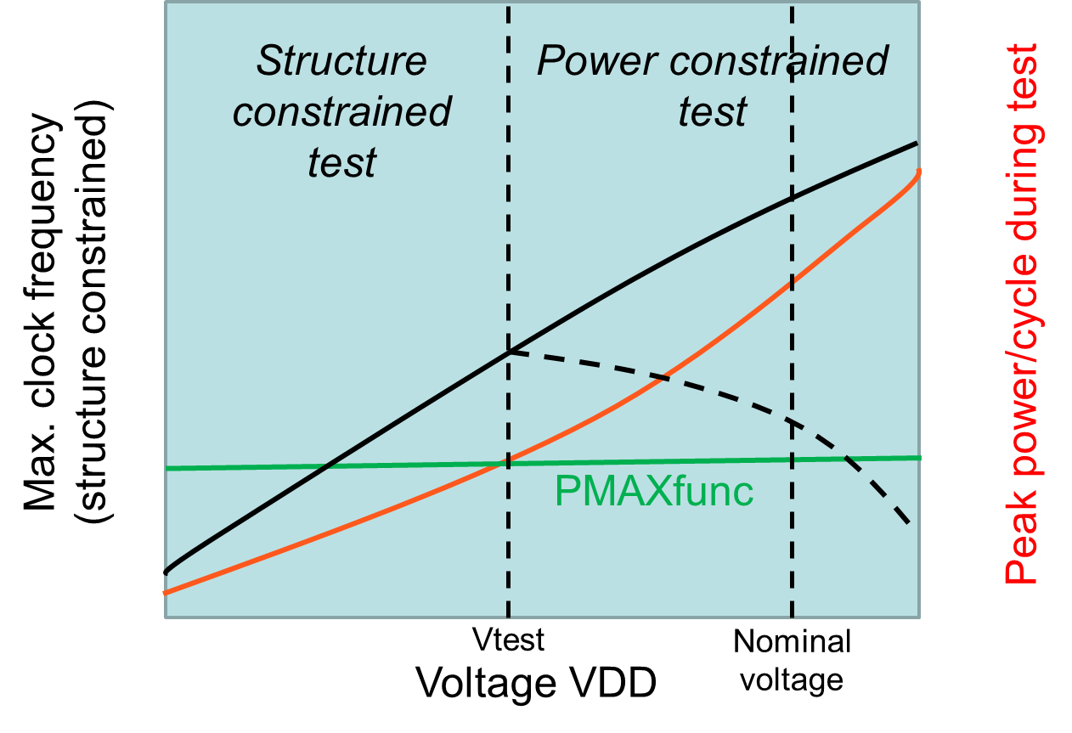
Power and Structure Constrained Tests
Courtesy: ITC Elevator Talk Reduced Voltage Test Can be Faster! by Vishwani Agrawal

Slide 8
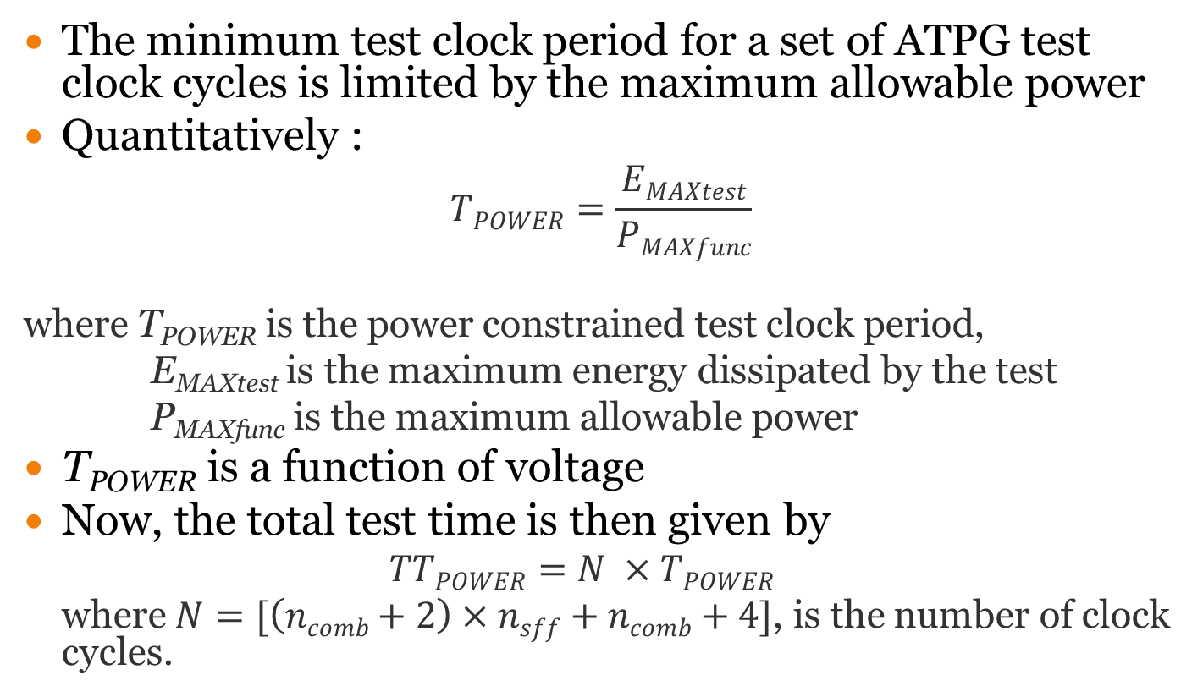
Analysis of Power constrained test
The minimum test clock period for a set of ATPG test clock cycles is limited by the maximum allowable power
Quantitatively :
  $$TPOWER=\frac{EMAXtest}{PMAXfunc}$$
  where T_{POWER} is the power constrained test clock period,
  E_{MAXtest} is the maximum energy dissipated by the test
  P_{MAXfunc} is the maximum allowable power
T_{POWER} is a function of voltage
Now, the total test time is then given by
  $$TTPOWER=N ×TPOWER$$
  where $N=[\left(ncomb+2\right)×nsff+ncomb+4]$, is the number of clock cycles.

Slide 9
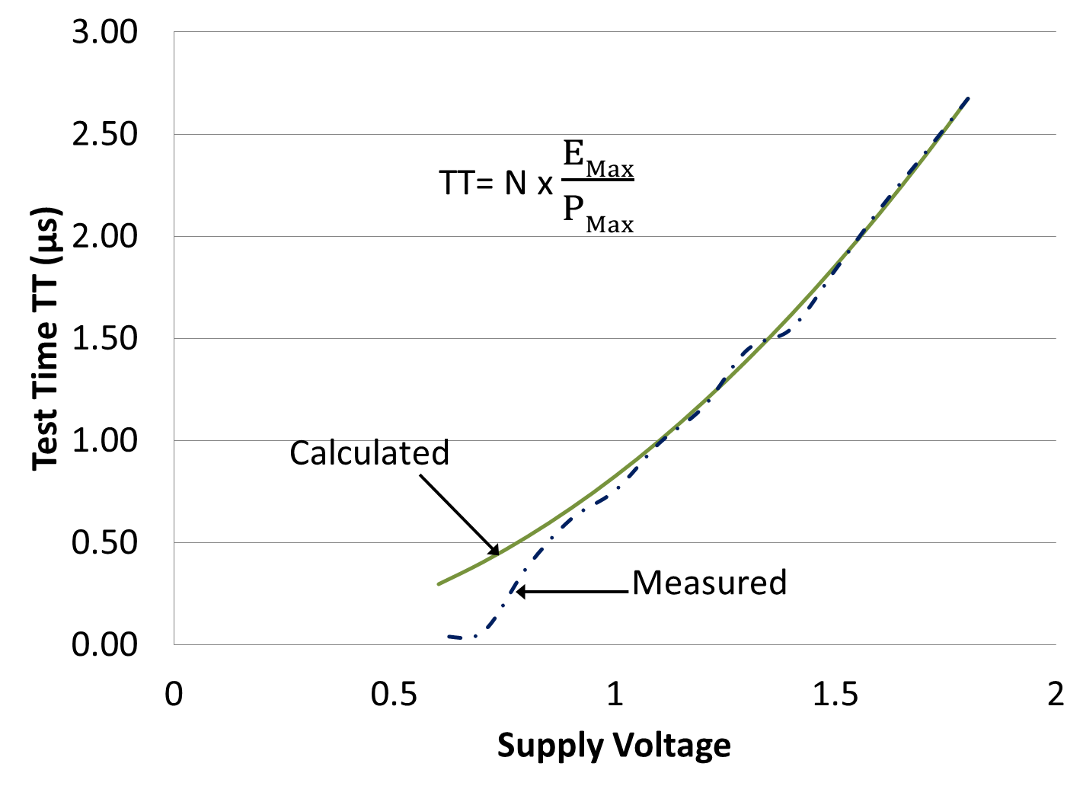
Analysis of Power constrained test

Slide 10
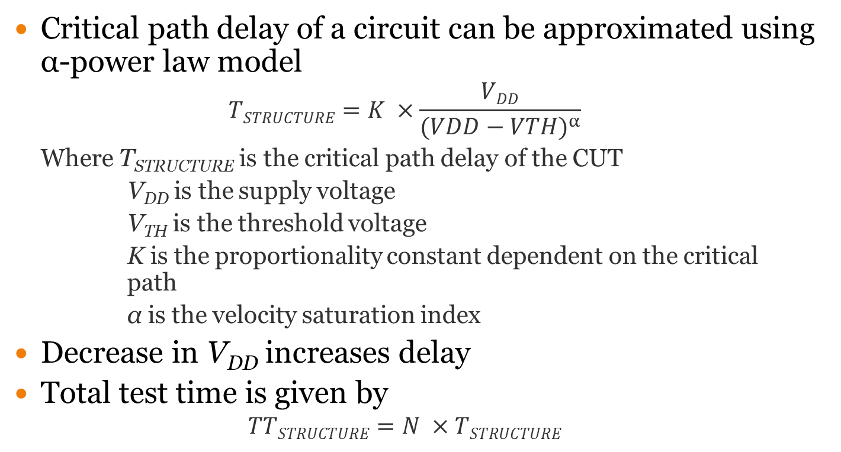
Analysis of Structure Constrained Test
Critical path delay of a circuit can be approximated using α-power law model
  $$TSTRUCTURE=K ×\frac{VDD}{{(VDD−VTH)}^{α}}$$
  Where T_{STRUCTURE} is the critical path delay of the CUT
  V_{DD} is the supply voltage
  V_{TH} is the threshold voltage
  K is the proportionality constant dependent on the critical path
  α is the velocity saturation index
Decrease in V_{DD} increases delay
Total test time is given by
  $$TTSTRUCTURE=N ×TSTRUCTURE$$

Slide 11
Analysis of Structure Constrained Test
Assumptions:
  Critical path does not change as voltage is reduced; found valid for small voltage changes
  Threshold voltage remains constant

Slide 12
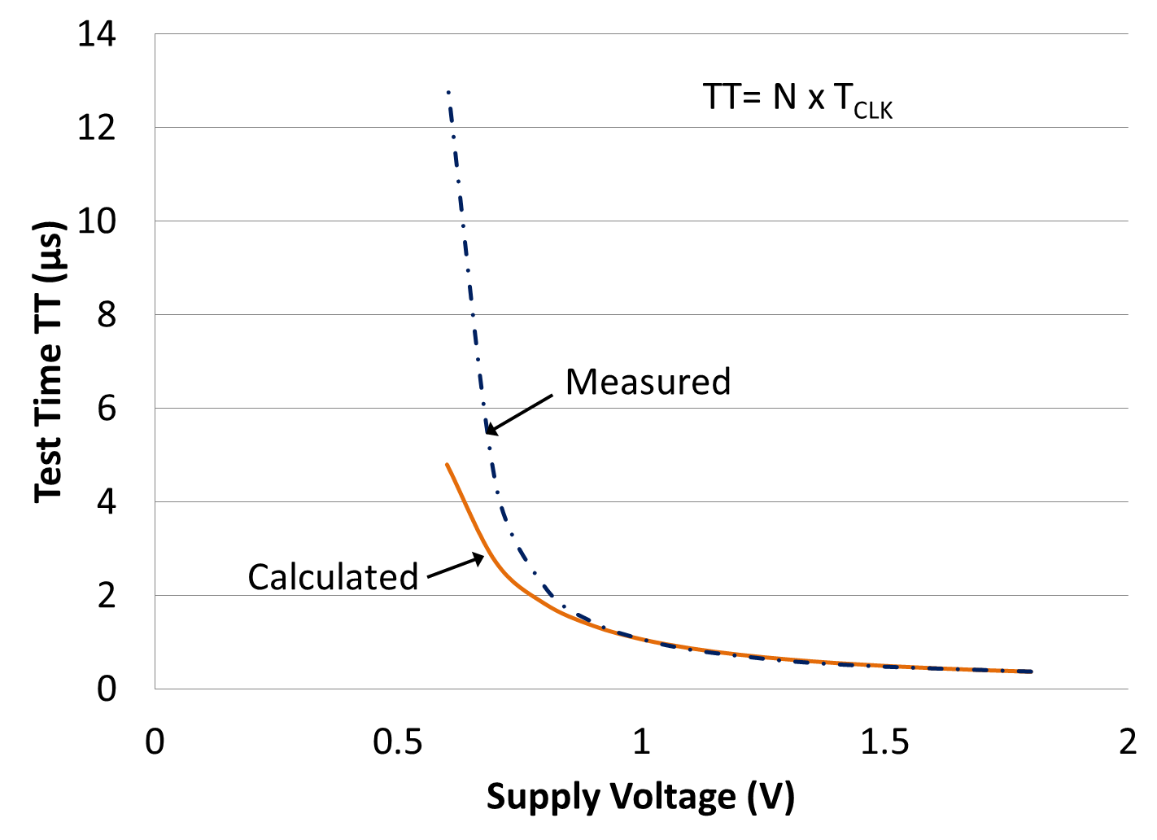
Analysis of Structure Constrained Test

Slide 13
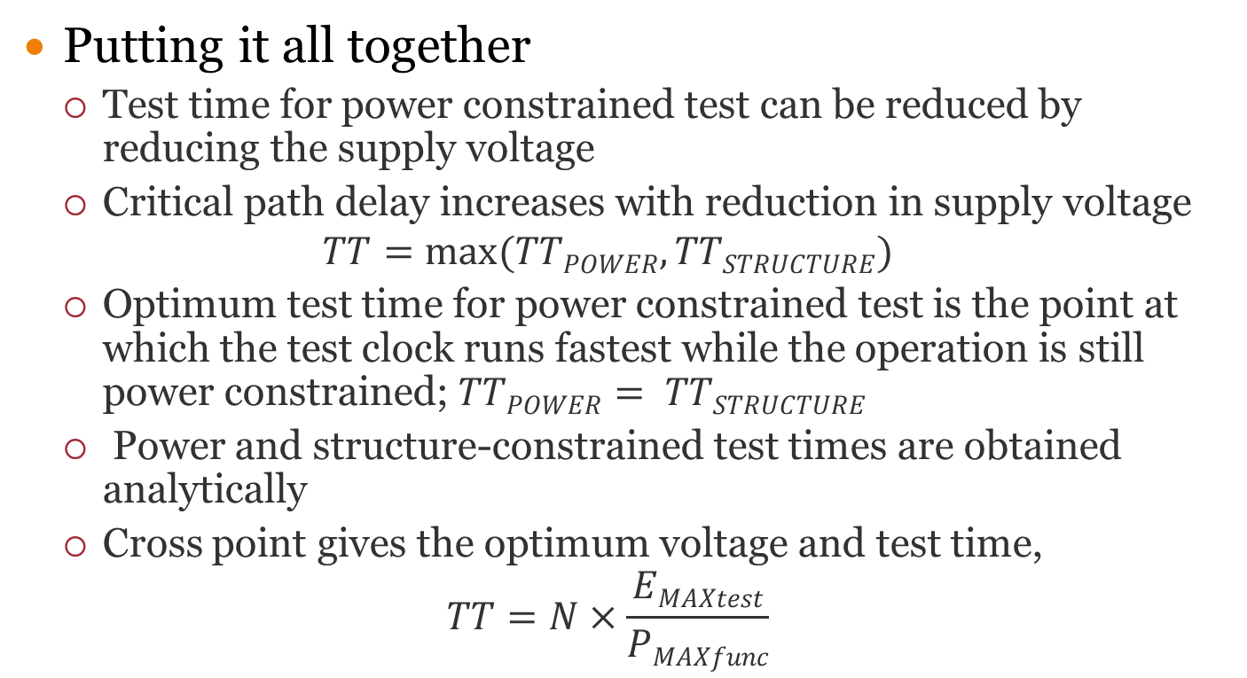
Optimum Test Time
Putting it all together
  Test time for power constrained test can be reduced by reducing the supply voltage
  Critical path delay increases with reduction in supply voltage
  $$TT=max⁡(TTPOWER, TTSTRUCTURE)$$
  Optimum test time for power constrained test is the point at which the test clock runs fastest while the operation is still power constrained; $TTPOWER= TTSTRUCTURE$
  Power and structure-constrained test times are obtained analytically
  Cross point gives the optimum voltage and test time,
  $$TT=N×\frac{EMAXtest}{PMAXfunc}$$

Slide 14
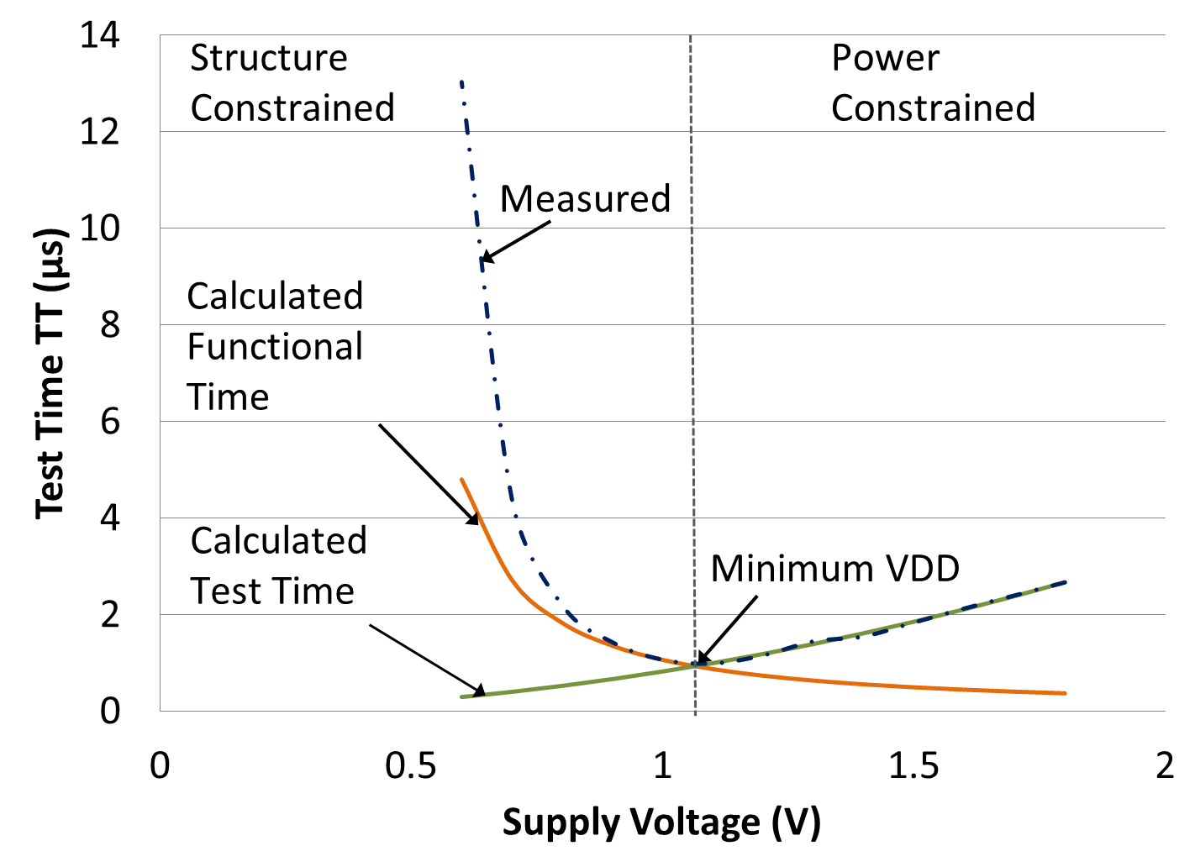
Optimum Test Time

Slide 15
Results: Test Time Optimization
CUT | No. of Vectors | Scan cycles | Peak power (µW) | Nominal Voltage, 1.8V |  | Optimum Voltage |  |  | Test Time Reduction (%)
 |  |  |  | Test freq. MHz | Test Time (µs) | Supply Voltage (volts) | Test Freq. (MHz) | Test Time (µs)
s298 | 33 | 498 | 0.0012 | 187 | 2.7 | 1.04 | 500 | 0.996 | 62.5
s382 | 31 | 704 | 0.0029 | 300 | 2.3 | 1.35 | 563 | 1.25 | 46.5
s713 | 44 | 809 | 0.0027 | 136 | 5.9 | 1.45 | 263 | 3.07 | 48.0
s1423 | 62 | 4649 | 0.0045 | 141 | 33.0 | 1.70 | 158 | 29.42 | 11.0
s13207 | 121 | 41266 | 0.0213 | 110 | 375.0 | 1.45 | 165 | 250.0 | 40.3
s15850 | 125 | 67624 | 0.1781 | 182 | 371.6 | 1.65 | 222 | 304.6 | 18.0
s38417 | 123 | 181536 | 0.0737 | 122 | 1491.9 | 1.50 | 175 | 1036.1 | 30.5
s38584 | 144 | 186159 | 0.1106 | 129 | 1443.1 | 1.30 | 187 | 995.5 | 31.0

Slide 16
Conclusion
What we have achieved
  Optimum test time for power constrained test
  Optimum voltage and frequency for power constrained tests
Future explorations
  Consideration of separate critical paths for scan and functional logic
  Delay testing at reduced voltage
  Adaptive dynamic power supply
  Dynamic test frequency (asynchronous testing)

