Slide 1
An Algorithm for Diagnostic Fault Simulation
Yu Zhang
Vishwani D. Agrawal
Auburn University, Auburn, Alabama 36849 USA

Slide 2
Introduction
Need for diagnosis:
Debugging over large chip area
Complex manufacturing process
Step 1: narrow down fault candidates for given fault model.
Step 2: guided probing, e-beam testing, etc.; here we only deal with step 1.

Slide 3
Diagnostic Fault Simulation
Given
a set of test vectors
A fault model (e.g., stuck-at faults)
Determine
Diagnostic fault coverage (DC)
Faults that need additional tests for diagnosis
Build upon existing ATPG and fault simulation tools.

Slide 4
Diagnostic Fault Simulation
Illustration: ISCAS85 benchmark circuit c17
1
10
3
22
20
2
16
14
11
6
21
23
15
19
7

Slide 5
Diagnostic Fault Simulation
22 collapsed fault in c17 (f1~f22):
f1: 22 sa1
f2: 10 sa1
f3: 22 sa0
f4: 16->22 sa1
f5: 3->10 sa1
f6: 1 sa1
f7: 3 sa0
f8: 3 sa1
f9: 16 sa1
f10: 16 sa0
f11: 11->16 sa1
f12: 2 sa1
f13: 11 sa0
f14: 3->11 sa1
f15: 11 sa1
f16: 6 sa1
f17: 23 sa1
f18: 19 sa1
f19: 23 sa0
f20: 16->23 sa1
f21: 11->19 sa1
f22: 7 sa1

Slide 6
Given Test Vectors
Test vector set for c17 generated by a diagnostic ATPG system (ETS’10)
vector 1: 00000 00
vector 2: 10110 10
vector 3: 11101 11
vector 4: 01110 00
vector 5: 10011 01
vector 6: 00111 00
vector 7: 11000 11
vector 8: 01010 11
Notes:
no need to deal with large number of fault pairs.
fault dropping is possible

Slide 7
Diagnostic Fault Simulation
Fault simulation of vector 1:
vector 1: 00000 00
f1: 10*
f2: 00
f3: 00
f4: 00
f5: 00
f6: 00
f7: 00
f8: 00
f9: 00
f10: 11*
f11: 00
f12: 11*
f13: 00
f14: 00
f15: 00
f16: 00
f17: 01*
f18: 00
f19: 00
f20: 00
f21: 00
f22: 01*
Fault free response
for vector 1
* indicates detected faults
Notes:
“*” indicates the detection of a fault
We can group faults according to their output responses.

Slide 8
Diagnostic Fault Simulation
Faults are grouped according to test output. Grouping for vector 1:
Groups | Faults | Syndrome t1
G1 | f1 | 10
G2 | f10, f12 | 11
G3 | f17, f22 | 01
G0 | All other faults | 00
Output ‘10’ represents a mismatch with fault free response ‘00’.
f1 is dropped from further simulation.
Notes:
in fault simulation a fault is dropped when it is detected.
f1 is dropped because it is fully distinguished from all other faults.
i.e. no other fault has same syndrome as f1.

Slide 9
Diagnostic Fault Coverage
Groups | Faults | Syndrome t1
G1 (dropped) | f1 | 10
G2 | f10, f12 | 11
G3 | f17, f22 | 01
G0 | All other faults | 00

Slide 10
Continuing Diagnostic Simulation
Fault simulation of vector 2:
G0: f2: 00*
f3: 00*
f4: 10
f5: 10
f6: 10
f7: 00*
f8: 10
f9: 10
f11: 10
f13: 10
f14: 10
f15: 10
f16: 10
f18: 10
f19: 10
f20: 10
f21: 10
vector 2: 10110 10
G2: f10: 11*
New G4: f12: 10
G3: f17: 11*
New G5: f22: 10
Fault free response
G0 contains undetected faults.
After vector 2, f2, f3, and f7 will leave G0 to form group G6

Slide 11
Continuing Fault Simulation
After applying vector 2:
Groups | Faults | Syndrome t2
G2 | f10 | 01
G4 | f12 | 00
G3 | f17 | 01
G5 | f22 | 00
G6 | f2, f3, f7 | 10
G0 | All other faults | 00
f10, f12, f17, f22 are dropped from further simulation
Notes:
t1 distinguishes f10 and f12 from all other faults.
t2 distinguishes f10 from f12, thus right now f10 can be distinguished all other faults, same with f12.
In diagnosis, when a sequence of syndrome: 11, 01 is observed, (assuming only single stuck at faults) the fault causing the failure must be f10.

Slide 12
Diagnostic Fault Simulation

Slide 13
Fault Dictionary for Two Vectors
Faults | Test syndrome
 | t1 | t2
f1 | 10 | X
f10 | 11 | 01
f12 | 11 | 00
f17 | 01 | 01
f22 | 01 | 00
f2, f3, f7 | 00 | 10
All other faults | 00 | 00
Notes:
if the first output response observed during testing is ’10’, then f1 is the most likely candidate causing failure.
‘X’ will not influence the diagnosability.

Slide 14
Diagnostic Fault Simulation
Continue to simulate vectors and divide faults into new groups.
G0:
f1, f2, f3,…f22
(no test applied)
G1:
f1 (10)
G2:
f10, f12 (11)
f1 is dropped
After vector 1:
G3:
f17, f22 (01)
G0:
All other faults (00)

Slide 15
Diagnostic Fault Simulation
G2:
f10, f12
After vector 2:
G2:
f10 (01)
G5:
f12 (00)
Single fault groups are dropped.

Slide 16
Diagnostic Fault Simulation
G3:
f17, f22
Also, group G3:
G3:
f17 (01)
G6:
f22 (00)
Single fault groups are dropped.

Slide 17
Diagnostic Fault Simulation
G0:
f2~f9, f11, f13~f16, f18~f21
For G0:
No faults are dropped here
G7:
f2, f3, f7 (10)
G0:
all other undetected faults (00)

Slide 18
Diagnostic Fault Simulation
original fault set
vector1:
fa
Vector 2:
fb
Vector 3:
Vector n:
fc
fd
fe
ff

Slide 19
Diagnostic Fault Simulation
For c17 after applying all 8 test vectors, we get 22 fault groups with only one fault in each group.

Slide 20
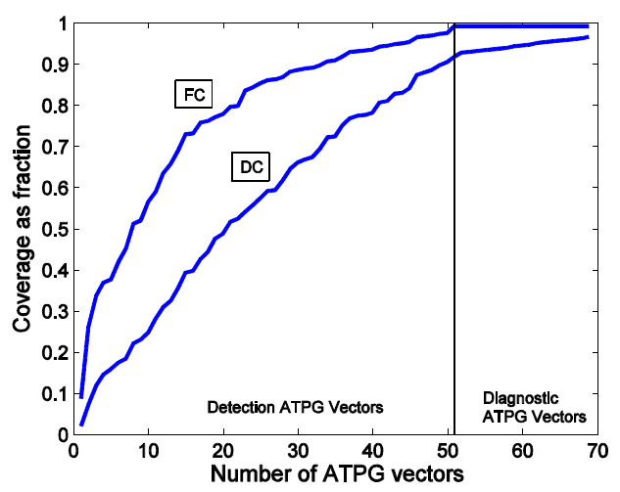
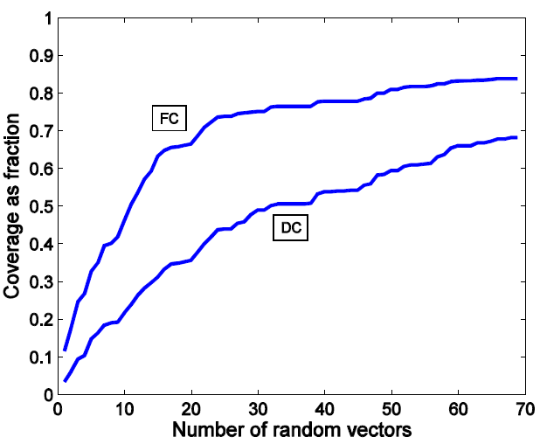
Diagnostic Fault Simulation
Simulation results for c432:

Slide 21
Experiment results
Circuit | Number of faults | Number of vectors | Fault coverage FC (%) | Largest undiagnosed group size | Diagnostic coverage DC (%) | CPU S* | CPU s* (no fault dropping)
c17 | 22 | 8 | 100.0 | 1 | 100.0 | 0.00 | 0.00
c432 | 524 | 69 | 99.24 | 2 | 97.51 | 0.14 | 0.30
c499 | 758 | 53 | 100.0 | 2 | 98.40 | 0.13 | 0.31
c880 | 942 | 60 | 100.0 | 2 | 94.16 | 0.19 | 0.45
c1355 | 1574 | 87 | 100.0 | 3 | 59.38 | 0.70 | 1.63
c1908 | 1879 | 134 | 99.89 | 8 | 86.46 | 1.28 | 2.89
c2670 | 2747 | 150 | 98.84 | 11 | 86.42 | 2.80 | 6.07
c3540 | 3428 | 174 | 100.0 | 8 | 89.69 | 2.00 | 5.74
c6288 | 7744 | 137 | 99.56 | 3 | 86.87 | 4.12 | 10.23
c7552 | 7550 | 296 | 98.25 | 7 | 86.85 | 5.34 | 14.67
*Intel Core 2 Duo 2.66GHz, 3GB RAM.

Slide 22
Conclusion
Diagnostic coverage metric defined.
Diagnostic fault simulation has similar complexity as conventional simulation with fault dropping. Explore dictionaries with X’s.
Diagnostic test generation is no more
complex than ATPG for single fault.
Need efficient fault equivalence checks.
Explore other fault models.

Slide 23
Thank you
Questions?

