Slide 1
ELEC 5200/6200 Computer Architecture and Design
Class Project, Spring 2012
Processor Design and Implementation
Director: Dr. Vishwani D. Agrawal
GTA: Jia Yao (jzy0001@auburn.edu)

Slide 2
Outline
The Goal
– What are you going to design?
The Software
The Hardware
Evaluation of your project
Demo

Slide 3
The Goal – What are you going to design?
Design a CPU
basic arithmetic operations: add (+), subtract (-)
basic logical operations: AND, OR, NOT
control flow structures: “if-else” structures, “while” loops and “for” loops
  relational operators: ==, !=, >, ≥,<, ≤
Functions: call and return
Halt
Input
Control
Datapath
Memory
Central Processing
Unit (CPU)
or “processor”
Output

Slide 4
Jump
Shift
left 2
0 mux 1
4
Add
1 mux 0
ALU
opcode
Branch
CONTROL
MemtoReg
RegDst
ALU
zero
MemWrite
MemRead
Instr.
mem.
PC
Reg. File
1 mux 0
Data
mem.
1 mux 0
0 mux 1
Datapath Example
ALU
Cont.
Sign
ext.
Shift
left 2

Slide 5

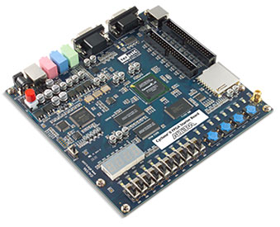
PC
Altera DE2 Board
Download your design and test program
What to do on PC:
Design your VHDL model for CPU
Simulate your model in Modelsim
(3) Synthesize and download your design into Altera Board by Quartus II
What to do on Altera Board:
(4) Test and debug the downloaded design
(5) Run test programs on a properly working CPU

Slide 6
CPU design project consists of five parts
Part1 – design an instruction set architecture (ISA):
define registers, instruction set
Part2 – design datapath that realizes your ISA: make a
choice from single-cycle, multi-cycle or pipeline ?
Part3 – datapath verification:
programming and simulation
Part4 – design control unit:
based on your choice of datapath
Part5 – hardware implementation and final demo:
Altera FPGA board

Slide 7
The Software
Programming: VHDL/Verilog
each component in the datapath is programmed in VHDL/Verilog.
Simulation: Modelsim 6.6b*
verification of logic functions.
Hardware implementation: Altera Quartus II 10.0 *
synthesis, timing analysis, design optimization and configuration of Altera FPGA board.
* Modelsim and Quartus II are available in Broun 320 Lab

Slide 8
The Hardware
Altera Development and Education Board (DE2) *
Control and Datapath: Altera Cyclone II FPGA
Clock: 27 MHz and 50MHz oscillators
Input: Pushbutton switches and toggle switches
Output: LEDs and 7-Segment Displays
Memory: 512 Kbyte SRAM, 8 Mbyte SDRAM, 4 Mbyte Flash Memory; Mega-function Plug-in
Configuring the board in JTAG mode or Active Serial mode
* Altera DE2 boards are available in Broun 320 Lab

Slide 9
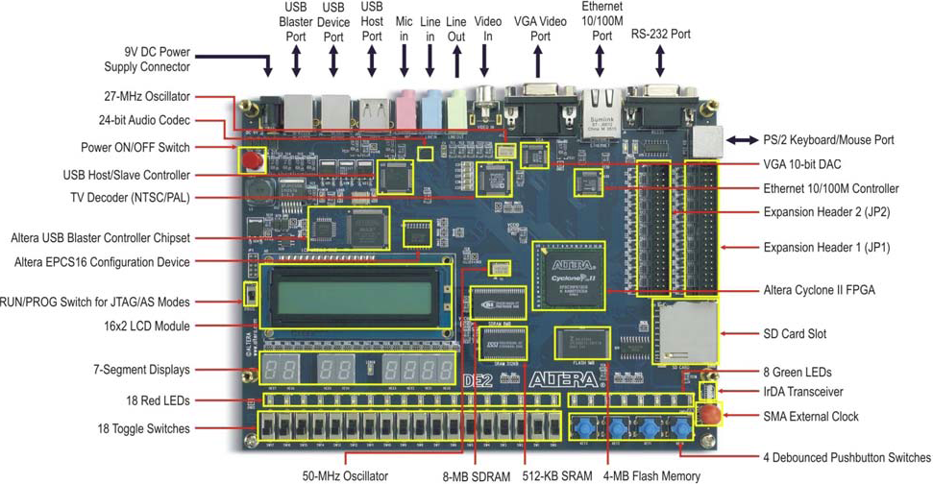
Altera DE2 Board

Slide 10
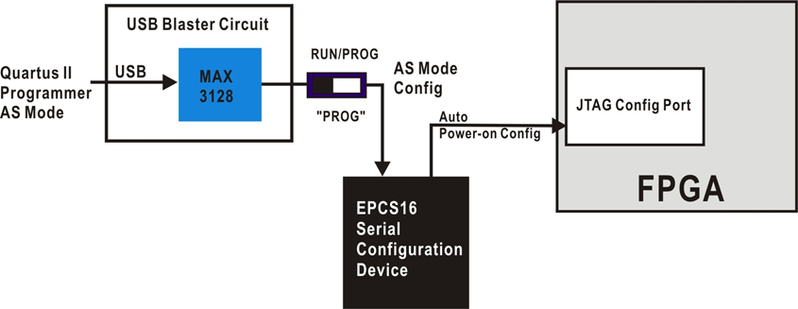
Active Serial Configuration Scheme
“PROG” ON – Configure EPCS16 device by selecting configuration bit stream file (.pof file) in Quartus II Programmer tool.
“RUN” ON – Reset the board; this action cause configuration data in EPCS16 device to be loaded onto the FPGA.
Data is retained in EPCS16 device even when power is turned off; when power is turned back on, data is automatically loaded onto the FPGA.

Slide 11
The Evaluation
A simple test program will be given to you in part 5, and you are encouraged to write your own test program.
Conduct a five-minute demo of the implemented design on your DE2 Board as follows:
Briefly describe the program you will run and the expected results.
Run the program with proper explanation of the buttons you press and results

Slide 12
Demo
Addi $s1, $s1, 2 % $s1=2, $s1 * $s2 = 2 * 4
Addi $s2, $s2, 3 %$s2=4
Addi $s6, $s6 7 % $s6=7
L1: Add $s5, $s5, $s1 %$s5= result of loop of addition
Addi $s2, $s2, -1 % $s2=$s2-1
Beq $s2, $zero, Exit % if $s2=0, end of loop
Jump L1 % continue loop
Exit: sw $s5, 7($s6) % Memory($s6+7) = $s5
Halt % program stops
Registers | Initial Value | Expected Value
s1 | 0 | 2
s2 | 1 | 0
s5 | 0 | 8
s6 | 0 | 7

Slide 13
Questions?

Slide 14
References
Altera Corporation, “Altera DE2 User Manual”, http://www.altera.com/education/univ/materials/boards/de2/unv-de2-board.html
Altera Corporation, “Intruduction to MegaWizard Plug-In”, http://www.altera.com/products/ip/altera/megawizd.html
Auburn University ELEC5200 class website, “Altera Quartus II and DE2 Manual”, http://www.eng.auburn.edu/~vagrawal/COURSE/E6200_Fall10/HW/HW3/Altera%20Quartus%20II%20and%20DE2%20manual.pdf
Auburn University ELEC5200 class website, “Altera Megawizard Plug-In Manager Manual ”
Auburn University ELEC5200 class website, “Run time content editable memory tutorial”, http://www.eng.auburn.edu/~vagrawal/COURSE/E6200_Fall10/HW/HW3/Run_time_content_editable_memory_tutorial.pdf

