Slide 1
Architectures for Extreme-Scale Computing
By: Aaron Biddings
Date: April 2, 2010

Slide 2
Overview
Peta-op perfomance
10^15 operations per second
Examples
Roadrunner
IBM’s Blue Gene/P
Blue Waters

Slide 3
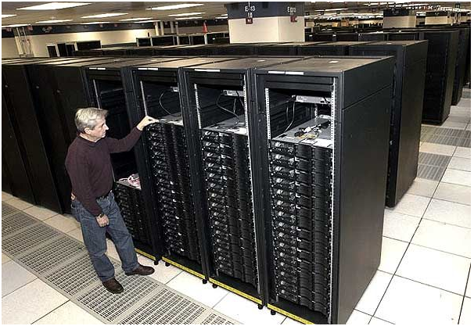
Roadrunner

Slide 4
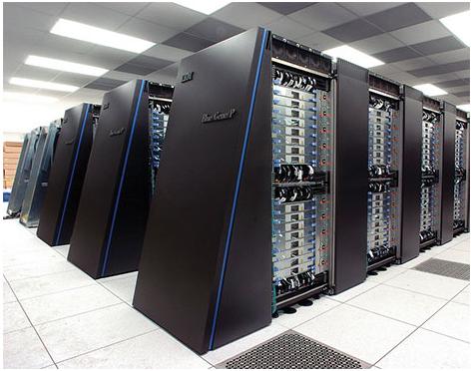
Blue Gene/P

Slide 5
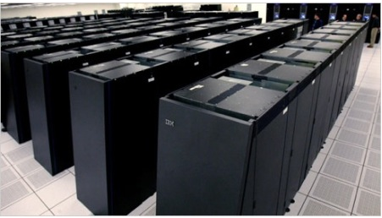
Blue Waters

Slide 6
Should Expect:
Exa-op performance
10^18 operations per second
Peta-op performance
10^15 operations per second
Tera-op performance
10^12 operations per second

Slide 7
Architectural Challenges
Incresing energy and power efficiency

Slide 8
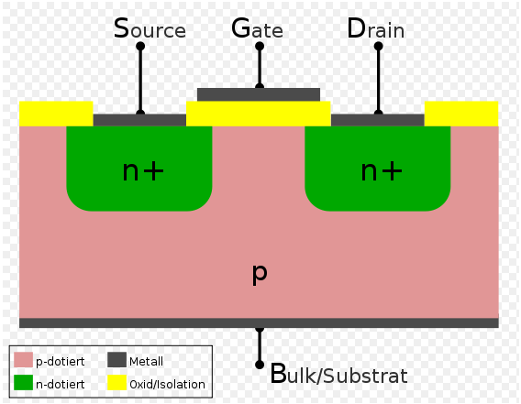
npn Transistor

Slide 9
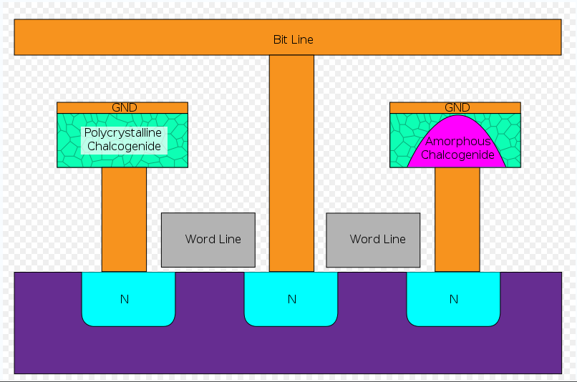
Phase Change Memory

Slide 10
Architectural Challenges
Enabling concurrency and locality

Slide 11
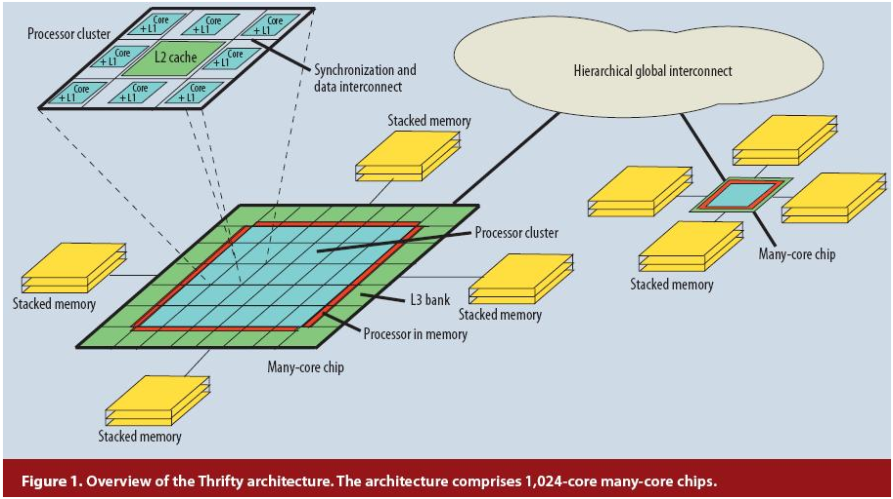
Many-Core Chip

Slide 12
Architectural Challenges
Bolstering resiliency

Slide 13
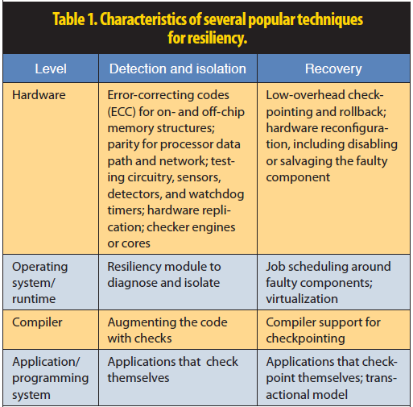
Techniques for Resiliency

Slide 14
Architectural Challenges
Designing for programmability

Slide 15
Additional Information
Reference:
Josep Torrellas, "Architectures for Extreme-Scale Computing," Computer, vol. 42, no. 11, pp. 28-35, Nov. 2009

