Slide 1
How to do research?
Xiao Qin
Department of Computer Science and Software Engineering
Auburn University
http://www.eng.auburn.edu/~xqin
xqin@auburn.edu
Some slides are adapted from notes by Dr. Matthew Turk
Notes:
How to be a successful research assistant?
References:
1. How to Succeed in Graduate School?
2. How to be a good graduate student1? I:\Papers\Talks\How to Do Computer Systems Research\References
Dr. Turk @ University of California, Santa Barbara

Slide 2
My Story of Doing Research
Undergraduate Student at Huazhong University of Science and Technology, (1996)
  Real-Time Disk Scheduling in Unix
M.S. Student at Huazhong University of Science and Technology, (1996-1999)
  Real-Time and Fault-Tolerant Scheduling
A doctoral student at the University of Nebraska-Lincoln (2001-2004)
  I/O-Aware Load Balancing
Assistant Professor at New Mexico Tech (2004-2007)
  Security-Aware Scheduling
Assistant Professor at Auburn University (2007-2010)
  Energy-Efficient Storage Systems
Associate Professor at Auburn University (2010-now)
  Active Storage Systems

Slide 3
Caveat emptor
These are my opinions, not departmental policies
Talk to others to get their views
These comments are intended for those who want to do research
  All undergraduate students, MS students, and PhD students doing theses and projects

Slide 4
Why are you here?
Possible Reasons
No Research Topic
What to do?
I couldn’t find a research topic
  I don’t know what I want to do as a graduate student
Make Money
Find Jobs
  I want to make money.
  I want to secure a good job.
Notes:
Minsky story – “If you’re here in order to get a job, then you shouldn’t be here.”
My story: going to graduate school.

Slide 5
Why I hope you’re here
Better Reasons
Passion
Exploring
I am passionate about research, about engineering and their applications.
  I want to explore new intellectual territory and push the frontiers of technology
Changing
Expert
  I want to change the world.
  I want to become a world expert in XYZ.
Notes:
And graduate schools, publications, fame, fortune, and more…

Slide 6
Your Future Career
Careers: Comp. Sci & Eng., Electrical Eng.
Phone and On-site Interviews
Programming skills
Problem solving skills
Personality
Quickly learn a new programming language
Programming experience

Slide 7
What Is A Typical Career Path?
College
Industry
An executive
such as CIO
A manager for large
projects
A system architect
on increasingly large
projects
Advance to analyst
designer
Earn college degree
in CSSE
Working for a company
writing code
Start your own
company
Principles
7
Practice
Management

Slide 8
Motivation and Experience
3
Lead
2
Management
4
Dedicate
1
Micro Management
Motivation: 0, 1, 2
Experience: 0, 1, 2

Slide 9
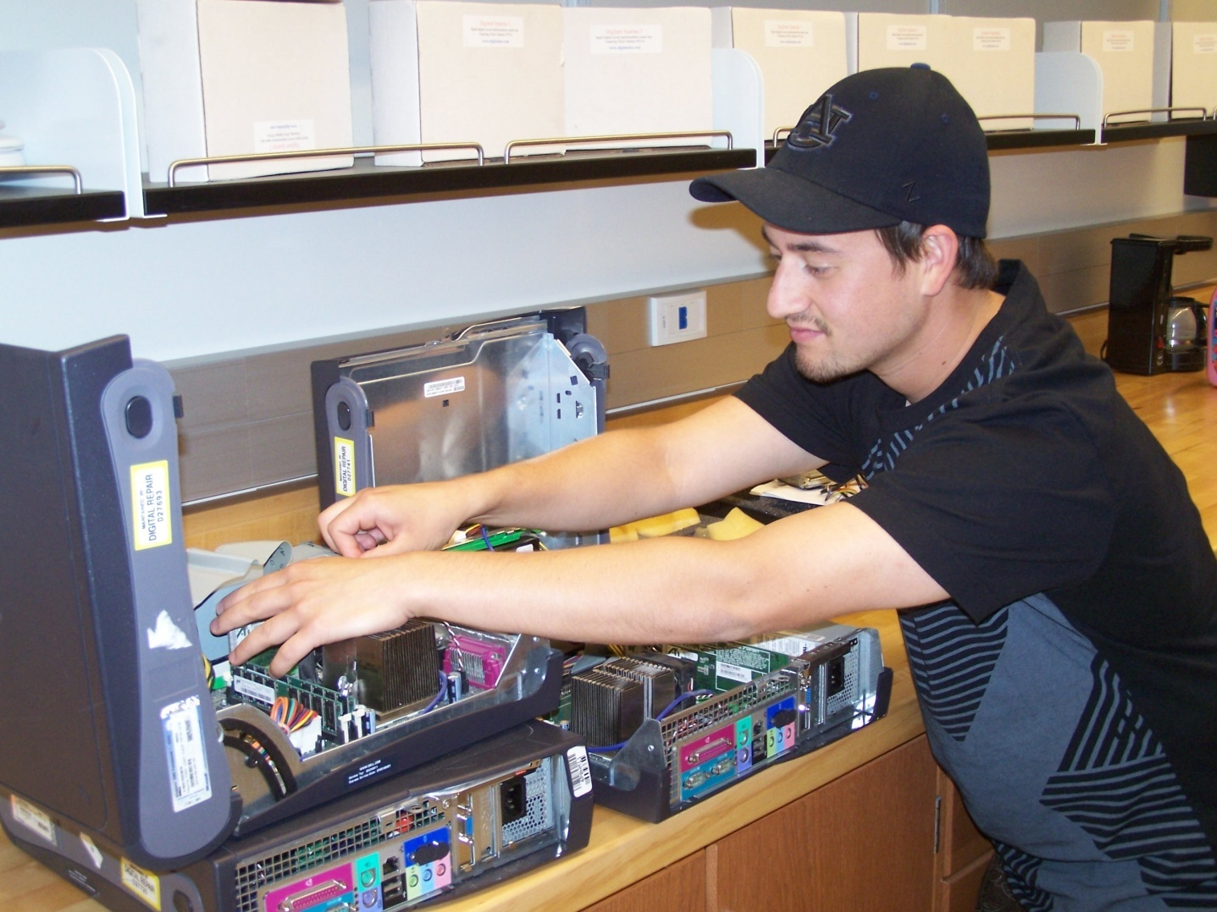
A Success Story
Undergraduate Research Assistant, 2005
Adam Manzanares, Ph.D. May 2010

Slide 10
How to be a successful
research assistant?
10 pieces of advice guaranteed to make you a successful research assistant.

Slide 11
1. Manage Yourself
Goals, priorities, and planning
  Set goals, and keep them updated
  Make a plan for each day, week, month, quarter
    “Failing to plan means planning to fail”
  Prioritize – do important things first
  Don’t waste time – kill your TV, xBox
    Keep track of how you spend your time
    Computer Science ≠ Web Browsing Engineering
    “Is this activity helping me to achieve my REU goal?”
  Keep a notebook, write these things down
Notes:
Be organized and systematic about setting and achieving goals.

Slide 12

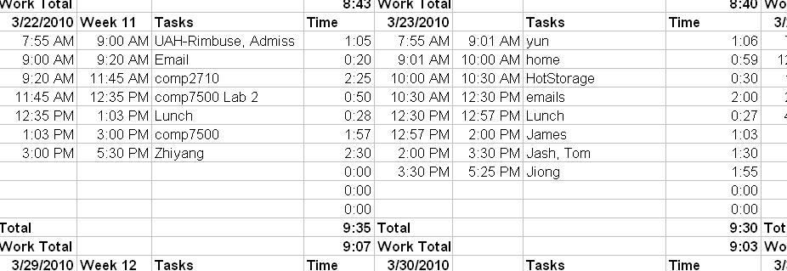
Example 1 –
Keep Track of Your Time
Notes:
Be organized and systematic about setting and achieving goals.

Slide 13
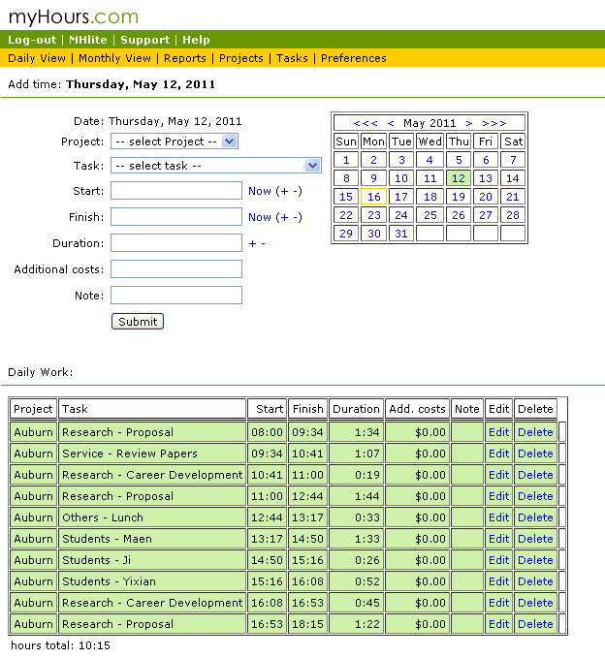
Example 2 –
Keep Track of Your Time: a better approach
Notes:
Be organized and systematic about setting and achieving goals.

Slide 14
Example 3: How to reply emails?
Google: “How to Read 100 Emails, Fast”
Check email once a day
Group emails
Reply to all the short emails - first with "yes" or "no" as an answer
Write brief emails
Long emails -> tasks -> must be prioritized

Slide 15
2. Develop Intellectual Discipline
Think!
  Set aside time for thinking. Really.
Read! (To be covered in another training session)
  Get to know the literature in your area intimately (not superficially)
Act!
  Don’t feel like you have to know everything first
  Don’t worry about being wrong
Evaluate!
  Solicit feedback – most ideas aren’t so good…
Notes:
Research is basically idea generation (plus lots of sweat and tears)

Slide 16

Example 4 –
Keep a notebook
Notes:
Be organized and systematic about setting and achieving goals.

Slide 17
3. Be proactive
Don’t wait to be told what to do
  Don’t be passive; in fact, be aggressive!
  Make things happen
You will not be spoon-fed
  What you get out of the research program is a non-linear function of what effort you put into it.
Research activities can be very unstructured
  Unlike undergraduate studies
  So it’s up to you (not your advisor)
Notes:
REU->graduate school
YOU are in charge of your graduate education. It is primarily up to YOU to make it a great experience.
Develop a “Can Do” attitude
Rose @ Eday

Slide 18
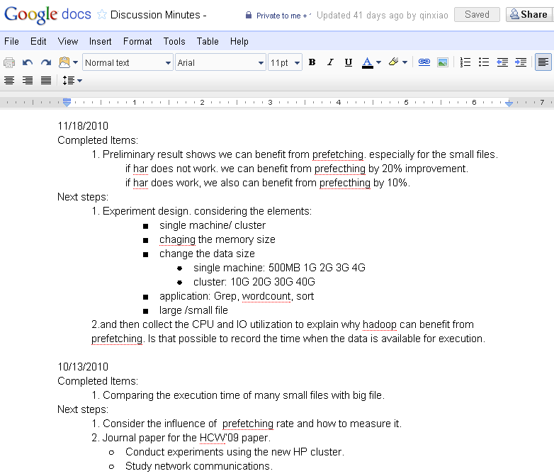
Example 5 –
Discussion Minutes
Notes:
Google doc for discussion minutes

Slide 19
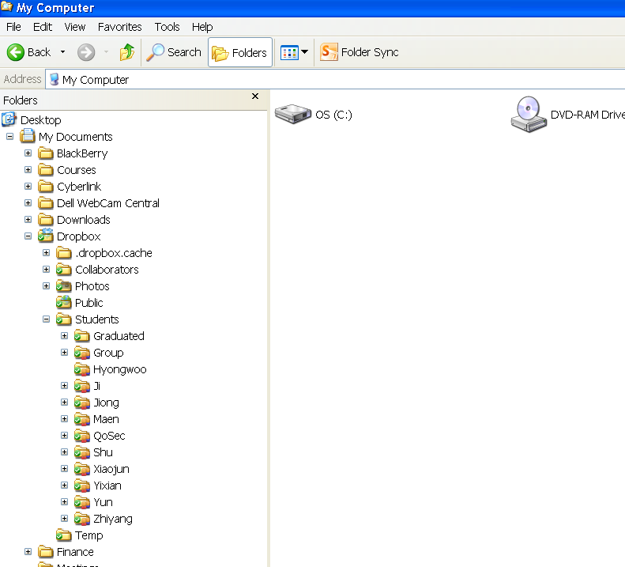
Example 6 –
Dropbox to share document
Notes:
Google doc for discussion minutes

Slide 20
4. Learn to communicate well
Your intelligence and ideas will be judged by your ability to communicate in English
Speaking
  Communicate clearly
Writing
  Organization and clarity
Presenting
  Not just “talking,” but communicating
  Even a lecture is a two-way interaction
These are skills that can be learned!
  Practice talks (videotaped), write short papers, ask friends and colleagues to help you, …
Notes:
Especially for non-native English speakers, but also for everyone
If you live and socialize with people who speak your (non-English) language, you will be at a disadvantage.
Force yourself.

Slide 21
5. Develop an intellectual community
Among your peers at Auburn, create something different and special
  Ask questions
  Discuss ideas
  Brainstorm
  Argue, challenge
  Collaborate
Notes:
Okay, be polite and appropriate, but don’t hesitate to ask questions, challenge a speaker, request clarification, etc. (Be nice but firm.)
MIT and CMU cultures – confrontational, not polite (but let’s be constructive and purposeful about it)
Again, it is up to YOU do make this happen.

Slide 22
6. Networking
Get to know the people in the department (faculty and grad students), and other people in your field
  Don’t wait – introduce yourself!
Go to conferences and meet other REU students and “famous” researchers
  Be aggressive!
Talk with visitors: “pick their pockets”
  You never know who will someday offer you a job, write a reference letter, review your paper, give you invaluable feedback or insight….

Slide 23
7. Choose a good research problem
This is the hardest, and most important, part of research!
The Goldilocks problem:
  Not too hard, not too soft, not too hot, not too cold, not too big, not too small
Think, read, act, evaluate
  And talk to everyone – not only your advisor
Passion or duty?
Notes:
You’ll be working on this for a long time, and it will be difficult at times. You’d better like it, and truly be interested in it, passionate about it.

Slide 24
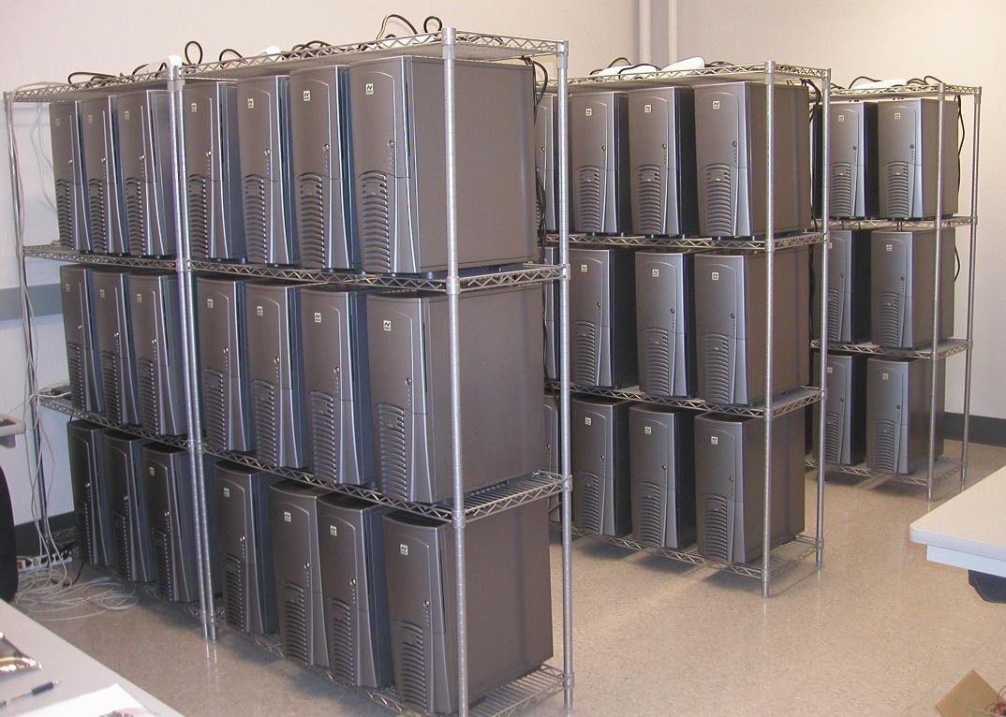
An Example
Data Placement in Hadoop Clusters
Notes:
Research is basically idea generation (plus lots of sweat and tears)

Slide 25
An Example
Data Placement in Hadoop Clusters (cont.)
The MapReduce programming model is growing in popularity
Hadoop is used by Yahoo, Facebook, Amazon.
Notes:
Research is basically idea generation (plus lots of sweat and tears)

Slide 26
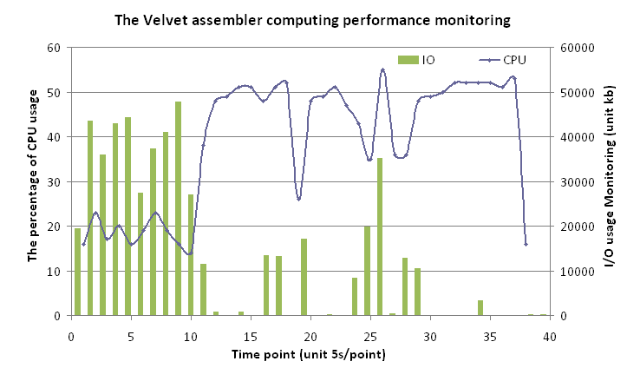
Another Example – How to think
I/O Performance Bottleneck Problems in Bioinformatics Applications
Notes:
Research is basically idea generation (plus lots of sweat and tears)

Slide 27
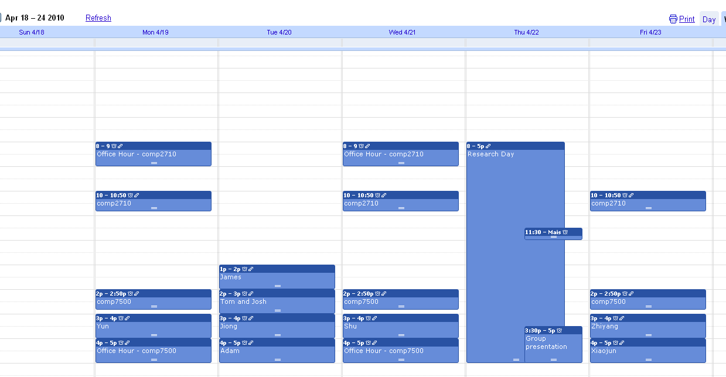
8. Understand the faculty
We are very busy.
  That’s no excuse. We do have time for you.
We know more than you do.
  At least for a little while.
  But not as much more as you might think.
We are not superior beings.
  Most of us have first names.
  Give us feedback too!
We are part mentor, part colleague, part human.
Notes:
In particular, your advisor

Slide 28
9. Study successful people
Senior grad students, faculty, pioneers, leaders in your field, …
  Read biographies
  Who are your heroes, mentors?
Seek advice
  But modify it to your particular situation

Slide 29
10. Have a Life
Work hard, networking, think, read, program, experiment, build, study, practice, ….
  So little time and so much to do!!
Still, amidst the chaos of the REU program, it is very important that you do not lose sight of who you are and what makes you tick.
  Have a social life
  Don’t neglect your family and friends, your health, your sanity
  Do make time for things that are important and meaningful to you
Notes:
This may seem to contradict everything else I’ve said, but….
This is not your whole life.
Keep grad school in perspective: Passion and drive, but not obsession
Remind yourself from time to time why you’re doing this. Also remind yourself from time to time what in life is important to you.

Slide 30
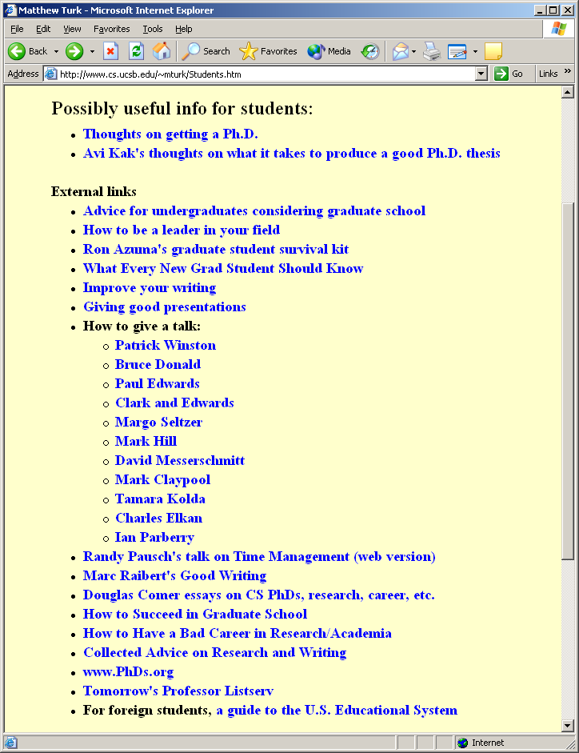
Further Research
Lots of links to good advice for graduate students:
  http://www.cs.ucsb.edu/~mturk
  Click on “Info for Students”

Slide 31

Further Research
http://www.eng.auburn.edu/~xqin

Slide 32
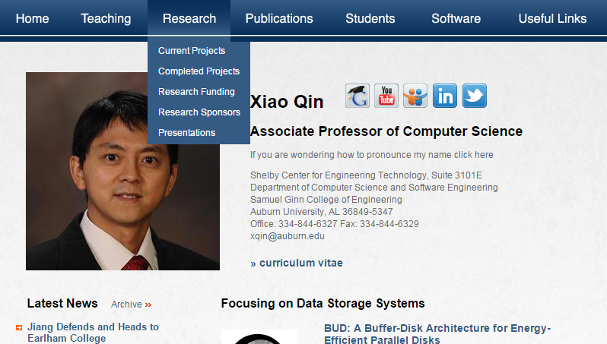
My webpage
http://www.eng.auburn.edu/~xqin

Slide 33
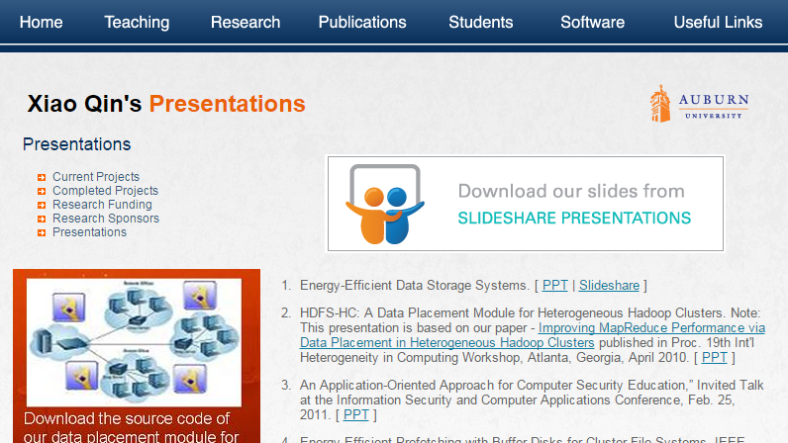
Download Slides at slideshare
http://www.slideshare.net/xqin74

Slide 34
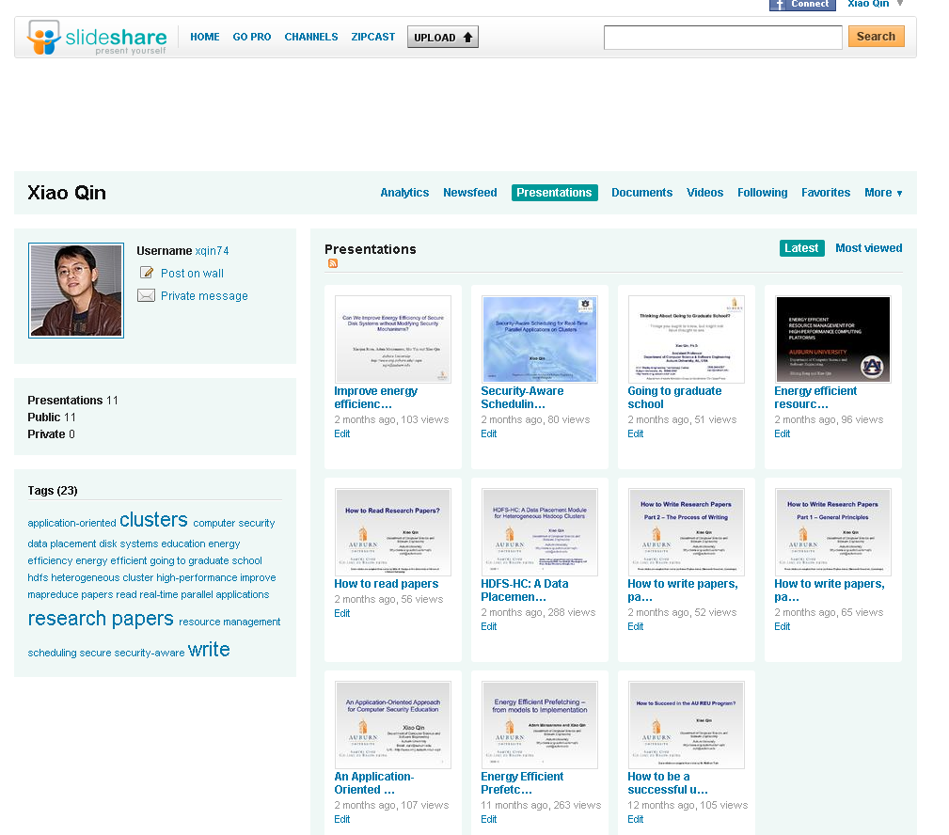

Slide 35
Summary
How to do research?
10 pieces of advice
Choose a good research problem
Download the slides at
http://www.slideshare.net/xqin74

Slide 36

Questions

